Slide 1
Counseling, Alcohol and Other Drug Assistance Program & Psychiatric Services (CAPS) and Community Based Counseling Services

Slide 2
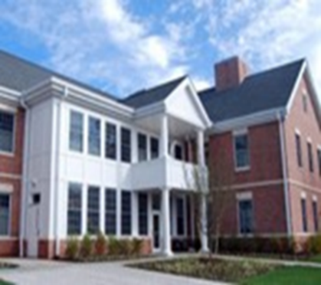
Rutgers Counseling, Alcohol and Other Drug Assistance Program & Psychiatric Services (CAPS) How to Get Connected to CAPS
Call CAPS at 848-932-7884
To initiate services, set up an assessment, schedule Let’s Talk or to schedule or reschedule an appointment, to access the CAPS daytime on call counselor (8:30 am - 4:30 pm) or after-hours service.
http://health.rutgers.edu/medical-counseling-services/counseling/
Visit 17 Senior Street
College Avenue Campus
New Brunswick, NJ

Slide 3
Clinical Services at Rutgers CAPS
Psychiatrists
Psychiatry
Clinical Social Workers, Counselors, AOD Counselors
Clinical Social Workers
Next Step
Alcohol and Other Drug Program
Recovery House
Director of CAPS
Clinical Social Work Team
Clinical Training
Clinical Social Workers
Doctoral Interns, Practicum Students
Psychologists and Associate or Assistant Directors
Community Based Counseling
Group Program
Clinical Social Workers and Counselors

Slide 4
Rutgers CAPS and Student Health Services
Counseling services for students are offered through Counseling, Alcohol and Other Drug Assistance Program & Psychiatric Services (CAPS), our University mental health support service.
The staff includes psychiatrists, psychologists, clinical social workers, and substance abuse counselors, all with expertise in both general mental health concerns and issues unique to a college environment.
Services include individual and group counseling, psychiatric and psychological services, crisis intervention, community-based counseling services, consultations with concerned staff or faculty, assessments of a University community’s needs, guidance and assistance with departmental guidelines and efforts focused on wellness
A CAPS on-call counselor is available for crisis intervention/emergencies every day during regular business hours (Monday – Friday, 8:30am–4:30pm, except University holidays). Students can access the on-call counselor by visiting 17 Senior Street on the College Ave Campus or calling 848-932-7884. The phone is answered by a service off hours that can provide students with immediate assistance in a crisis.
Website: http://health.rutgers.edu/medical-counseling-services/counseling/

Slide 5
What do Community Based Counselors (CBC) do at CAPS?
Community Based Counselors are clinically trained social workers, licensed counselors and psychologists who provide a variety of services in embedded locations throughout the Rutgers campus.
CBCs develop relationships with Deans, faculty, staff and student leaders in assigned departments, programs or cultural centers, where they provide consultation and support mental health and wellness initiatives.
CBCs provide direct services, such as groups, individual counseling, Let’s Talk on location to students from a place of enhanced understanding due to their level of engagement with each specific community.
CBCs support student mental health and wellness and serve as a resource for those in need of additional services, either on campus or in the community.
CBCs provide education about mental health, substance use and other resources on campus for support and provide workshops to enhance student health and well-being, share strategies for self-management and build improved skills for coping with the stresses of college life.
Notes:
To meet these goals, specific CBC efforts are designed to:
Provide education about overall wellness, mental health and substance use and corresponding treatment and coping strategies
Offer group interventions and workshops that may reduce or eliminate the need for individually based mental health services
Increase awareness on campus about mental health and wellness resources by participating in or hosting events
Demystify and reduce stigma about wellness, mental health and substance use concerns, and promote help-seeking
Consider and address cultural and other barriers to help-seeking

Slide 6
Services That CBCs Provide To Students
Workshops that Teach New Skills
Information/Referral to Community Services
Community Outreach/Community Based Counseling
Individual Counseling and Psychotherapy
Group Counseling and Psychotherapy
“Let’s Talk” – Informal Consultation with a Community Based Counselor
Crisis Care and Case Management
Presentations and Wellness Projects
On Campus and Community Partnerships
http://health.rutgers.edu/medical-counseling-services/counseling/therapy/
Notes:
CBS activities may include, but are not limited to:
Designing and delivering presentations, lectures and workshops to students, faculty and staff
Tabling and screening events, providing CAPS presence at events developed by other campus units
Providing psychological first aid or other support to critical incidents on campus
Serving as faculty/staff advisor to student organizations
Writing articles or responding to requests for interviews from the media
Collaborating on training or research projects with other faculty/staff
Providing drop in “Let’s Talk” drop-in hours in non-CAPS locations
Creating content for the CAPS website, including text and videos
Collaborating with our counterparts in other campus units (e.g., planning for an event, attending meetings)
Prevention services, based on needs assessments and national/local/ Rutgers Data regarding wellness to improve quality of life and to reduce risk (e.g., suicide, alcohol and other drug, and unhealthy coping behaviors).
Providing clinical services, individually and in groups.

Slide 7
CAPS Community Based Counseling Locations
Paul Robeson Cultural Center
Center for Latino Arts and Culture
Asian American Cultural Center
Center for Social Justice and LGBT Communities
Rutgers Global: International Students and Scholar Services
Student Access and Diversity Programs
School of Business
School of Engineering
Rutgers Graduate School and Graduate School of Biomedical Sciences
Mason Gross School of the Arts
School of Environmental and Biological Sciences
Honors College
Ernest Mario School of Pharmacy

Slide 8
“Let’s Talk” with Community Based Counselors
CAPS staff locate themselves for 1-2 hours per week in a community of our students to offer general support, consultation, education or a connection to other CAPS or community services. These drop-in hours have been labeled “Let’s Talk.”
Services are flexibly provided based on University protocols related to COVID-19. At present, CBCs are able to provide Let’s talk via telehealth or in person, and students can schedule a time by contacting CAPS at 848-932-7884 and choosing option 2 to schedule an appointment.
The Student Health website is updated each semester and provides information about the times and locations for Let’s Talk. See health.rutgers.edu/medical-counseling-services/counseling/therapy/community-based-counseling/ for details.

Slide 9
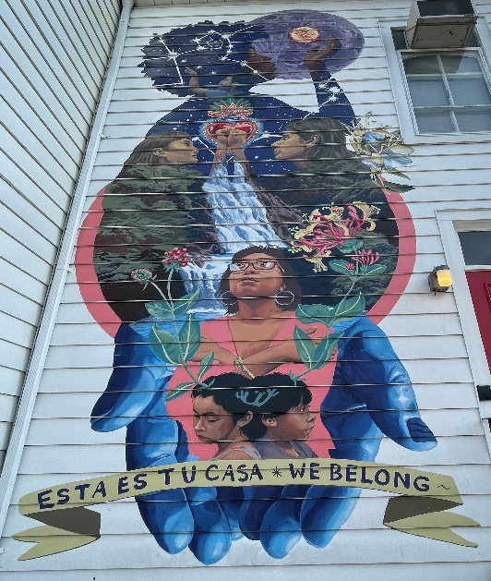
CBCs Walk the Walk Social Justice, Diversity, Equity and Inclusion
Many community based activities are focused on students who identify as members of marginalized or historically underrepresented groups and seek to promote and equalize their access to quality care where they can work with professionals who understand their unique needs through a lens of intersectional cultural awareness.
#STOP
AAPI
HATE

Slide 10
Scan this QR Code for up to date Let’s Talk locations, schedule and information!

Slide 11
Other Resources for Help in a Crisis
Rutgers University Police Department (RUPD) - In the event of a crisis or emergency, contact RUPD by calling 911 or (non-emergency) 848-932-7211.
Acute Psychiatric Services (APS): 855-515-5700 (Middlesex County, includes New Brunswick/Piscataway and surrounding areas; available 24/7), or outside Middlesex County, contact your local NJ designated screening center, which can be found here: https://www.state.nj.us/humanservices/dmhas/home/hotlines/MH_Screening_Centers.pdf
NJ Hopeline: 855-654-6735 (New Jersey only; available 24/7) and by text or chat via njhopeline.com
National Suicide Prevention Lifeline: 1-800-273-TALK (8255), 24/7, national
Trans LifeLine (Transgender Suicide Hotline): 877-565-8860 (available 24/7)
National Crisis Text Line: Text “HELLO” to 741741 (available 24/7)
Trevor Project (for LGBTQIA support): 1-866-488-7386 (available 24/7)
NJ Peer Recovery (for alcohol or other drug support): 833-422-2765 (NJ residents only; available 7 days a week, 8am-8pm)
NAMI HelpLine: 1-800-950-NAMI (6264), Monday-Friday, 10am-10pm, www.nami.org/help

Slide 12
Worried About A Friend? Do Something To Help – Share A Concern!

