Slide 1
Academic and Research Integrity
Janet Alder, PhD
Assistant Dean of Academic and Student Affairs, SGS
Assistant Vice Chancellor for Postdoctoral Affairs, Rutgers Health
Associate Professor Neuroscience and Cell Biology, RWJMS
Orientation
2026

Slide 2
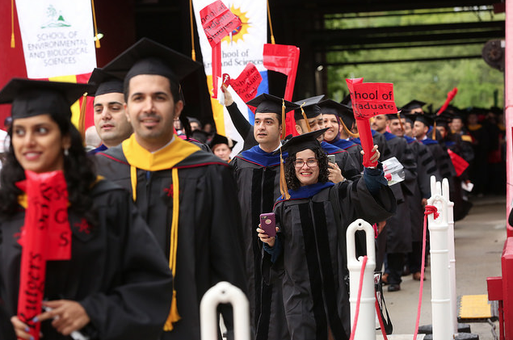

Graduate School Success

Slide 3
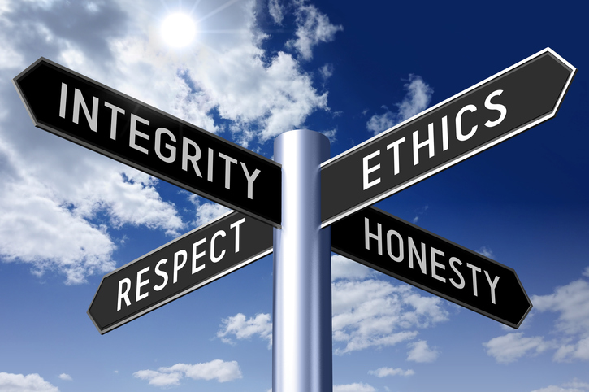
Academic Integrity
Cheating: Dishonesty of any kind with respect to homework, examinations, large and small group activities, written exercises, journal club, laboratory, presentations or required web-based activities
Plagiarism and Copyright: You must use your own words or paraphrase articles/books used with appropriate reference to the article/book cited.
Professionalism: Includes both the application of academic integrity and honesty in your class participation and assignments and treating both classmates and faculty with respect. Professionalism also includes attendance at required sessions and checking your school email regularly!!

Slide 4
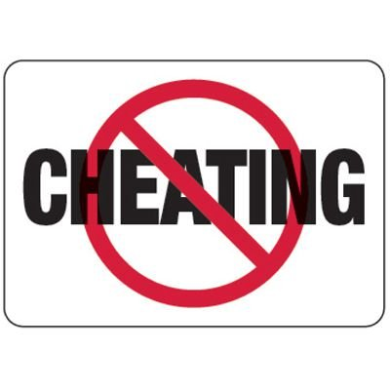
Examinations
Classroom examination:
Unless otherwise stated, no material (books, notes, calculators, computers) of any kind can be used during an examination. You may not look at or copy the work of another student during an exam.
NO communications devices, especially cell phones.
Take-home examination or work:
Unless otherwise stated, research and writing must be done individually without assistance or exchange of information with others.

Slide 5

To check for possible plagiarism
Turnitin Software is licensed by Rutgers University.
  Turnitin compares your paper to digital content on the web, archived digital content, student papers and thesis, and published journal articles.
  It does not determine plagiarism, instead it detects matched content
You can request a Sandbox site in Canvas and then create your own assignment to check your paper using Turnitin before you submit them to classes or your advisor

Slide 6
Appropriate Use of Artificial Intelligence
Unless stated otherwise, assume that the use of AI apps are NOT permitted at any point in a course.
Transparency in AI Use https://it.rutgers.edu/ai/
Rutgers University community members must disclose their use of generative AI in all academic, educational, and research contexts. Do not publish research findings based on AI-generated content (e.g., text, images, or code) without explicitly stating how AI was used in the process. Researchers are encouraged to save relevant elements when making use of generative AI tools including:
  Tool name and version (e.g., ChatGPT [GPT-3.5 Turbo], Microsoft Copilot [Pro], Google Gemini [1.5])
  Time and date of usage
  Prompt or query
  Response
  Follow up queries and responses
  Name of person who queried

Slide 7
Ways to detect for Gen AI
  Turnitin AI - https://www.turnitin.com/products/features/ai/.
  GPTZero - https://gptzero.me/ - detecting text generated by ChatGPT, co-founded by Edward Tian, then Princeton student, in Jan 2023.
  Copyleaks - https://copyleaks.com/
  Providing full source for a quotation.
Use a citation manager to cite them in an appropriate style.
7

Slide 8
What if You Suspect Cheating or Professionalism Violations?
Report it:
  During the exam/exercise to the proctor
  As soon as possible after the exam/exercise to either the
  Course director
  Program directors
  Deans Janet Alder or Jim Millonig

Slide 9
Research Misconduct
Fabrication - making up data or results
Falsification - inaccurate representation of the results by changing or omitting data, by manipulating research materials, equipment or processes
Plagiarism - appropriation of someone else’s ideas, results or words without giving appropriate credit
… in proposing, performing, reviewing research, or in reporting research results
committed intentionally, knowingly or recklessly
DOES NOT include honest error, conflicting data, differences of opinion, or differences in interpretations or judgments about data or experimental design.

Slide 10
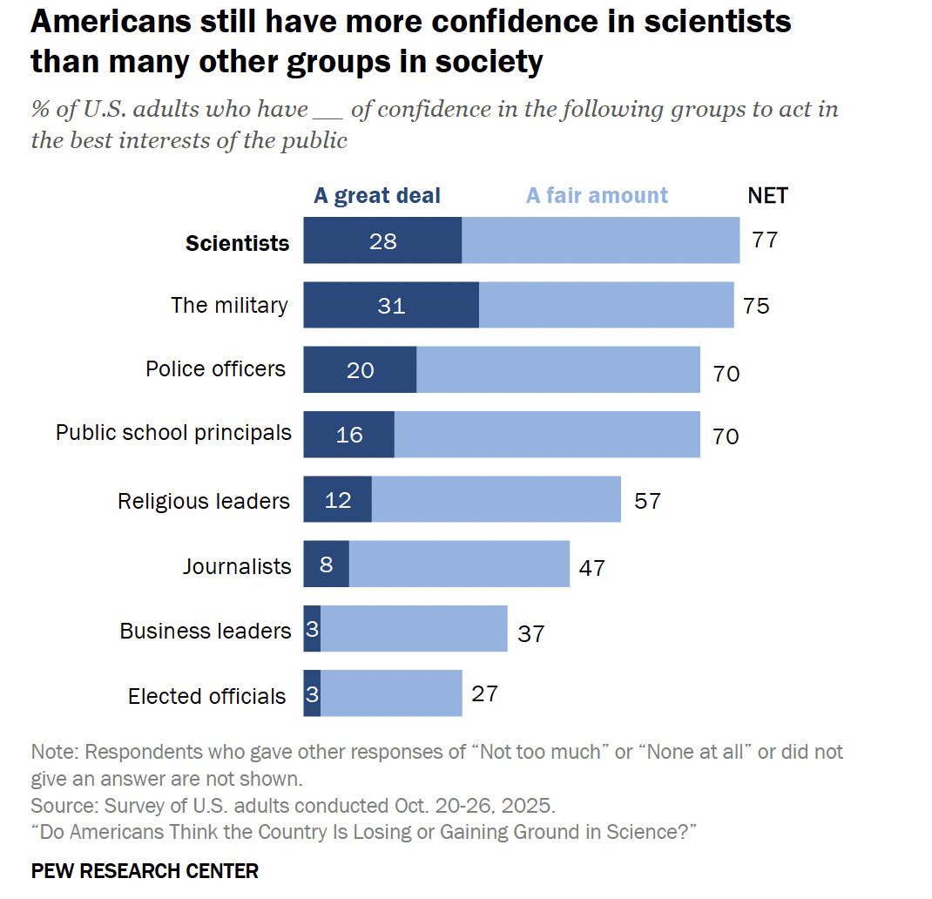
Yet scientists are still one of the most trusted groups in society.
We have a lot of responsibility…
Public, government and philanthropic agencies support research
Potential to harm animal and human subjects
Direct impact on human health
Scientists have mutual dependency
Pew Research Center 2025

Slide 11
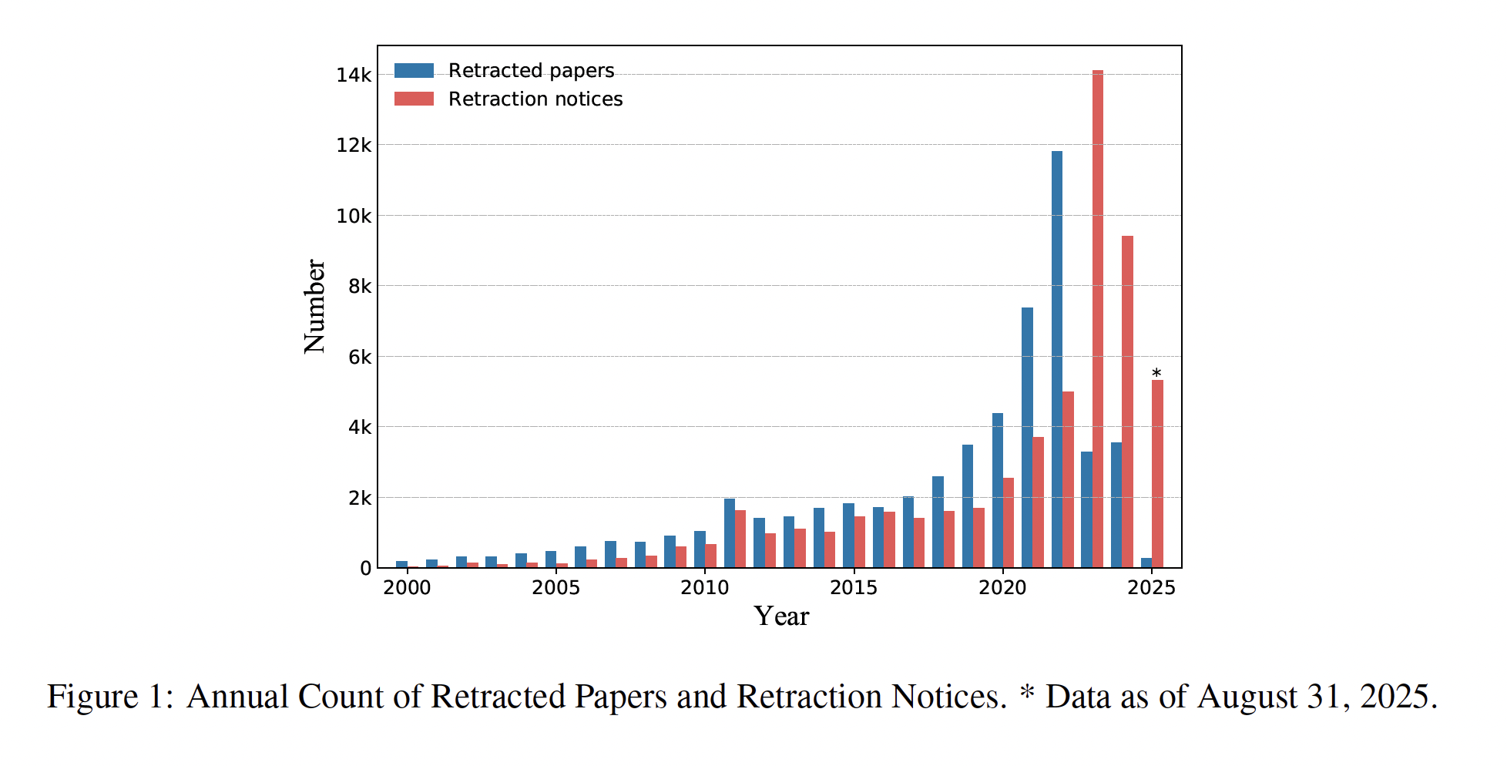
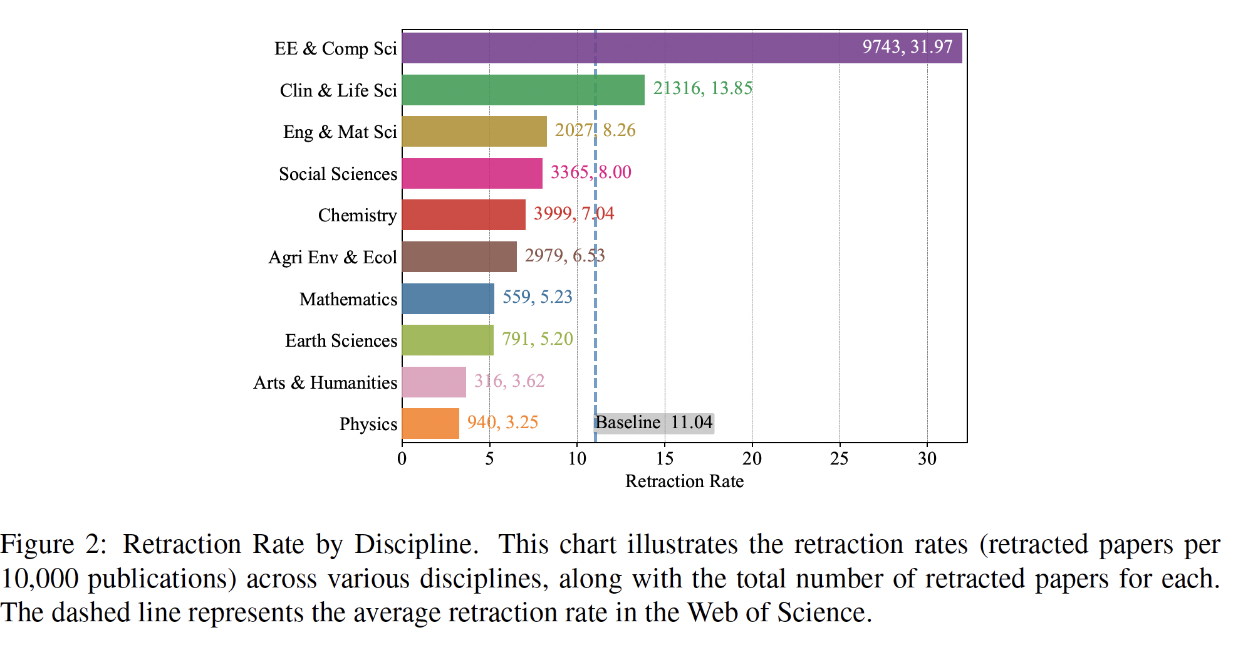
Retractions of Papers in the Life Sciences
Zhou et al., 2025
Using data from the Retraction Watch database (RWDB), scientists with retracted publications had:
younger publication age
higher self-citation rates
larger publication volume than those without any retracted publications.
retractions were more common in the life sciences and rare or nonexistent in several other disciplines
PLoS Bio, Ionninis et al., 2025

Slide 12

Are You Authorized To Collect Data?
Human subjects:
  CITI training, IRB submission or addition
Animal subjects:
  IACUC approval, vivarium training and tour
Radioactive materials:
  Training
Laboratory safety:
  Training

Slide 13

Human Subjects: Informed Consent
Voluntary: problems with prisoners, students, employees, children, etc.
No undue inducements
Must be understandable to subject
Risks and potential benefits must be presented accurately
Right to withdraw at any time
Deception is generally not allowed

Slide 14
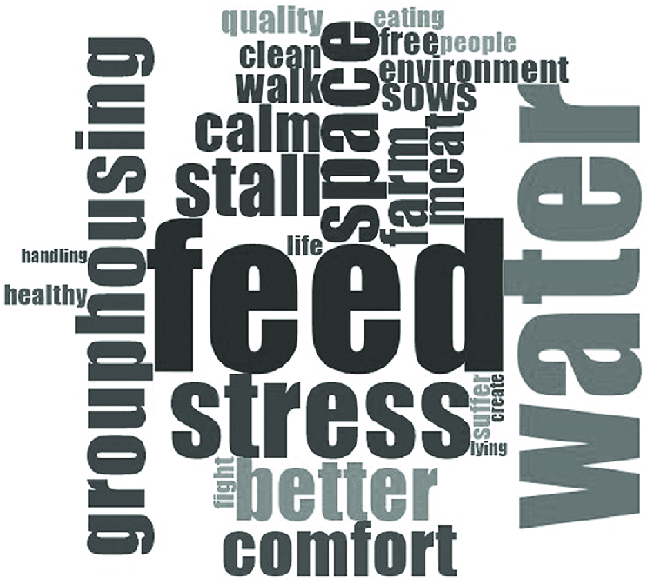
Animal Subjects: The Three Rs
Emphasis on New Approach Methodologies (NAMs)—use human cells, tissues, and computer simulations instead of living animals to test safety and study diseases.
Replace the use of animals with alternative techniques, or avoid the use of animals altogether.
Reduce the number of animals used to a minimum, to obtain information from fewer animals or more information from the same number of animals.
Refine the way experiments are carried out, to make sure animals suffer as little as possible. This includes better housing and improvements to procedures which minimize pain and suffering and/or improve animal welfare.

Slide 15
Enhancing Reproducibility through
Rigor and Transparency
Four areas that NIH is now requiring in applications and reviewing:
• Significance:
Describe Scientific premise: consider strengths and weaknesses of published research or prelimary data crucial to the support of the application
(rigor of previous experiments; methodology, analysis and interpretation, relevant biological variables, authentication of key resources)
• Research strategy:
2) Describe rigorous experimental design and methods and how will achieve robust and unbiased results: sample size calculation for significance (# mice per group), randomize subjects, blinded, inclusion/exclusion criteria etc.
3) Consider relevant biological variables for vertebrate animals or human subjects: e.g. Sex, weight, age, genetic strain etc.
4) Authentication of key biological and/or chemical resources; how plan to authenticate; methods to ensure identity and validity
e.g. Cell lines (not mis-identified or contaminated), speciality chemicals, antibodies, other biologicals
• Revised review criteria: Useful Training Module:
https://grants.nih.gov/reproducibility/module_1/presentation.html

Slide 16

Fabrication and Falsification
Best way to prevent scientific misconduct is promote good research practices:
Good record keeping
Solid basis for data selection
Talking to each other, to PI, to other researchers; don’t get isolated

Slide 17

Data Acquisition and Lab Tools
Data are the basis of science
Who owns them?
Data entry into lab book
  Date
  What you did
  Why you did it
  How you did it
  Where the materials are
  What happened
  Your interpretation
  Contributions of others
  What’s next
Notebooks - paper or electronic (LabArchives)
Computer files (not editable)
Physical samples (not removable)
Confidentiality
Keep for how long?
NIH Data Management and Sharing (DMS) policy requires all grants to include a detailed data management, sharing, and preservation plan.

Slide 18
What if You Suspect Research Violations?
Report it immediately to either:
PI
Office for Research
Michael E. Zwick
Senior Vice President for Research
michael.zwick@rutgers.edu
or
Hila Berger
Assistant Vice President, Research Regulatory Affairs
732-445-0488 Ext: 40022
hiberger@research.rutgers.edu

Slide 19

Protection and Responsibilities of “Whistle Blowers”
Initially, the identity of a complainant can be kept confidential.
Should the allegation lead to an inquiry or investigation, testimony by the complainant may be required.
The University is committed to the protection of “good-faith” whistleblowers.
However, “whistle-blowers” whose allegations which prove to be untrue and which are found to have been made in bad faith will be subject to appropriate disciplinary actions by the University.

Slide 20
Policies of Rutgers
School of Graduate Studies Policies and Procedures
https://grad.rutgers.edu/current-students/policies-procedures-students
Rutgers Academic Integrity Policy
http://academicintegrity.rutgers.edu/
Artificial Intelligence at Rutgers
https://it.rutgers.edu/ai/
Rutgers Policy on Research Misconduct 90.2.2
https://policies.rutgers.edu/B.aspx?BookId=12045&PageId=459400
Ignorance of rules is not an excuse!

Slide 21
Expectations of graduate students
PROFESSIONALISM – be in lab, respond to PIs requests/complete work in timely manner, communicate. Treat this as a JOB.
Consider taking your headphones off in lab
Ensure we have correct contact information
Familiarize yourself with website content
Complete and submit academic forms in timely manner
Maintain 3.0 GPA
Follow academic integrity policies
Follow research integrity policies
Let us know if there is a problem
Let us know when something good happens!
Check and respond to Rutgers email

Slide 22

A Scientist’s Oath

Slide 23
A SCIENTIST’S OATH*
As I embark on my career as a scientist, I willingly pledge that:
I will practice and support a scientific process that is based on logic, intellectual rigor, personal integrity, and an uncompromising respect for truth;
I will perform my professional activities and interactions with scientific integrity and respect for the field and my peers;
I will acknowledge my role as an ambassador of science to the public, and strive to be honest, respectful, and unbiased with engaging the public;
I will value my work and its contribution to the scientific community;
I will never let the potential for personal recognition or advancement cause me to act in a way that violates the public trust in science or in me as a scientist;
I will foster a community that is inclusive of all and recognize that diversity cultivates innovation, creativity, and progress;
I will acknowledge and honor the contributions of scientists who have preceded me and become a worthy role model deserving of respect by those who follow me;
And I will always be cognizant that my work is for the advancement of knowledge and the benefit of all humanity.
By pronouncing this Oath, I declare my commitment to these professional standards and goals.
*Kelsey E. Bettridge, Ashley L. Cook, Roy C. Ziegelstein, Peter J. Espenshade, A Scientist’s Oath, Molecular Cell, Volume 71, Issue 6, 2018.

Slide 24


