Slide 1

Rutgers Student Health
Counseling, Alcohol and Other Drug Assistance Program & Psychiatric Services (CAPS)
Rutgers University, New Brunswick Campus

Slide 2
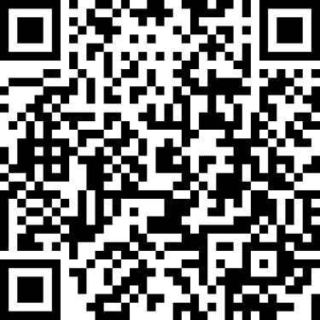
For
ko-choh-LOH-neh
Rutgers Student Health
Rutgers Student Health Operates 3 Health Centers on the New Brunswick Campus
Busch Livingston Health Center
110 Hospital Road, Piscataway, NJ 08854
Hurtado Health Center
11 Bishop Place, New Brunswick, NJ 08901
Cook Douglass Health Center
61 Dudley Road, Suite 150, New Brunswick, NJ 08901
AND
Counseling, Alcohol and Other Drug Assistance Program & Psychiatric Services (CAPS)
17 Senior Street, New Brunswick, NJ 08901
AND
Health Outreach, Promotion, and Education (HOPE)
8 Lafayette Street, New Brunswick, NJ 08901
For more information about Rutgers Student Health’s Services, use this QR code or visit https://health.rutgers.edu

Slide 3
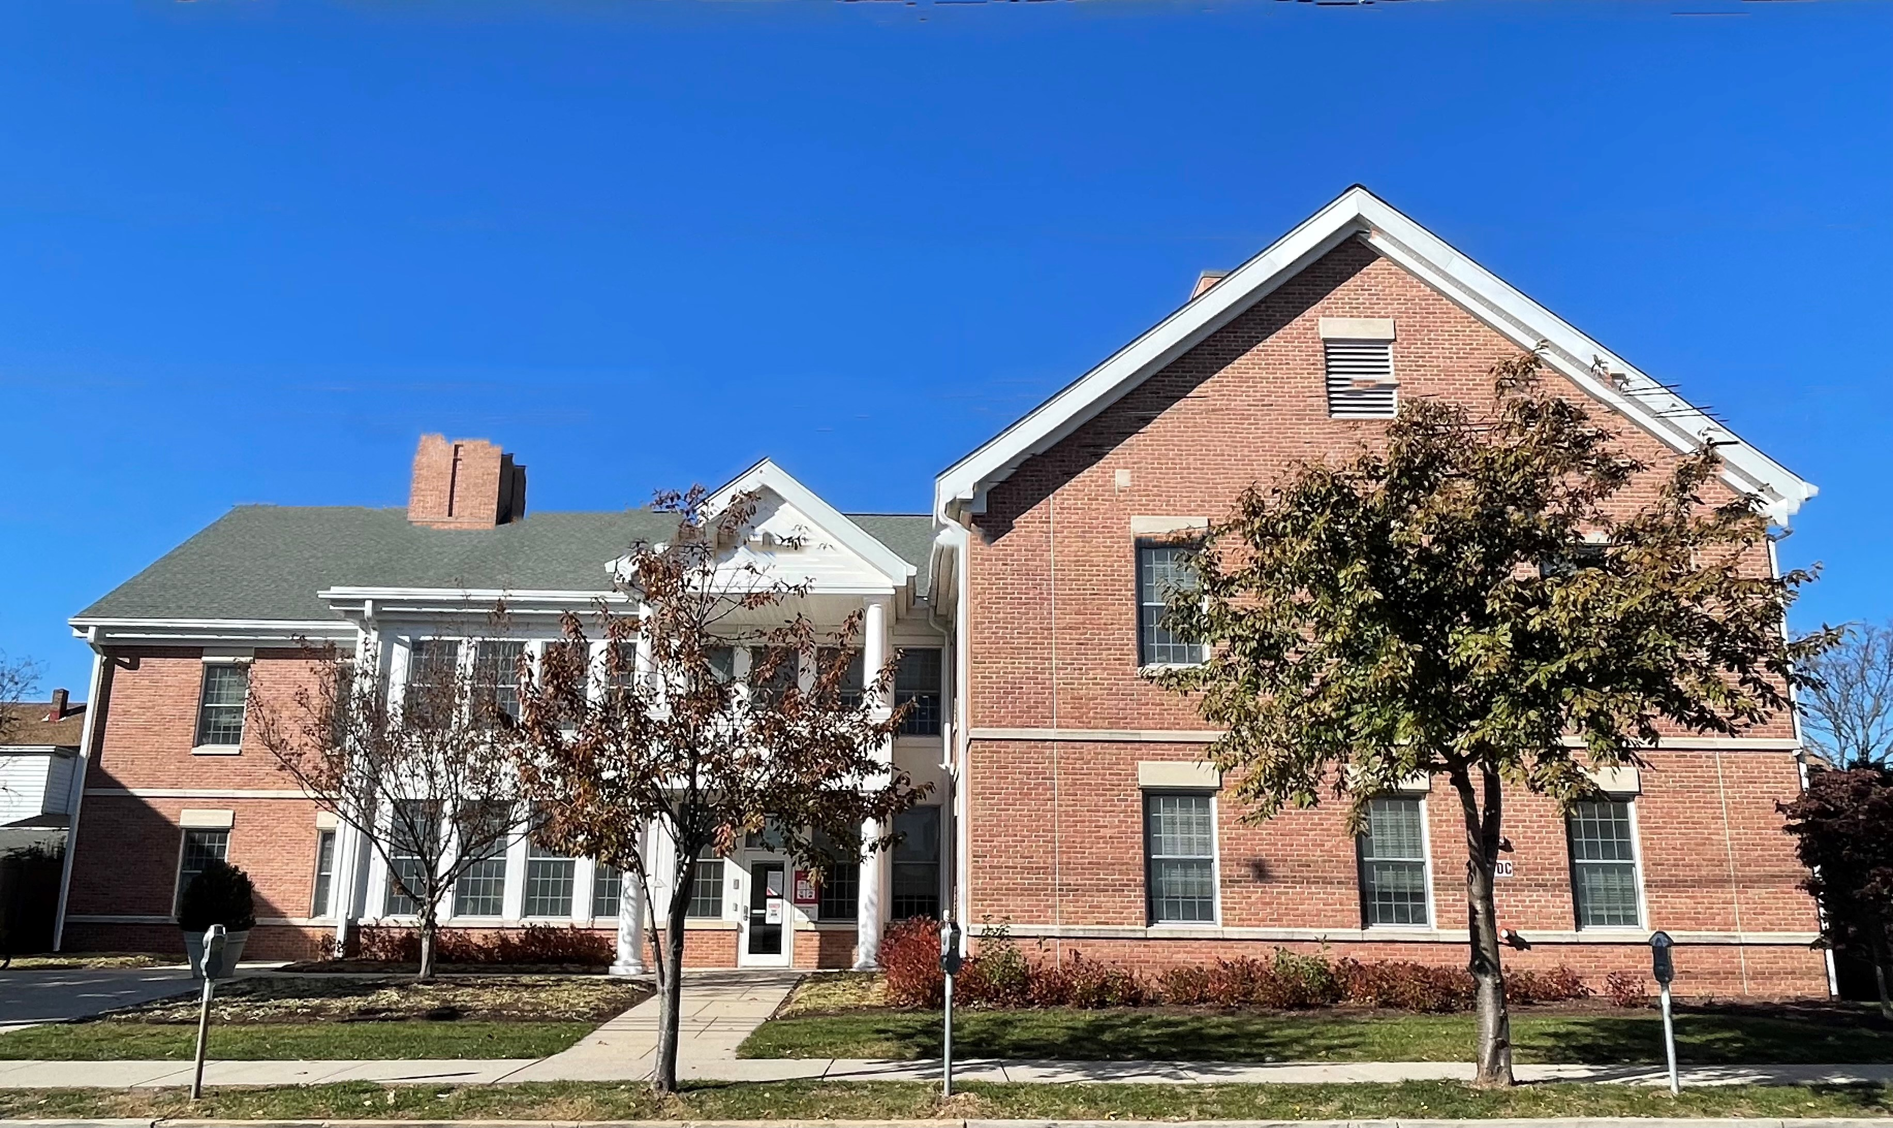
Rutgers Counseling, Alcohol and Other Drug Assistance Program & Psychiatric Services (CAPS)
CAPS is part of Rutgers Student Health and is the mental health counseling and support service for
Rutgers – New Brunswick students
CAPS is open:
Monday, Tuesday, Thursday, Friday 8:30 am – 4:30 pm and
Wednesday 10:30 am – 4:30 pm
except University holidays
To connect with CAPS, students can:
Visit 17 Senior Street on the College Ave Campus
Call 848-932-7884
Drop in to Let’s Talk
Speak with CAPS On Call staff in a crisis
Visit our website for more information at
https://health.rutgers.edu/medical-and-counseling-services/counseling-services

Slide 4
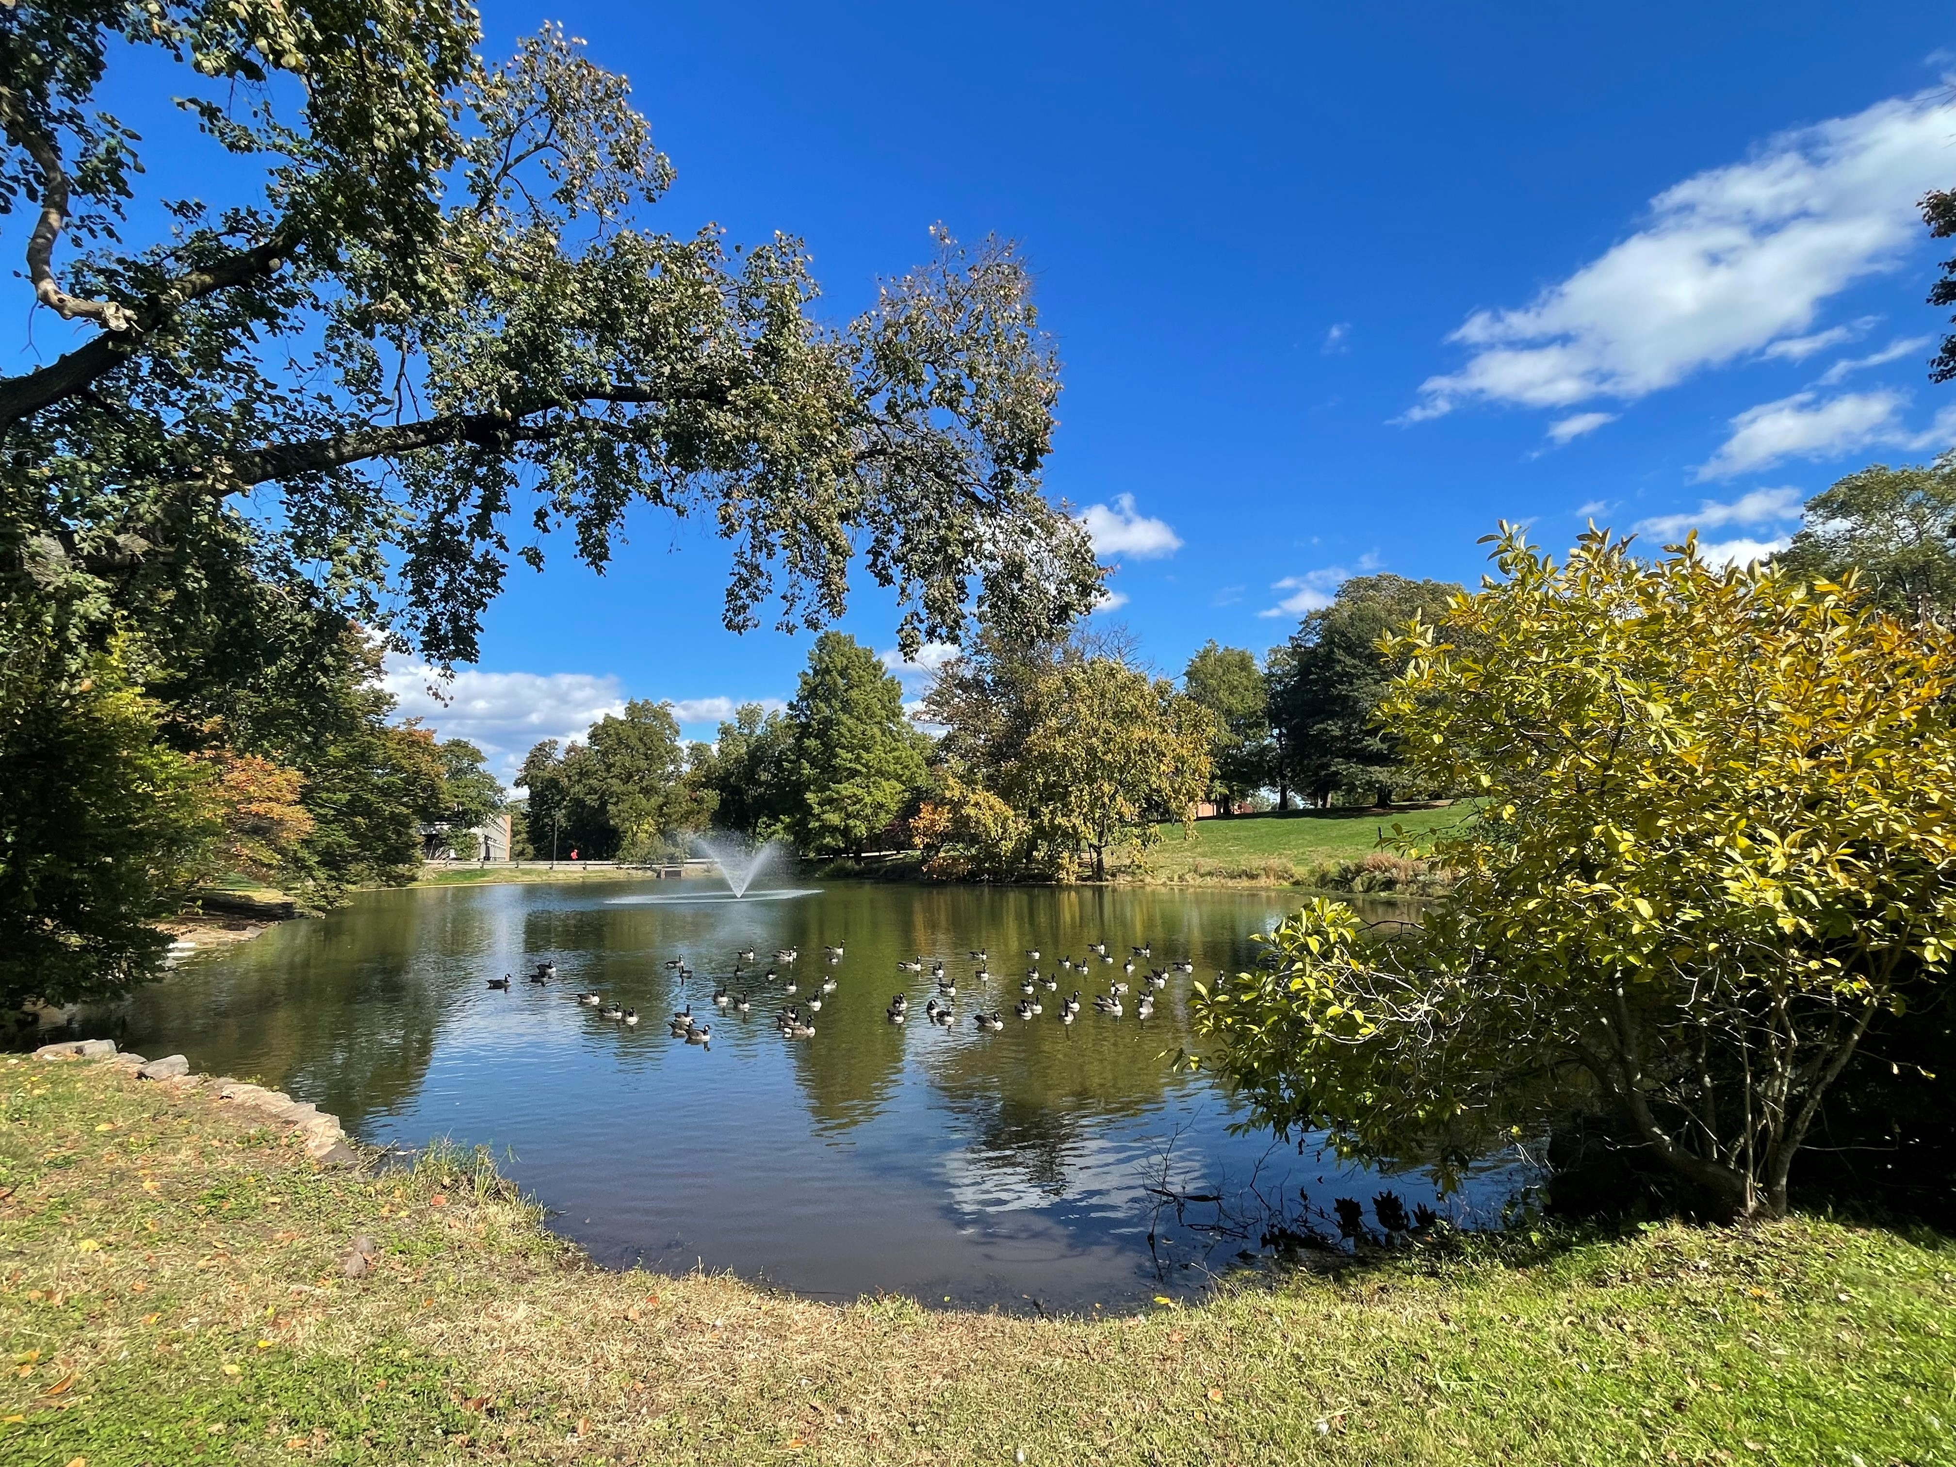
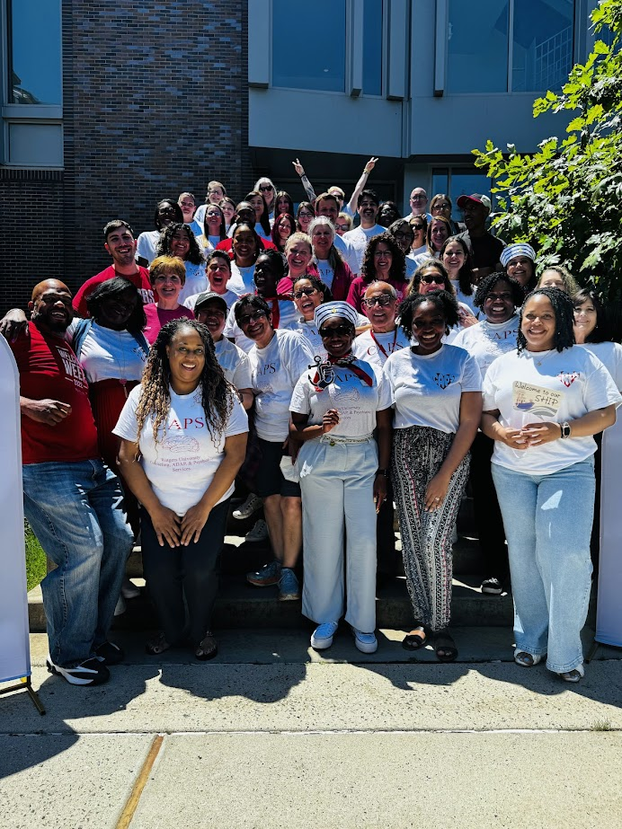

Who are the Staff at CAPS?
Psychologists
Psychiatrists
Social Workers and Professional Counselors
Substance Use Counselors
Front Desk and Administrative
Staff
Case Managers
4
Notes:
The staff includes psychiatrists, psychologists, clinical social workers, licensed professional counselors and substance use counselors, all with expertise in both general mental health concerns and issues unique to a college environment.

Slide 5
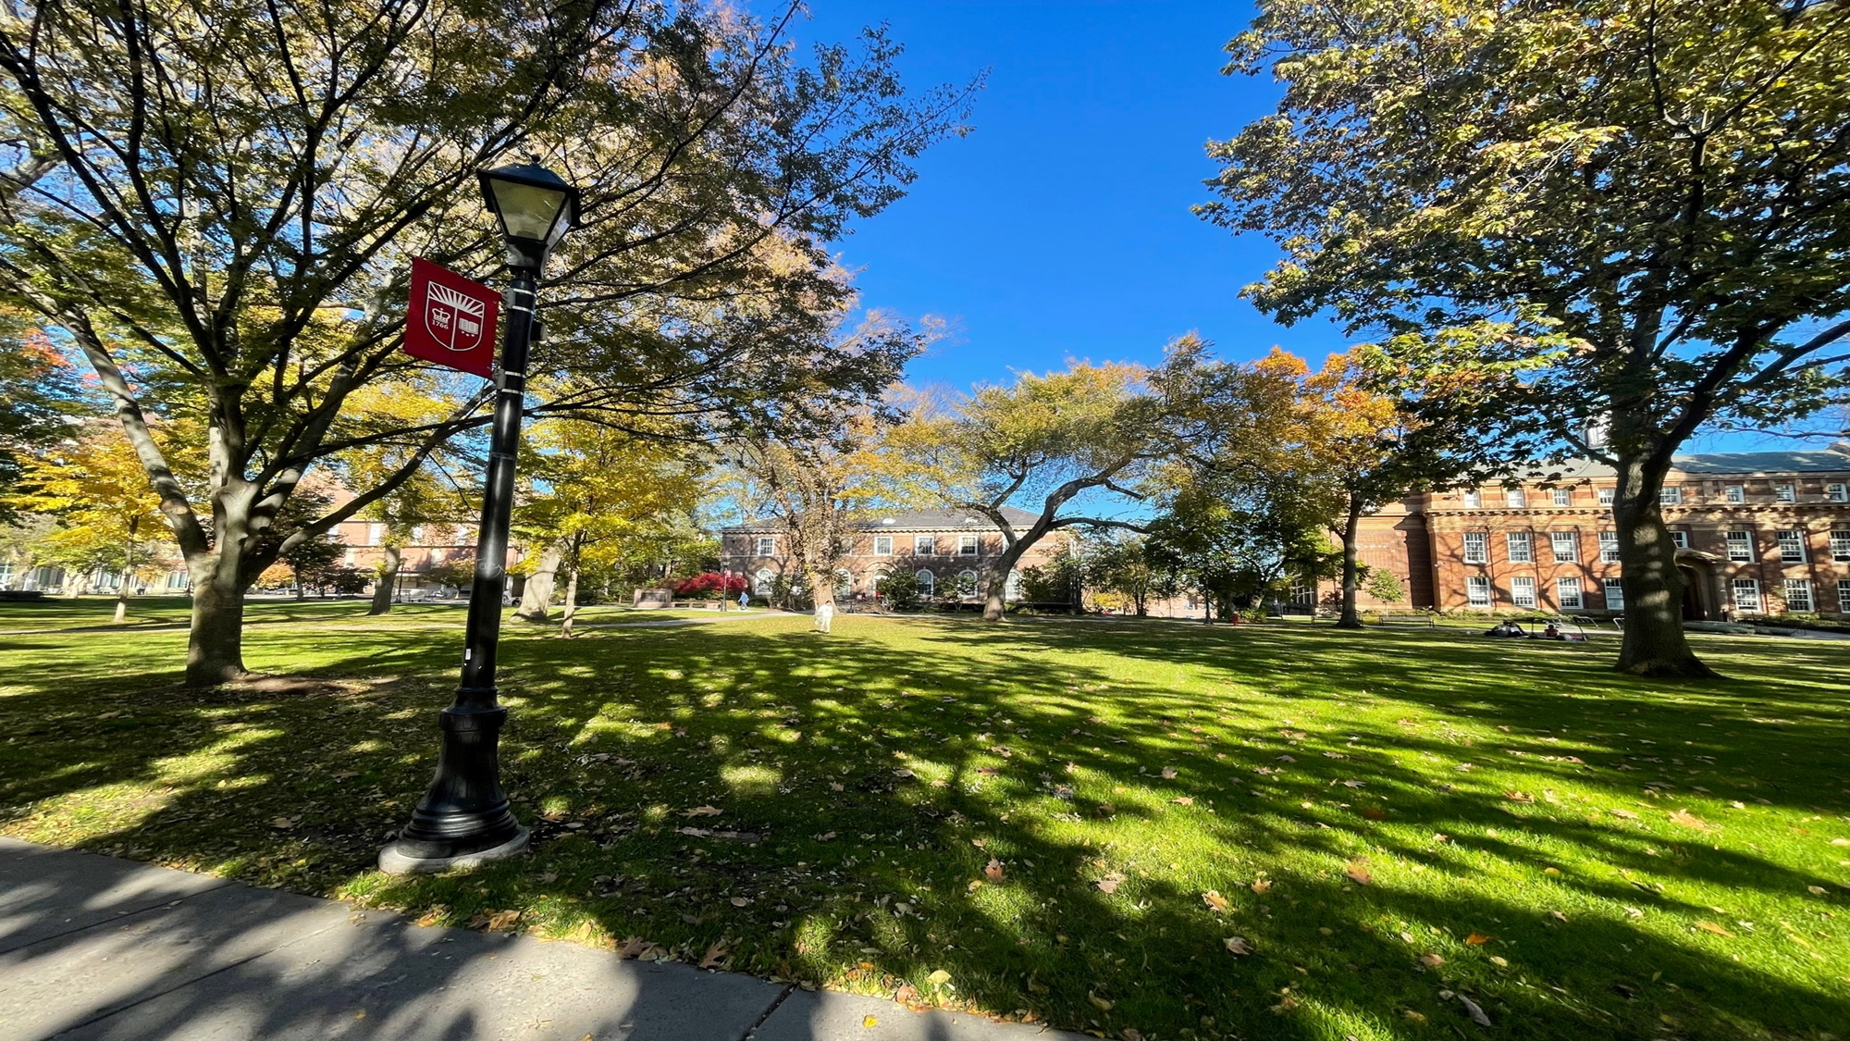
Who are the Staff at CAPS?
Programs at CAPS
Psychologists, Clinical Social Workers and Counselors
Integrated Health
Sabrina Starkman, LCSW
Psychiatry
Dr. Huang
Dr. Efremova
Psychiatrists and Advance Practice Nurses
Clinical Social Work Team
Shane Uber, LCSW
Training Program
Dr. Reese Mayer
Dr. Leah Maselli
Doctoral Psychology Interns and Practicum Students
Associate Director, Mallory Everett, PsyD, LPC
Director of CAPS
Director,
Jennifer Jones-Damis, PsyD
Clinical Social Workers and Case Managers
Psychologists and Associate or Assistant Directors
Community Based Counseling
Manda Gatto, LCSW
Alcohol and Other Drug Program
Keith Murphy, LPC, LCADC
Recovery House
Kenneth Bae, LSW
Community Based Counselors
Group Program
Julissa Perez, LCSW
Clinical Social Workers, Counselors, AOD Counselors
5
Notes:
The staff includes psychiatrists, psychologists, clinical social workers, licensed professional counselors and substance use counselors, all with expertise in both general mental health concerns and issues unique to a college environment.

Slide 6

What Services Does CAPS Provide?
Crisis Counseling (On Call)
Individual Therapy
Group Counseling
Psychiatric Treatment
Community Outreach
Supportive Case Management
“Let’s Talk” Consultations with a Community Based Counselor
Substance Use Treatment and Recovery Housing
Presentations and Wellness Projects
Workshops and Special Events
Clinical Supervision and Training
Information and Referral to Community Services
Notes:
Services include individual and group counseling, psychiatric services, crisis intervention, case management and care coordination, community-based counseling services, consultations with concerned staff or faculty, assessments of a University community’s needs, support, guidance and assistance with efforts focused on wellness including workshops and presentations around campus, outreach.

Slide 7

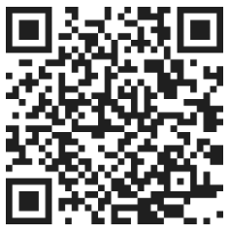

Scan this QR Code for up-to-date Let’s Talk locations, schedule and information!
“Let’s Talk”
with Community Based Counselors
Add Title
Community Based Counselors (CBCs) are located in 16 communities on campus and provide drop-in support (like office hours) for 1-2 hours per week
Counselors offer general support, consultation, education or can help get you connected to CAPS or community services.
Let’s Talk is provided by phone, video or in person.
Call CAPS at 848-932-7884 and choose option #2 to schedule an appointment or drop in to one of our locations.
The Student Health website is updated each semester and provides information about the times and locations for Let’s Talk.
Use QR code to see times and locations or health.rutgers.edu/medical-counseling-services/counseling/therapy/community-based-counseling/ for details.

Slide 8
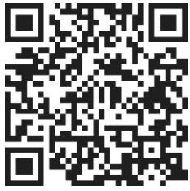
Rutgers Counseling, Alcohol and Other Drug Assistance Program & Psychiatric Services (CAPS)
How Do Students Get Connected to CAPS?
Call the CAPS Office at 848-932-7884 To set up a phone screening for services and schedule an initial meeting with a counselor To reschedule an appointment To ask questions OR Visit Our Website for More Information https://health.rutgers.edu/medical-and-counseling-services/counseling-services | Reach the Daytime On-call Counselor for Crisis Support A CAPS on-call counselor is available for crisis intervention and emergencies Monday through Friday, 8:30am to 4:30pm, except University holidays. The phone is answered by a service that can provide students with immediate assistance in a crisis service when CAPS is closed. Students can access the on-call counselor by visiting 17 Senior Street on the College Ave Campus or calling 848-932-7884. | Drop-In to Let’s Talk with Community Based Counselors CBCs are located in 16 communities on campus and have office hours 1-2 hours a week for students to drop in to discuss a concern, get support, consult, get information or to be connected to a CAPS counselor. Let’s Talk is provided by phone, video or in person. Call CAPS at 848-932-7884 and choose option #2 to schedule an appointment or drop in to one of our locations. For more information about Let’s Talk:
Notes:
https://healthymindsnetwork.org/wp-content/uploads/2025/04/2023-2024-HMS-National-Data-Report_041525.pdf

Slide 9
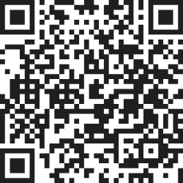
We Want to Know What You Think!
Please Tell Us by Taking Our Workshop Interest Survey https://rutgers.ca1.qualtrics.com/jfe/form/SV_b9mAfjf5DSlNZOK
Notes:
https://healthymindsnetwork.org/wp-content/uploads/2025/04/2023-2024-HMS-National-Data-Report_041525.pdf

Slide 10

Thank you!
Questions?
Comments?

