Slide 1

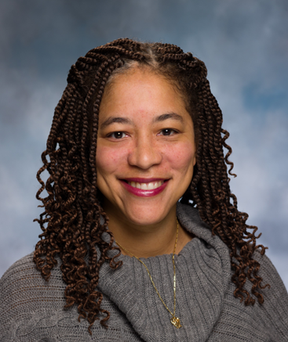
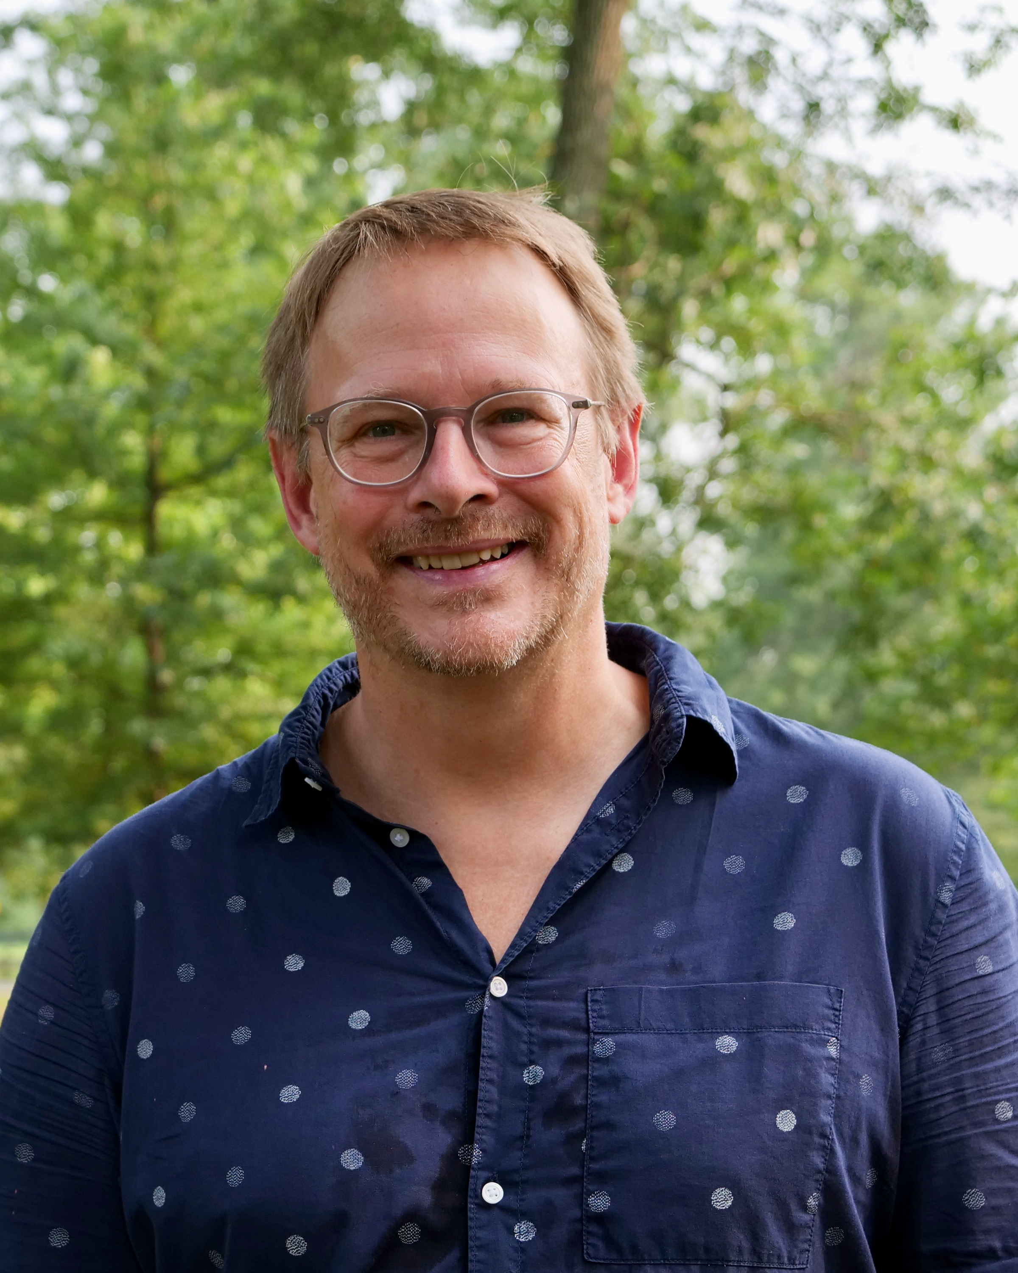
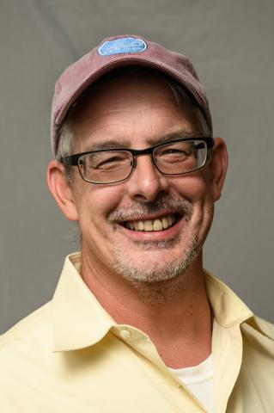
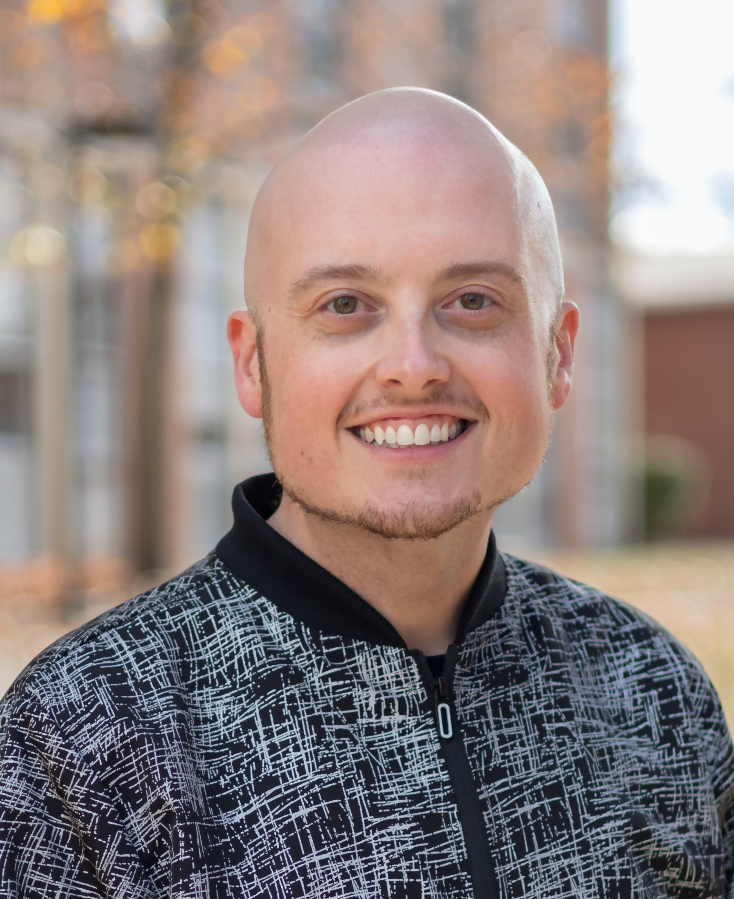
PROGRAM DIRECTORS
Tracy Scott Ph.D.
Loren Runnels Ph.D.
James Millonig Ph.D.
Brian Daniels Ph.D.

Slide 2
RUTGERS EDGE PROGRAM ELEMENTS
1. Annual EDGE Bootcamp (for YRS1-3) Ph.D. Students
Bootcamps that prepare you with the skills and knowledge for the year ahead.
EDGE Workshops (for YRS1-3) to Increase Readiness for Academic Research.
Students will enroll in the Maximizing Student Development (MSD) Course (16:718:515:01) for 1 credit
3. EDGE Seminar Series & Annual EDGE Symposium (for all years).
Showcasing cutting edge biomedical science, the EDGE seminar series and annual EDGE Symposium
offers biomedical Ph.D. students to share their science and grow as communicators throughout the year.
The year culminates with the annual EDGE Symposium.
EDGE Coaching and Mentoring Program (for all years): Offers individualized support that build
your capacity to thrive as a student. Employing the EDGE individualized development plan (EDGE-IDP) ,
you’ll make and achieve technical, operational, and professional skills.
EDGE Community Events (for all years): The Rutgers EDGE Program is diverse and inclusive.
We celebrate growing as scientists together in community.

Slide 3






Maximizing Student Development (MSD) Course
Y1 PRE-FALL
Y1 FALL
Y1 SPRING
Y1 Bootcamp
Rotation Workshop
Imposter Syndrome Workshop
Reflection on 1st Semester Workshop
Choosing a Lab Workshop
EDGE Workshop:
Proposal Writing Workshop
EDGE
Symposium
EDGE Workshop / iJOBS
Y1
IDP-3D
EDGE Workshop / iJOBS
EDGE Seminar Series
Y2 PRE-FALL
Y2 FALL
Y2 SPRING
Y2 Bootcamp
Scientific Presentations Workshop
Reflections Workshop: Settling into Lab
Wellness Workshop
Scientific Paper and Figure Workshop
EDGE Workshop:
Proposal Writing
EDGE
Symposium
Y2
IDP-3D
EDGE Workshop / iJOBS
Data
Carpentry
Workshop
EDGE Workshop / iJOBS
Big Data & Computer Training Module
EDGE Seminar Series
Y3 PRE-FALL
Y3 FALL
Y3 SPRING
Y3 Bootcamp
EDGE Workshop / iJOBS
EDGE Workshop / iJOBS
EDGE
Symposium
Sci-PhD Training
Y3
IDP-3D
Communicating Science
or Fellowship Writing Course
NEXT BIG THING SEMINAR
EDGE Seminar Series

Slide 4

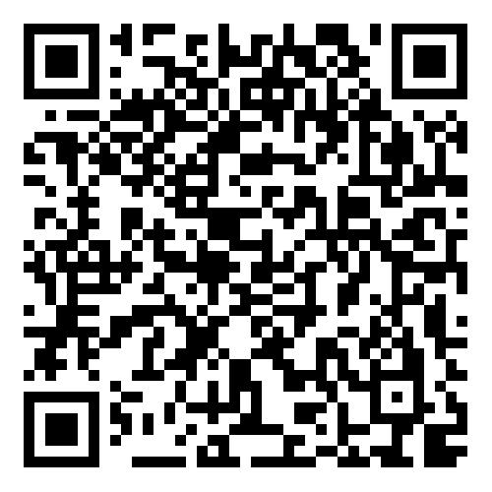
Rutgers EDGE Bootcamp
Monday August 31, 2026 10 am-1 pm
The purpose of the EDGE Bootcamp for 1st-Year Ph.D. students in the Biomedical Sciences
is to share resources and strategies that will help set you up for success in your training.
Schedule:
10:00 a.m. – 11:00 p.m. The EDGE program
  Introduction to EDGE
  Choosing Your Rotation
  Finding the Right Mentor
  Developing Mentee Skills
  The Hidden Curriculum
11:00 a.m. – 12:00 p.m. Resources on Campus
  Shan Reeves - Counseling, Alcohol and Drug Assistance,
  and Psychiatric Services (CAPS) (11-11:30)
  Kelly Martini - Graduate Student Life (11:30-12)
12:00 p.m. – 1:00 p.m. Introduction of Peer Mentors and Lunch
Bootcamp Registration

