Slide 1
PubMed, EndNote, Covidence,
SOAR, ORCID, and AI
Yingting Zhang, MLS, AHIP-D
Rutgers Health Sciences Libraries
SGS Biomedical Sciences Orientation
August 26, 2026

Slide 2
Outline
RUL Health Sciences Libraries
PubMed
EndNote
Covidence
SOAR
ORCID
AI
2

Slide 3
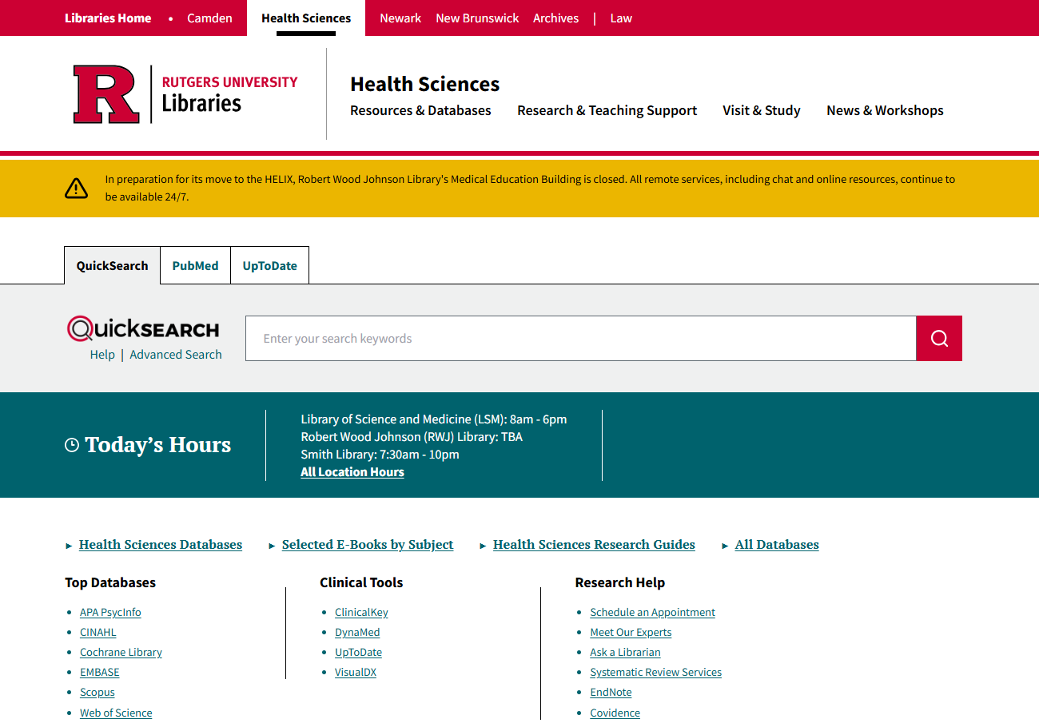
Health Sciences Libraries
https://www.libraries.rutgers.edu/health-sciences
3

Slide 4
PubMed
https://www.libraries.rutgers.edu/indexes/pubmed
4

Slide 5
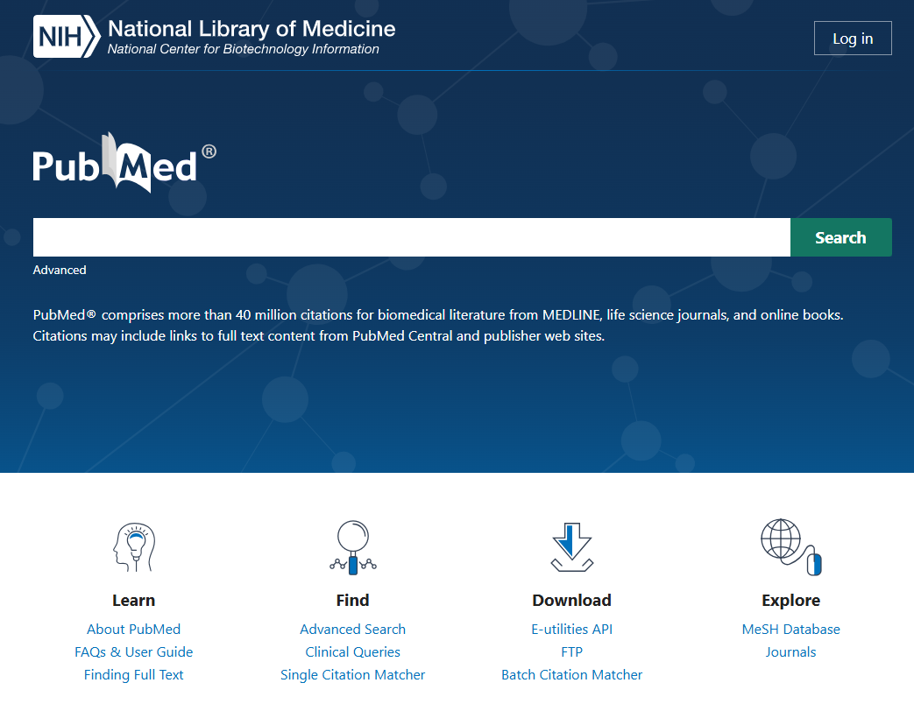

About and Accessing PubMed
PubMed is a free resource of over 38 million citations for biomedical literature from MEDLINE, life science journals, and online books.
It is developed and maintained by NLM’s NCBI.
Rutgers users should access PubMed via the Rutgers-specific link to PubMed in order to get full-text articles via from Rutgers-subscribed resources.
Other ways of accessing PubMed:
From the PubMed search tab above the QuickSearch box on the RUL Health Sciences Libraries website.
From the RUL Databases list.

Slide 6
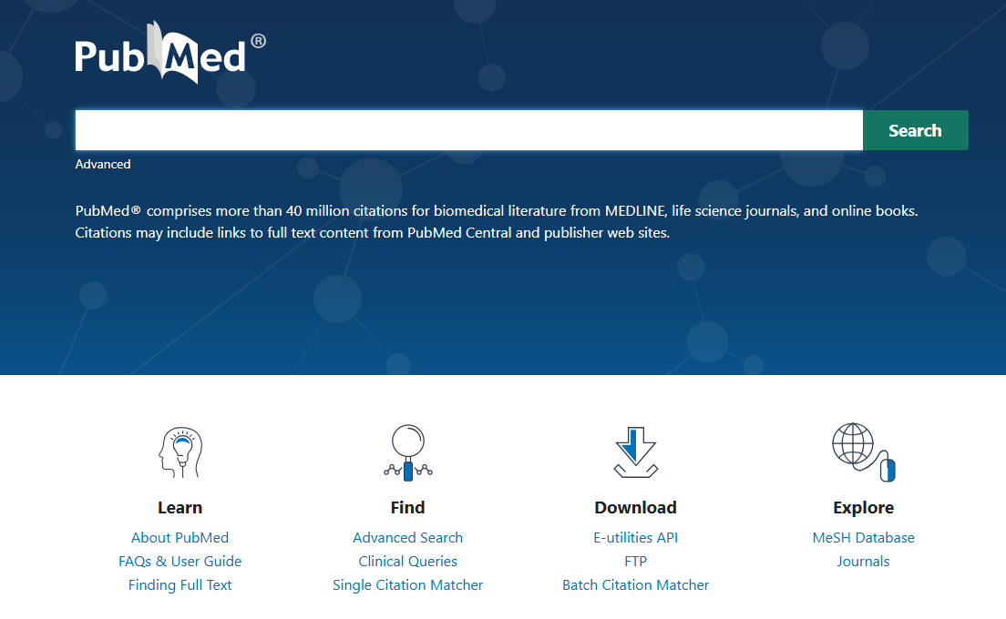
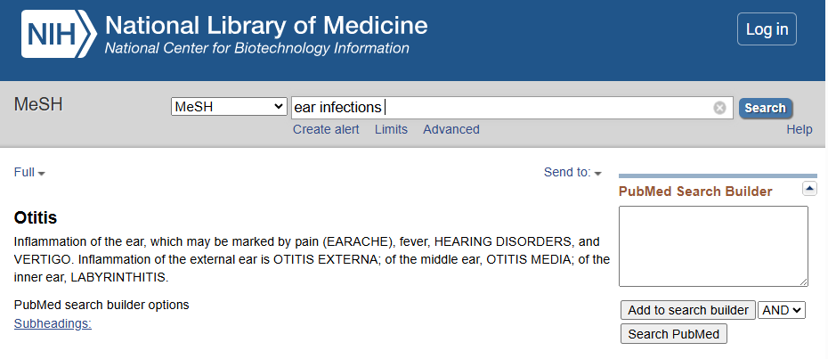
Accessing the MeSH Database
6

Slide 7
PubMed Search Features
Search by keyword(s) / ATM searching
Search by MeSH
Proximity Search (e.g. “dental pain”[Title/Abstract:~2)
Search by Field (e.g. Author, Affiliations, Title, Abstract, etc.)
Search Journals in NLM catalog
Topic Specific Queries - https://www.nlm.nih.gov/psd/special_queries.html
To learn how to search PubMed effectively, contact the health sciences librarians at rbhs_librarians@libraries.rutgers.edu
7

Slide 8
EndNote
https://www.libraries.rutgers.edu/research-support/citation-management/endnote
8

Slide 9
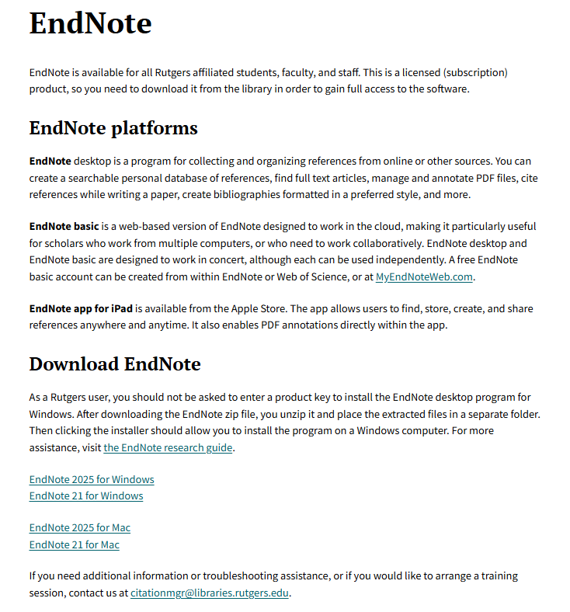
About EndNote
EndNote is a bibliographic management tool used by researchers to store, organize, and cite references. Rutgers University Libraries provides a site license for Rutgers-affiliated users to download the EndNote desktop program to their Mac or Windows computers.
https://www.libraries.rutgers.edu/research-support/citation-management/endnote
9

Slide 10
EndNote – Download Tips
The University Libraries are licensed to provide download access to EndNote for all Rutgers users. As a Rutgers user, you are not required to enter a product key to install the program.
Go to: https://www.libraries.rutgers.edu/research-tools-and-services/citation-management/endnote to download EndNote. The latest version is EndNote 2025.
Note: For Windows, you must extract the zip file and place the extracted files in a separate folder from where the zip file is located. Otherwise, you will be asked to enter a product key.
To request training or help with the use of EndNote, please email: citationmgr@libraries.rutgers.edu.
10

Slide 11
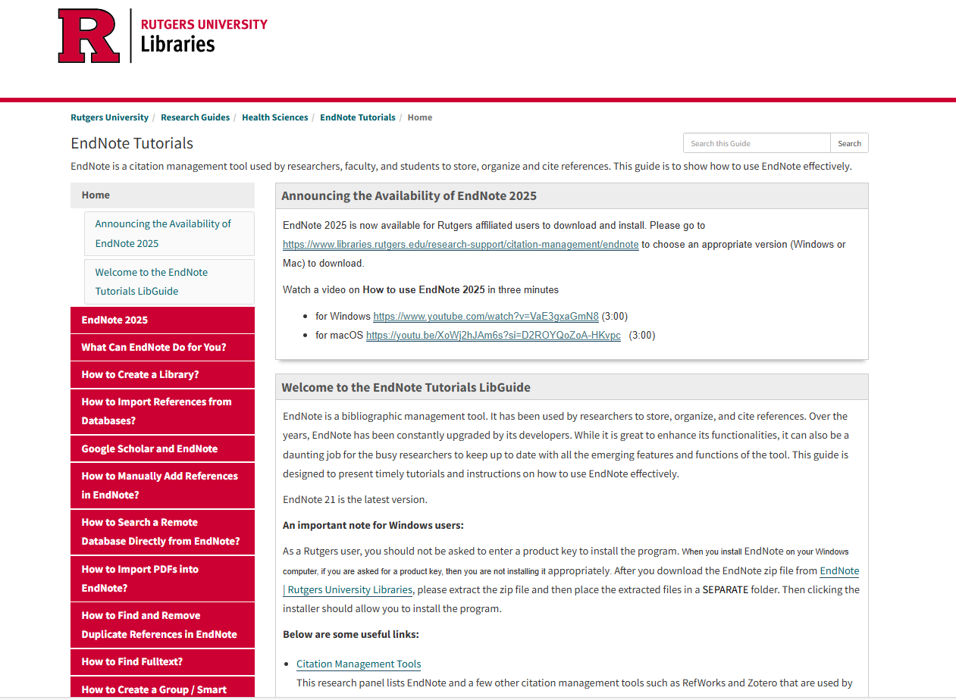
EndNote Tutorials
https://libguides.rutgers.edu/endnotetutorials
11

Slide 12
Covidence
https://www.libraries.rutgers.edu/databases/covidence
12

Slide 13
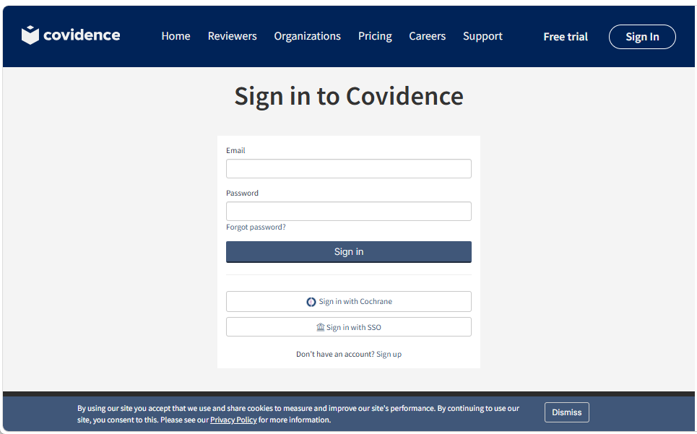
Covidence
https://www.libraries.rutgers.edu/databases/covidence
Covidence is a tool for creating and collaborating on systematic reviews. But it can also be used for a single-reviewer literature review.
It is available only to Rutgers University affiliates and requires a personal account.
New students, staff, and faculty users, select the Connect to Database link, choose “Sign in with SSO,” and sign in with NetID to create a new Covidence account.
To learn how to use Covidence, contact: ask_research@libraries.Rutgers.edu
13

Slide 14
SOAR
    http://soar.rutgers.edu
14

Slide 15
Rutgers Open Access Policy
    Passed on Oct 19, 2012, implemented on Sept 1, 2015.
    Applicable for all Rutgers faculty & scholars including graduate students & postdocs.
    Requires that RU authors deposit legal copies of scholarly articles into SOAR at the time of the article’s final acceptance for publication, at no cost to them, making scholarship freely accessible to the public.
    Showcases all university scholarships in one place
    Preserves access over time
    Allows authors to retain rights to their works
    Ensures greater visibility & impact for Rutgers research worldwide.
    Open Access Scholarship at RUL -http://www.libraries.rutgers.edu/researchers/open_access
    Open Access Publishing Opportunities - https://www.libraries.rutgers.edu/research-support/open-access-publishing-opportunities-rutgers-researchers
Any questions on OA, contact: ask_research@libraries.Rutgers.edu
15

Slide 16
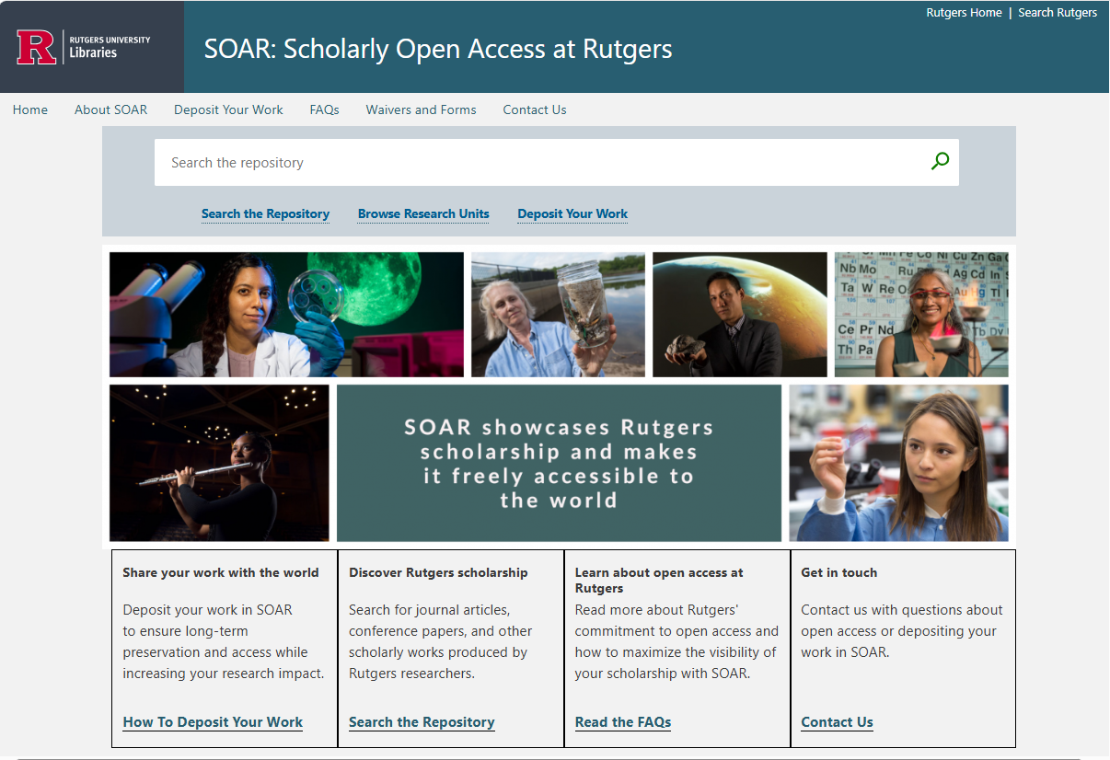
SOAR: Scholarly Open Access at Rutgers
https://soar.libraries.rutgers.edu/
16

Slide 17
ORCID
    https://orcid.org/
17

Slide 18
What Is ORCID?
ORCID stands for Open Researcher and Contributor ID.
It provides a unique digital identifier that distinguishes a researcher from those with the same or similar names.
ORCID iD connects researchers and their research activities throughout their careers.
Sample ORCID iD:
ORCID is the organization; ORCID iD is the unique identifier.
0000-0003-0757-1837
18

Slide 19
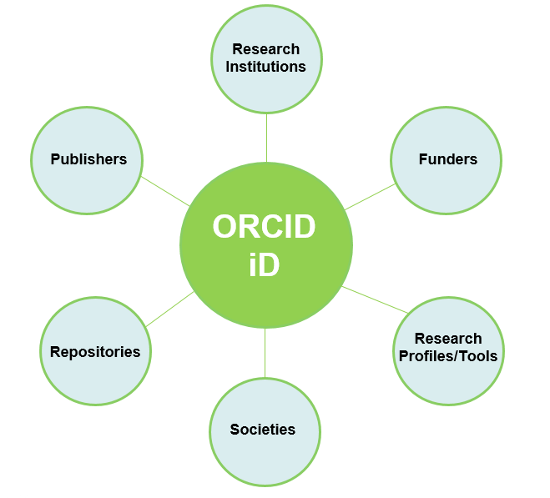
Why ORCID?

Slide 20
Managing Your Research Identity with ORCID
Register for an ORCID account for an ORCID iD
Populate your ORCID record (profile)
Connect to the Rutgers Personal Contact Information page and other trusted parties for interoperability
Meeting funders, publishers, and other stakeholders’ requirements
Showcasing your research in one place to increase visibility and research collaboration
On October 21, 2021 (during the OA Week), there will be a workshop on “Managing researcher Digital Identity with ORCID” (by Yingting Zhang)
Questions on ORCID? contact: ask_research@libraries.Rutgers.edu

Slide 21
AI
21

Slide 22
Responsible Use of AI
AI at Rutgers - https://it.rutgers.edu/ai/: information for assistance and guidance on the use of AI for Rutgers-affiliated users
University-licensed AI Tools:
  MS Copilot Chat
  Google Gemini
  Gemini Notebook
AI Research Guide - https://libguides.rutgers.edu/artificial-intelligence
GenAI Features in Major Databases and Platforms - https://libguides.rutgers.edu/ai-eresource-platforms
Questions on AI use for research? contact: ask_research@libraries.Rutgers.edu

Slide 23
Thank You!
Questions?
Email: ask_research@libraries.Rutgers.edu
23

