Slide 1

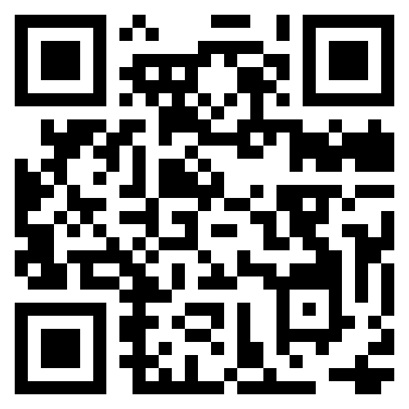
ODS Web Page
ods.rutgers.edu

Slide 2
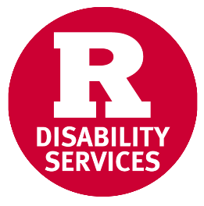
Who We Are and What We Do
We confirm that a student has a disability protected under the Americans with Disabilities Act by reviewing documentation and engaging the student in an interactive process.
We work collaboratively to remove barriers for Rutgers University students who live with functional limitations as a result of a disability.
We work with campus partners to promote awareness and accessibility.
Notes:
LW

Slide 3
Types of Accommodations
Exam Related
  Extended time on tests
  Taking exams in a reduced distraction location
  Use of a computer for tests/exams
  Use of a reader or a scribe
In-Class
  Note taking services
  Alternate format for text and materials
  Assistive Technology (Text-to-Speech and Speech-to-Text)
  Physical Access
  Class Assistants
Other Offices That Manage Their Own Accommodations
  Housing
  Transportation
  Dining
Notes:
LW

Slide 4
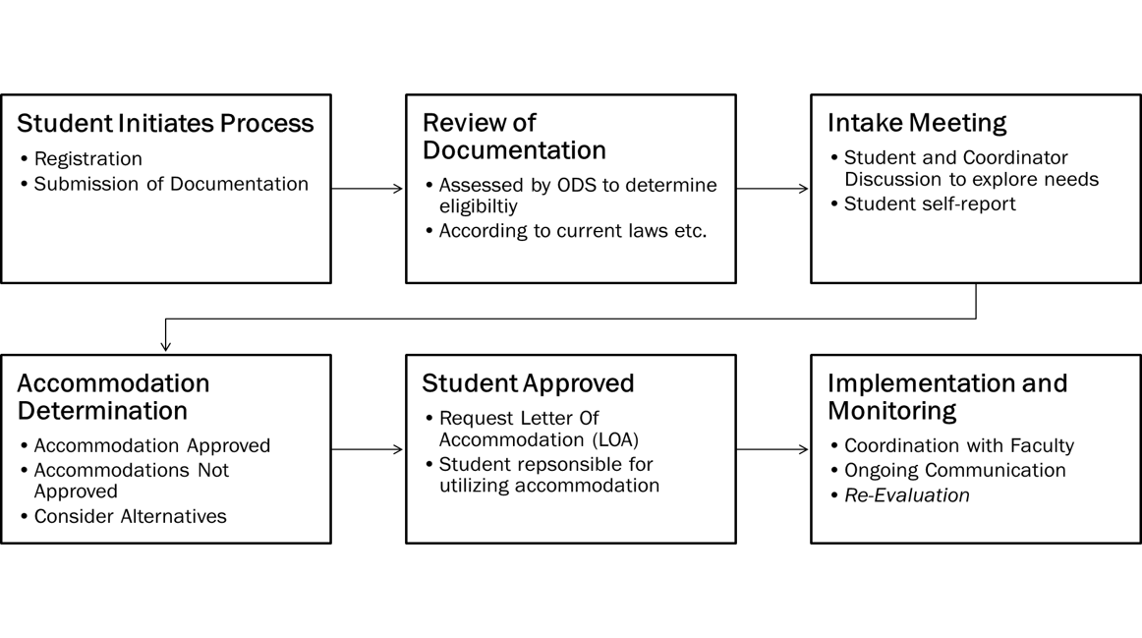
Receiving Accommodations at Rutgers
Notes:
Lex-Some of the process is legally dictated, but most processes require some similar basic elements:
Registration- need to disclose (different than HS)
Once registered assigned a coordinator and do an intake to capture the student’s perspective on what they need and what they think might allow for equal access
Documentation fills in gaps/holes and provides additional information
Consult schools/ faculty when needed
HIGHLY interactive- sometimes may go back through the process multiple times

Slide 5
Providing Accommodations as an Instructor
Faculty and staff support
  Receiving a Letter of Accommodation
  Exam Upload Site
  Digital Accessibility
  Accommodation Basics
Contact ODS or the Assigned Coordinator
Speaker Requests

Slide 6
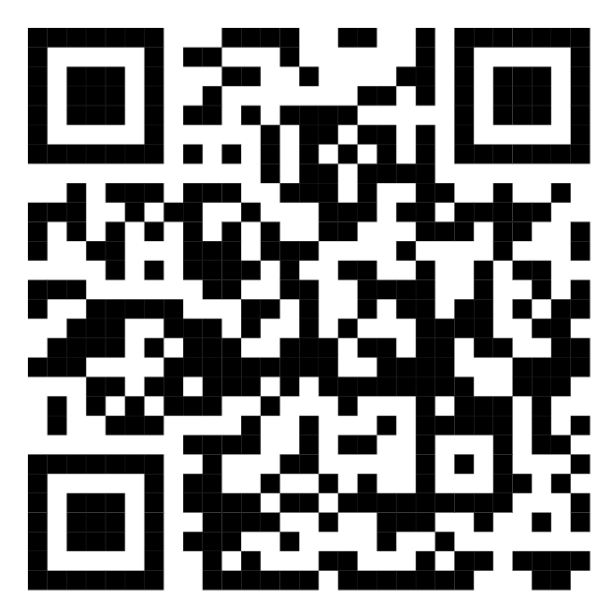

Registering With ODS
Scan to Register

Slide 7
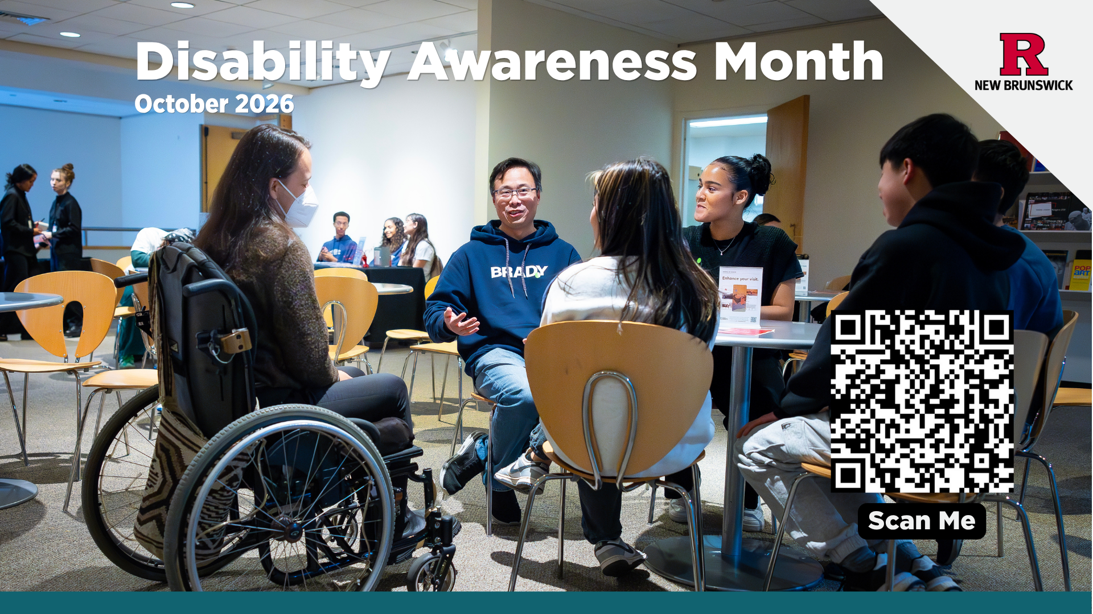
Disability Awareness Month NB October 2026

