Slide 1


OEE: An Overview
David Sparnroft
Senior Investigations Specialist
Office of Employment Equity
August 2026
Notes:
Thank you so much for that introduction. I’m one of two Investigations Specialists in the Office of Employment Equity. My goal today is to provide you with information about OEE’s policies and procedures so that you become familiar with the work that we do and when you should reach out to our office.

Slide 2

OFFICE OF EMPLOYMENT EQUITY
HUMAN RESOURCES
  OEE is a branch of Human Resources within University Human Resources.
  Office of Workplace Culture in Human Resources
OVERSEE UNIVERSITY POLICIES
  Among other things, conduct investigations into whether University employees are engaging in conduct that violates one of the four policies we oversee.
PROVIDE TRAINING
  Providing trainings within the University about various topics to help create a work environment that is free from harassment.
REQUEST SUPPORTIVE MEASURES
Notes:
The Office of Employment Equity (which we refer to as OEE) is a branch of Human resources within University Human resources. Our goal is to ensure an equitable and inclusive work environment across the university.
OEE falls under the umbrella of the Office of Workplace Culture, which is led by our fantastic Assistant Vice President, Caroline Dellatore. Our offices are housed in ASB II on the New Brunswick campus, if you ever need to find us in person.
We investigate complaints filed against employees working at Rutgers under the four polices that we administer.
We also provide training and education for the university on various topics.
OEE also provides Accommodations for faculty/staff, which my colleague Elizabeth Weber will be presenting on later today.
Finally, OEE provides support services, by offering resources and support to employees and students experiencing discrimination or harassment.

Slide 3
POLICIES
UNIVERSITY POLICY PROHIBITING WORKPLACE VIOLENCE
UNIVERSITY TITLE IX POLICY & GRIEVANCE PROCEDURE
UNIVERSITY POLICY PROHIBITING DISCRIMINATION & HARASSMENT
CONSCIENTIOUS EMPLOYEE PROTECTION POLICY
Prohibits intentional physical contact for the purpose of causing harm.
Applies to sexual harassment that is: quid pro quo harassment, severe, pervasive, and objectively offensive; sexual assault; stalking; domestic violence.
Prohibits discrimination & harassment based on membership in a protect class, eg: race, sex, disability status, sexual orientation, gender identity, national origin, military service, veteran status, etc.
Prohibits sexual harassment not covered by Title IX.
Prohibits retaliation for exposing or threatening to expose, objecting to, refusing to participate in, testifying, or providing information about, a practice that the employee reasonably believes in the violation of the law and public policy.
Investigate the retaliation, not the alleged illegal activities.
Prohibits menacing or threatening behavior, where such behavior would be interpreted by a reasonable person as being evidence of intent to cause physical harm.
Prohibits possession of a firearm.
Notes:
Here are the four policies that we oversee. I’ll briefly describe them here and go into more detail in future slides.
The first policy is the Policy Prohibiting Workplace Violence. It prohibits violent behavior, including intentional physical contact for the purpose of causing harm and menacing or threatening behavior that could be interpreted as evidence of intent to cause physical harm..
The second policy is the Policy Prohibiting Discrimination and harassment. This policy prohibits discrimination and harassment based on membership in a protected category, such as race, sex, disability, sexual orientation, gender identity, national origin, military, and veteran service.
The third policy is the Title IX policy, which prohibits sexual harassment and sexual misconduct meeting the definitions outlined in the federal Title IX regulations. This policy is applicable for instances of quid pro quo harassment (which means this for that, and describes a reciprocal arrangement), or conduct that is severe, pervasive, and objectively offensive, including sexual assault. The Title IX policy follows a different procedure than the other 3 policies that we administer because it is federally mandated.
The last policy is our Conscientious Employee Protection Policy, or CEPA – This policy protects whistleblowers from retaliation for reporting or objecting to illegal workplace activities, policies, and practices.
We do not investigate general hostile work environment claims.
Now I’ll get into a little more detail about each of the policies.

Slide 4

Covered Sexual Harassment under Title IX
Quid Pro Quo Harassment
Sexual relations are required in exchange for continued employment or benefits
Dating Violence
Violence committed by a person in a romantic relationship.
Severe AND Pervasive
Harassment that is severe, pervasive and objectively offensive.
Stalking
Sexual Assault
Repeated harassment or threatening behavior.
Sexual contact or behavior without explicit consent.
These types of sexual harassment are prohibited under Title IX.
Notes:
I explained that sometimes sexual harassment will be investigated under the Title IX policy. The types of sexual harassment that falls under Title IX are incidents of quid pro quo harassment, sexual assault, sexual harassment that is severe, pervasive, AND objectively offensive, dating violence, and stalking.
The Title IX process is mandated by the federal Title IX civil rights law that prohibits sex-based discrimination in any school or education program that receives federal funding.
In Title IX cases, OEE Investigators still investigate and issue reports, but the reports do not contain findings like the reports we issue in other policies. This is because Title IX cases require a hearing with a decision-maker who ultimately decides whether the conduct violates the Title IX policy.
Just to give you examples of what I’ve investigated under Title IX – one was allegation of an inappropriate touching in an OB/GYN office. Another was an allegation made against a swimming instructor who allegedly inappropriately touched a student during a lesson. Both of these examples involved allegations of inappropriate touching of an intimate body part.

Slide 5


Supervisor’s Duty to Report
University employees must report complaints of discrimination and/or harassment based on membership in a protected class, sexual harassment, and workplace violence to OEE
Employees must report details of prohibited conduct under TIX involving students to a TIX Coordinator
Any employee who receives a report of prohibited conduct under the TIX Policy involving a student is required to inform a TIX Coordinator
Administrators, supervisors/managers, and faculty have an affirmative obligation to immediately report such complaints to OEE
Supervisors have a duty to immediately report all details of complaints of prohibited conduct to OEE
Notes:
So what are your responsibilities as a supervisor, if you receive a complaint that may fall under one of the policies we administer?
Supervisors have an affirmative obligation to immediately report any complaints of prohibited conduct to OEE. Explain what they can tell an employee

Slide 6




Ways to Avoid Workplace Harassment
Respect others
Be professional
Communicate issues
Proceed with caution
Avoid inappropriate remarks or actions towards coworkers based on gender, ethnicity, religion, etc.
Maintain professional language and refrain from gossip or negativity.
If conflicts arise, address them appropriately through proper channels.
Be careful about asking coworkers out on dates.
By being mindful of our words and actions, we can create a welcoming environment where everyone feels valued.
Notes:
I’ve got a few points listed on this slide, but the number one recommendation I have for people is to think before you speak!

Slide 7

Office of Employment Equity Complaint Process
Fill out fillable PDF complaint form and submit via email, fax or mail
Staff contacts complainant for intake call to provide complaint process details and gather additional information
Director reviews complaint to determine if appropriate for investigation
If appropriate, complaint is assigned to investigator and issued to parties and respondent's supervisor
File complaint
Intake call
Review complaint
Issue complaint
Conduct investigation
Issue report
Determine discipline
Investigator interviews parties and witnesses, reviews evidence to determine if policy violated
Investigator drafts report on findings, copies provided to parties and respondent's supervisor
Disciplinary action up to respondent's department
Notes:
The first step for a complainant is to complete a complaint form, which is available on our website. Once a formal complaint is filed, a staff member will conduct an intake with the complainant and gather additional information about the issue. OEE’s Director will then review the complaint and determine whether it is appropriate to be issued for investigation. If the complaint is issued, it’s assigned to myself or one of the two other investigators in our office. The complaint is sent to the complainant, respondent, and the respondent’s highest-level supervisor. We will conduct an investigation, which includes interviewing the parties and witnesses, and gathering evidence. We will prepare a report of our findings, which is issued by our director. The report is confidential and only shared with the Complainant, Respondent, and Respondent’s highest-level supervisor.
The process typically takes up to 60 working days.
Witnesses often reach out to ask for a copy of the report, which will not be provided to them.
If a finding is made, discipline is determined by another department.

Slide 8

Examples of Supportive Measures
Supportive measures are available with or without the filing of a formal complaint.
Examples of supportive measures include:
Counseling
Deadline extensions
Modification of work or class schedules
Tutoring
Campus escort services
No Contact Order
Change in work or housing location
Increased security on campus
Administrative leave with pay*
*Only UHR may place an employee on administrative leave with pay pending the outcome of an investigation

Slide 9



Confidentiality Policy
Need-to-know basis
Limited awareness
Informed witnesses
Only complainant, respondent, and highest-level supervisor know about the complaint initially
More immediate supervisors may be made aware on a need-to-know basis
Witnesses are given enough information to participate in the investigation intelligently
Confidentiality is maintained on a need-to-know basis to facilitate investigation while protecting privacy.
Notes:
I explained most of this information already – this process is confidential to the extent that it can be, and witnesses are on a need-to-know basis.

Slide 10



Retaliation
No retaliation
Participation protection
Informed witnesses
OEE policies prohibit retaliation against individuals who report complaints in good faith.
OEE policies prohibit retaliation against individuals who participant or refuse to participant in investigations.
OEE policies prohibit retaliation against individuals who protest alleged prohibited conduct.
OEE policies strictly prohibit retaliation for exercising rights under the policies.
Notes:
Our polices prohibit retaliation for reporting or participating in an OEE investigation. We will investigate complaints of retaliation.

Slide 11
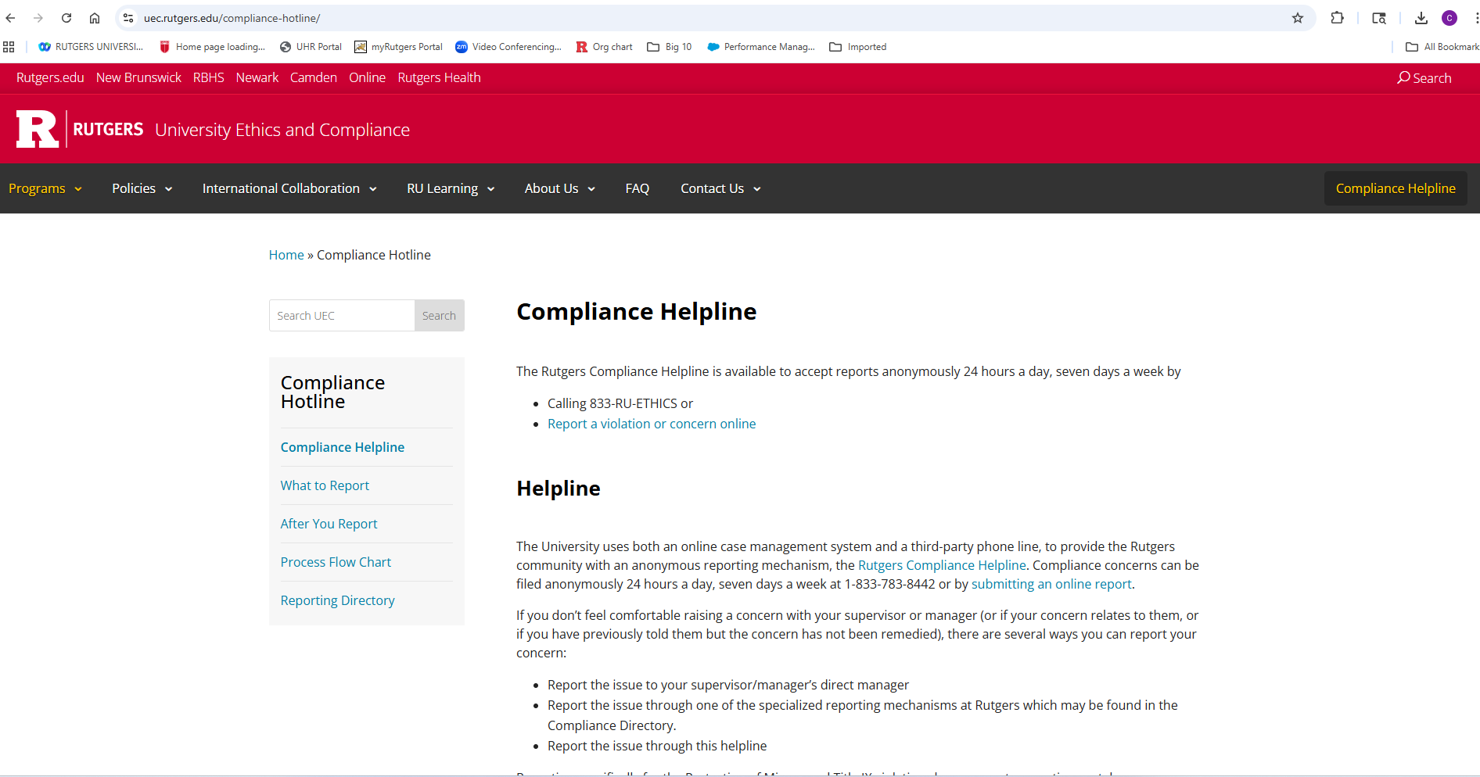
Making a Report
Contact OEE directly:
  employmentequity@hr.Rutgers.edu
The Helpline
  This is the most convenient reporting mechanism
  uec.Rutgers.edu/compliance-hotline
    OR Google “Rutgers Helpline”

Slide 12
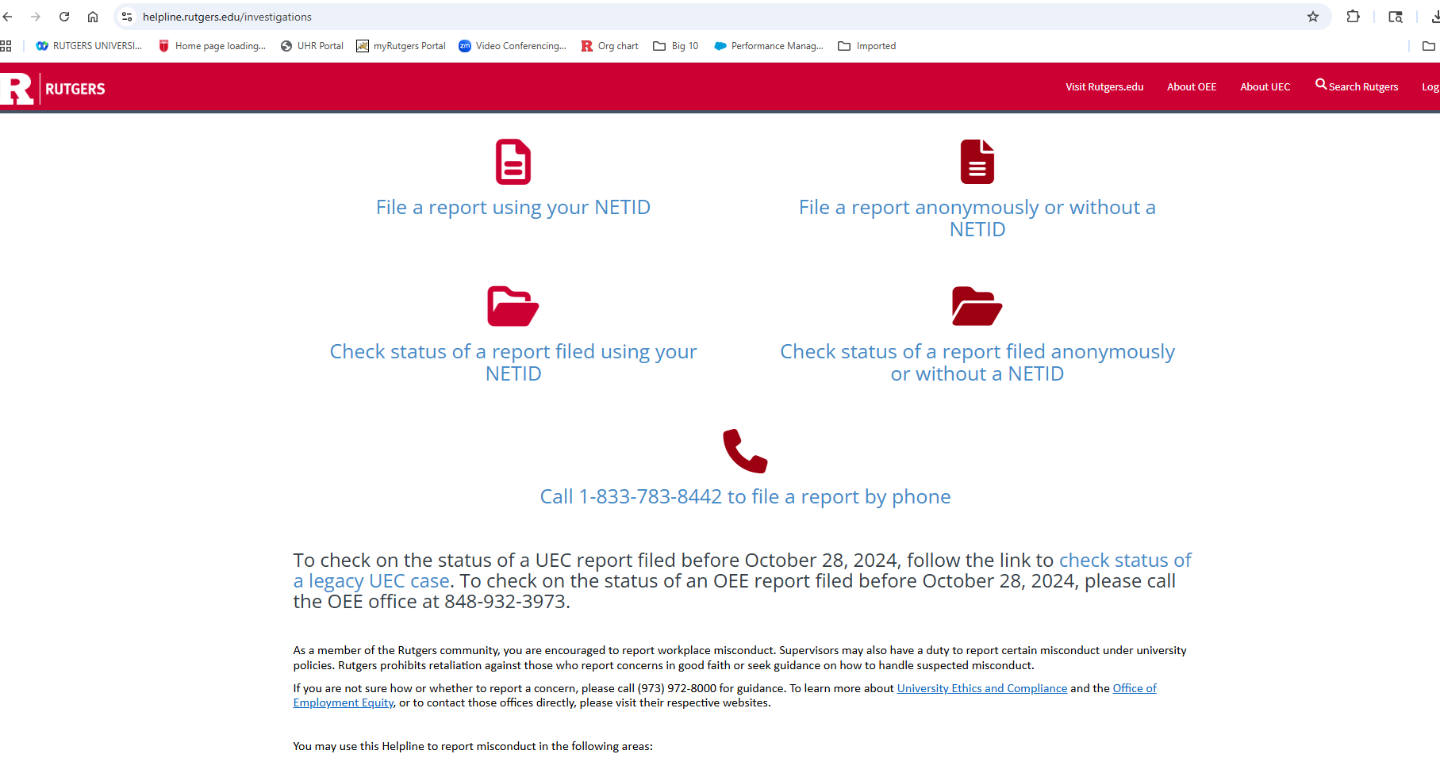
Helpline Cont.

Slide 13
Recommended resources
Office of Employment Equity
Employee Assistance Program
Hostile Work Environment issues
Based on membership in protected class
Severe/pervasive
Sexual harassment
Department administrator
Union
University Ethics and Compliance
Lyra Health
Workplace violence
Employee Partners for Conflict Transformation (EMPACT) – if not aligned
877-390-6766
6 FREE sessions for employees and their family members
Rutgers.lyrahealth.com
Notes:
This is a list of recommended resources and when you can utilize them. I’ve explained a lot about OEE and what we investigate. There is also the Employee Assistance Program, which is a confidential resource available to all employees. Hostile work environment claims can be brought to a department administrator, union, EMPACT, or University Ethics and Compliance.
EMPACT is a newer program under the Office of Workplace Culture, and it’s designed to assist non-aligned employees with conflict management. I recommend you check out their page when you have a minute.

Slide 14

CONTACT US
1
57 US Highway 1, Cook Campus (ASB II)
848-932-3973
2
employmentequity@hr.rutgers.edu
https://uhr.rutgers.edu/oee/home
3
Melissa Ercolano, Director, OEE
me501@hr.Rutgers.edu
Notes:
Here’s some contact information for you.
I’ve reached the end of my presentation, but I’m happy to answer any questions you might have.

