Slide 1
Parking and Transportation Services
John Karakoglou – Director of Transportation Services
Domenick Rizzo – Assistant Director of Transportation Services
Rolando Feliz - Director of Parking Operations
Magen Davies – Manager of Community Engagement

Slide 2
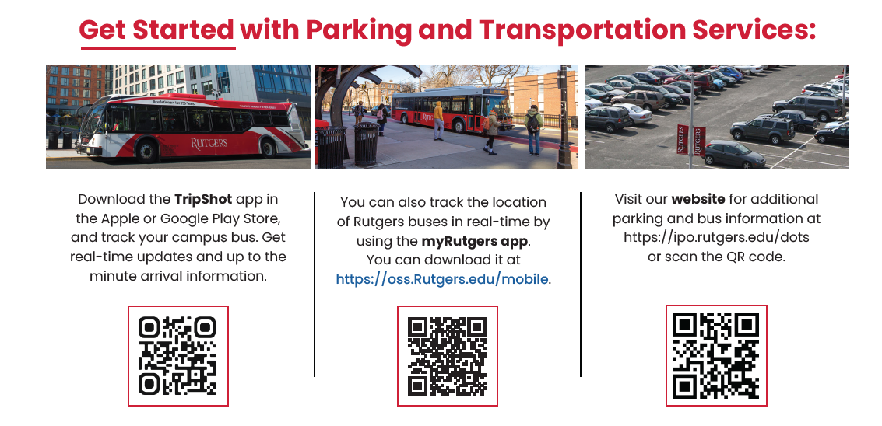

Slide 3
