Slide 1
VPVA Services
Counseling
Prevention
Education
Awareness
Campaigns
Advocacy

Slide 2
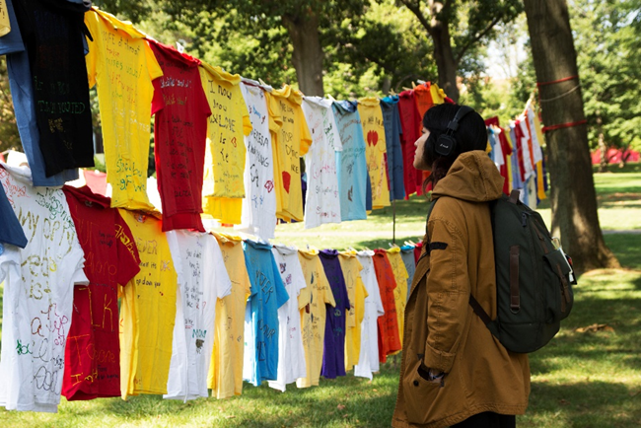
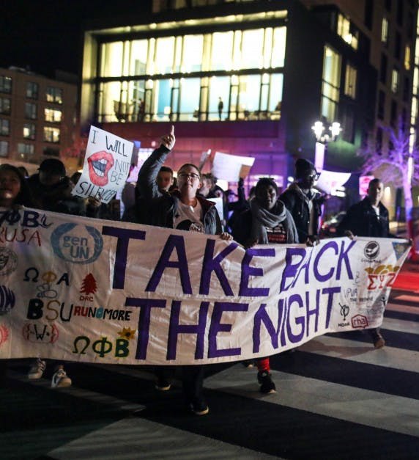
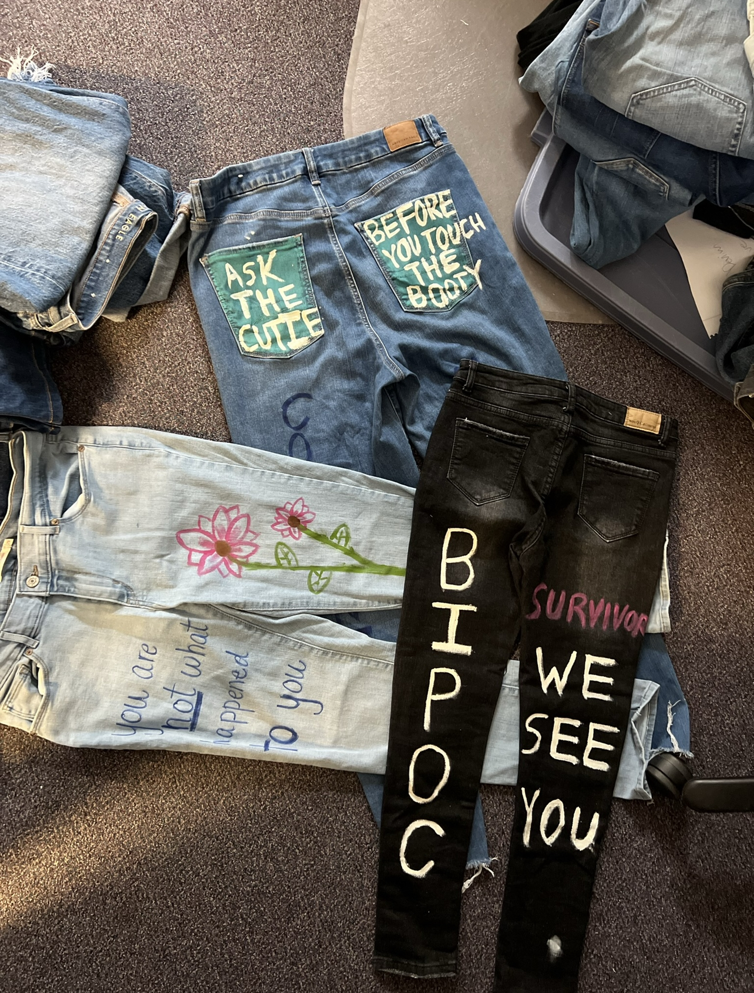
Awareness Programs
Clothesline Project
Take Back The Night
Denim Day

Slide 3
Advocacy
  Legal Advocacy
    Restraining orders, accompaniment to RUPD, etc.
    Can’t give legal advice, but we can provide referrals and general psycho-ed on legal processes
  Academic Advocacy
    Emailing professors for accommodations
    Working with ODS to help secure long term academic accommodations
  University Advocacy
    Title IX, RUPD, Dean of Students, Student Conduct, etc.
  Medical Advocacy
    Coordinate forensic medical exams or work with Student Health Services for medical STI, pregnancy or other medical needs
  Mental Health Advocacy
    Consult or refer to mental health resources based on individual need
24/7 Hotline | 848-932-1181

Slide 4
Become a VPVA Advocate!
What is an Advocate?
Confidential Crisis Response Advocates include trained volunteers (students, faculty and staff)
They receive a state mandated 60-hour training to respond to survivors of interpersonal violence. Their role is to:
  Provide crisis intervention and emotional support to victims/survivors
  Provide information about rights, options, and referrals available
  To support whatever decision a survivor makes - we do not give advice
  To accompany (physically and emotionally) the survivor as they move through systems
Apply at VPVA.rutgers.edu
24/7 Hotline | 848-932-1181

Slide 5
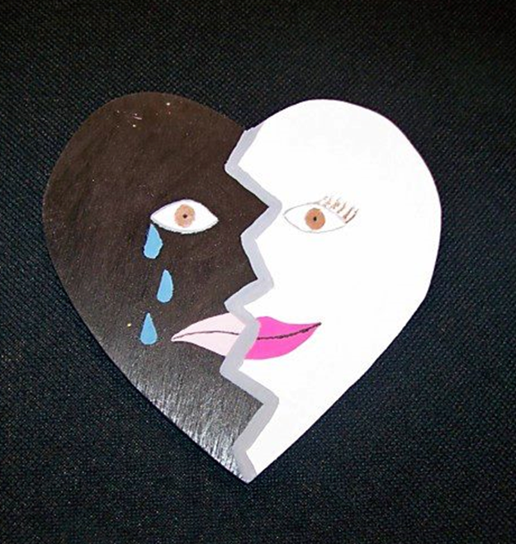
Counseling
  Confidential and Free (no need for insurance)
  Work with ALL victims of trauma and crime
  Trauma doesn’t have to be while at Rutgers
  Focus on sexual violence, dating/family violence, stalking and harassment
  In-Person and virtual
  Trauma-informed counseling modalities
  Secondary Survivors
Healing the Wounded Heart Exhibit

Slide 6
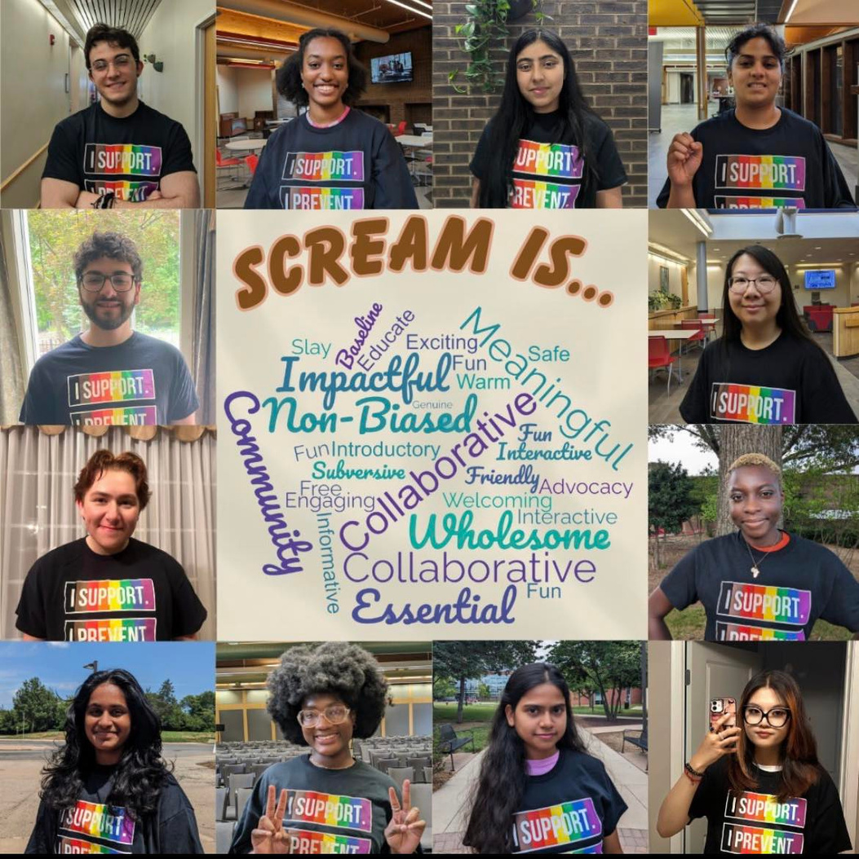
Prevention Education
  SCREAM Theater
  Bystander Intervention Trainings
  Healthy Masculinity
  Identity and Oppression
  Sexy and Mandatory
  Rutgers CARES

Slide 7

Connect with us :)
VPVA
3 Bartlett Street
College Ave Campus
(around the corner from CASC and Panera)
848-932-1181 (24/7 hotline)
IG @rupvpva @ruscreamtheater
Looking Ahead!
September 24th 2026 | Clothesline Project | Voorhees Mall | College Ave
September 29th 2026 | VPVA Open House
October 2026 | Turn The Campus Purple
--Smash the Pumpkin/Patriarchy
-- SCREAM Theater
-- Survivor Support Squad

