Slide 1
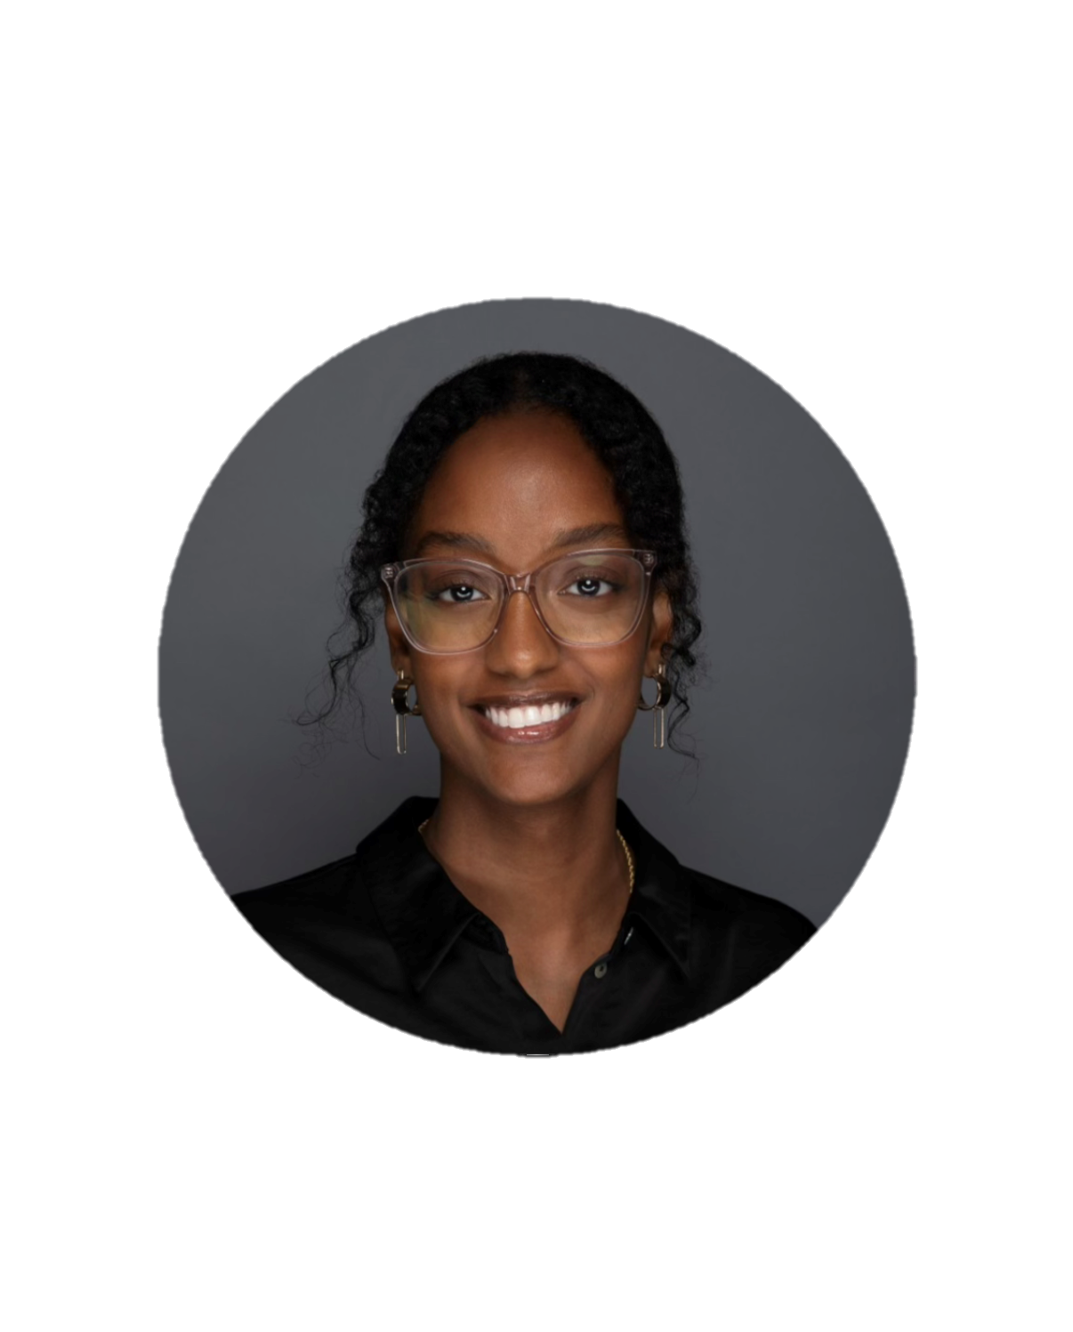
ABOUT ME
Beza Indashaw
BI
THE WORK I DO
HR Business Partner
Global Education & HEMA
DePuy Synthes
I partner with leaders in global commercial education and health economics & market access to build the teams, skills, and culture they need to bring orthopedic innovations to patients. Ask me about how teams find or grow scientific talent.
CONTACT
BIndasha@its.jnj.com
MY CAREER JOURNEY
Education
2019–2021: HR Leadership Development Program
2022-2025
Now
Quinnipiac University
B.S. Health Science Studies (Pre-Med, Biochemistry)
People Experience Operations , Global Services
Training and Squad Development Leader, HR Intelligent Automation
Project Leader, Strategic Partnerships, Global Talent Management
HR Business Partner, Innovative Medicine R&D
HR Business Partner, Education & HEMA, DePuy Synthes

Slide 2
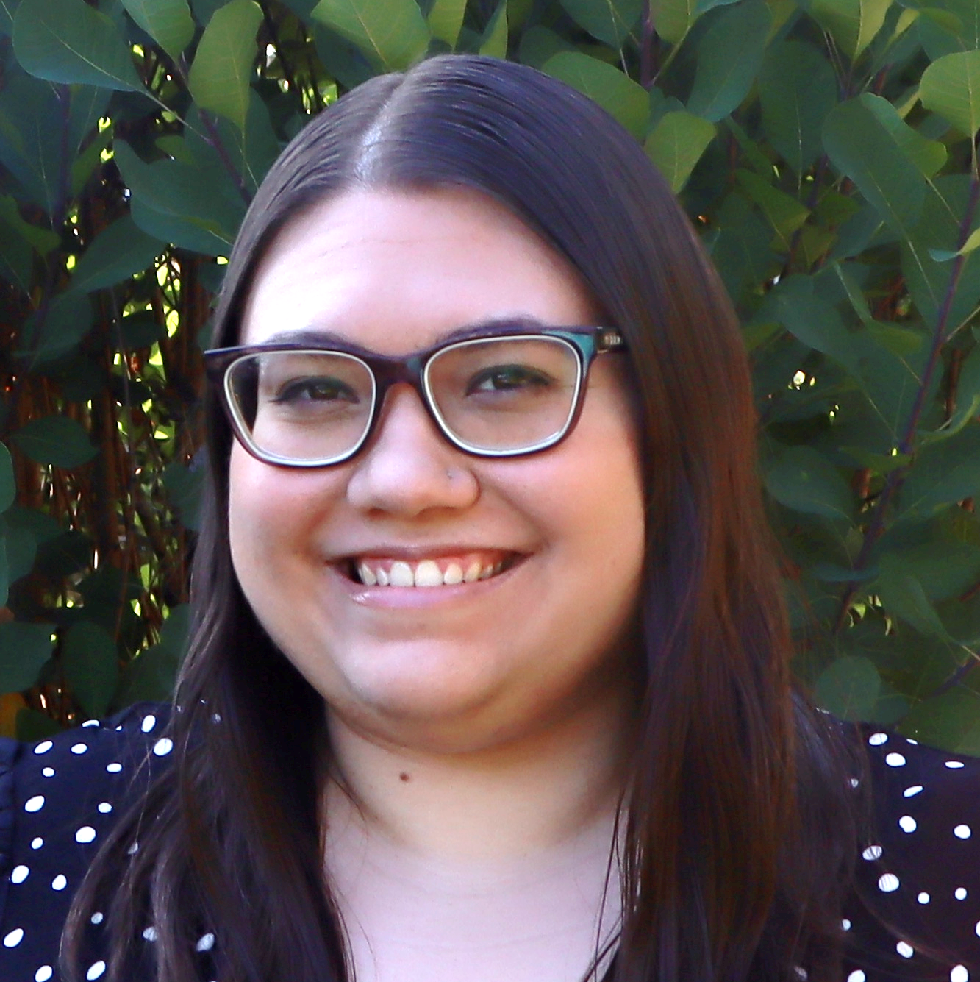

Biology, B.S. and M.S., 2014
Rensselaer Polytechnic Institute (RPI)
Troy, NY
Actalent (Contract),
2022- 2025
Providing services for
J&J MedTech – Surgery
Somerville/Raritan, NJ
Microbial Biology, Ph.D., 2022
Häggblom Lab
Rutgers–New Brunswick
New Brunswick, NJ
Michelle Zeliph, Ph.D.
Senior Scientist, R&D Microbiology🧫
https://www.linkedin.com/in/
michelle-zeliph
Johnson & Johnson MedTech – Surgery
2025 - Present
Raritan, NJ
Role Summary: Partner across MedTech to advance device development
using a customized approach to design, optimize, validate, and execute
proof of antimicrobial/antibacterial efficacy methods for products

Slide 3
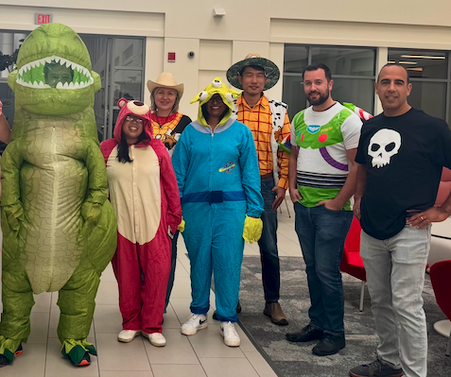
This is me!
Chang Zhang, PhD
Background
PhD from the University of Minnesota – Twin Cities (2014 - 2019)
Internship at Seagate, Twist-East, BCBS, Insight (2018 - 2019)
Data Scientist/Manager at J&J (2020 - 2025)
Business Product Manager at J&J (2025 - now)
Current Role
I connect Medical Affairs and technology teams to build AI tools for discovering, creating, and generating insights from scientific information and medical content.
Identify business problems that digital tools and AI can help solve
Translate business needs into requirements for technology teams
Continuously improve digital products after launch

Slide 4
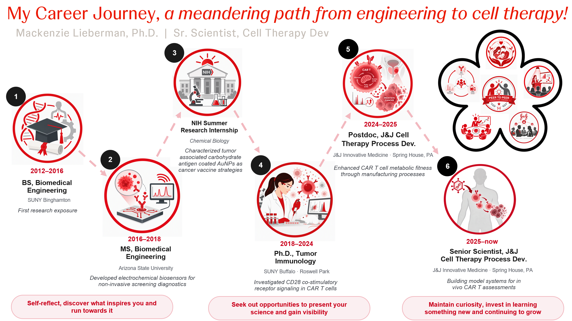

Slide 5
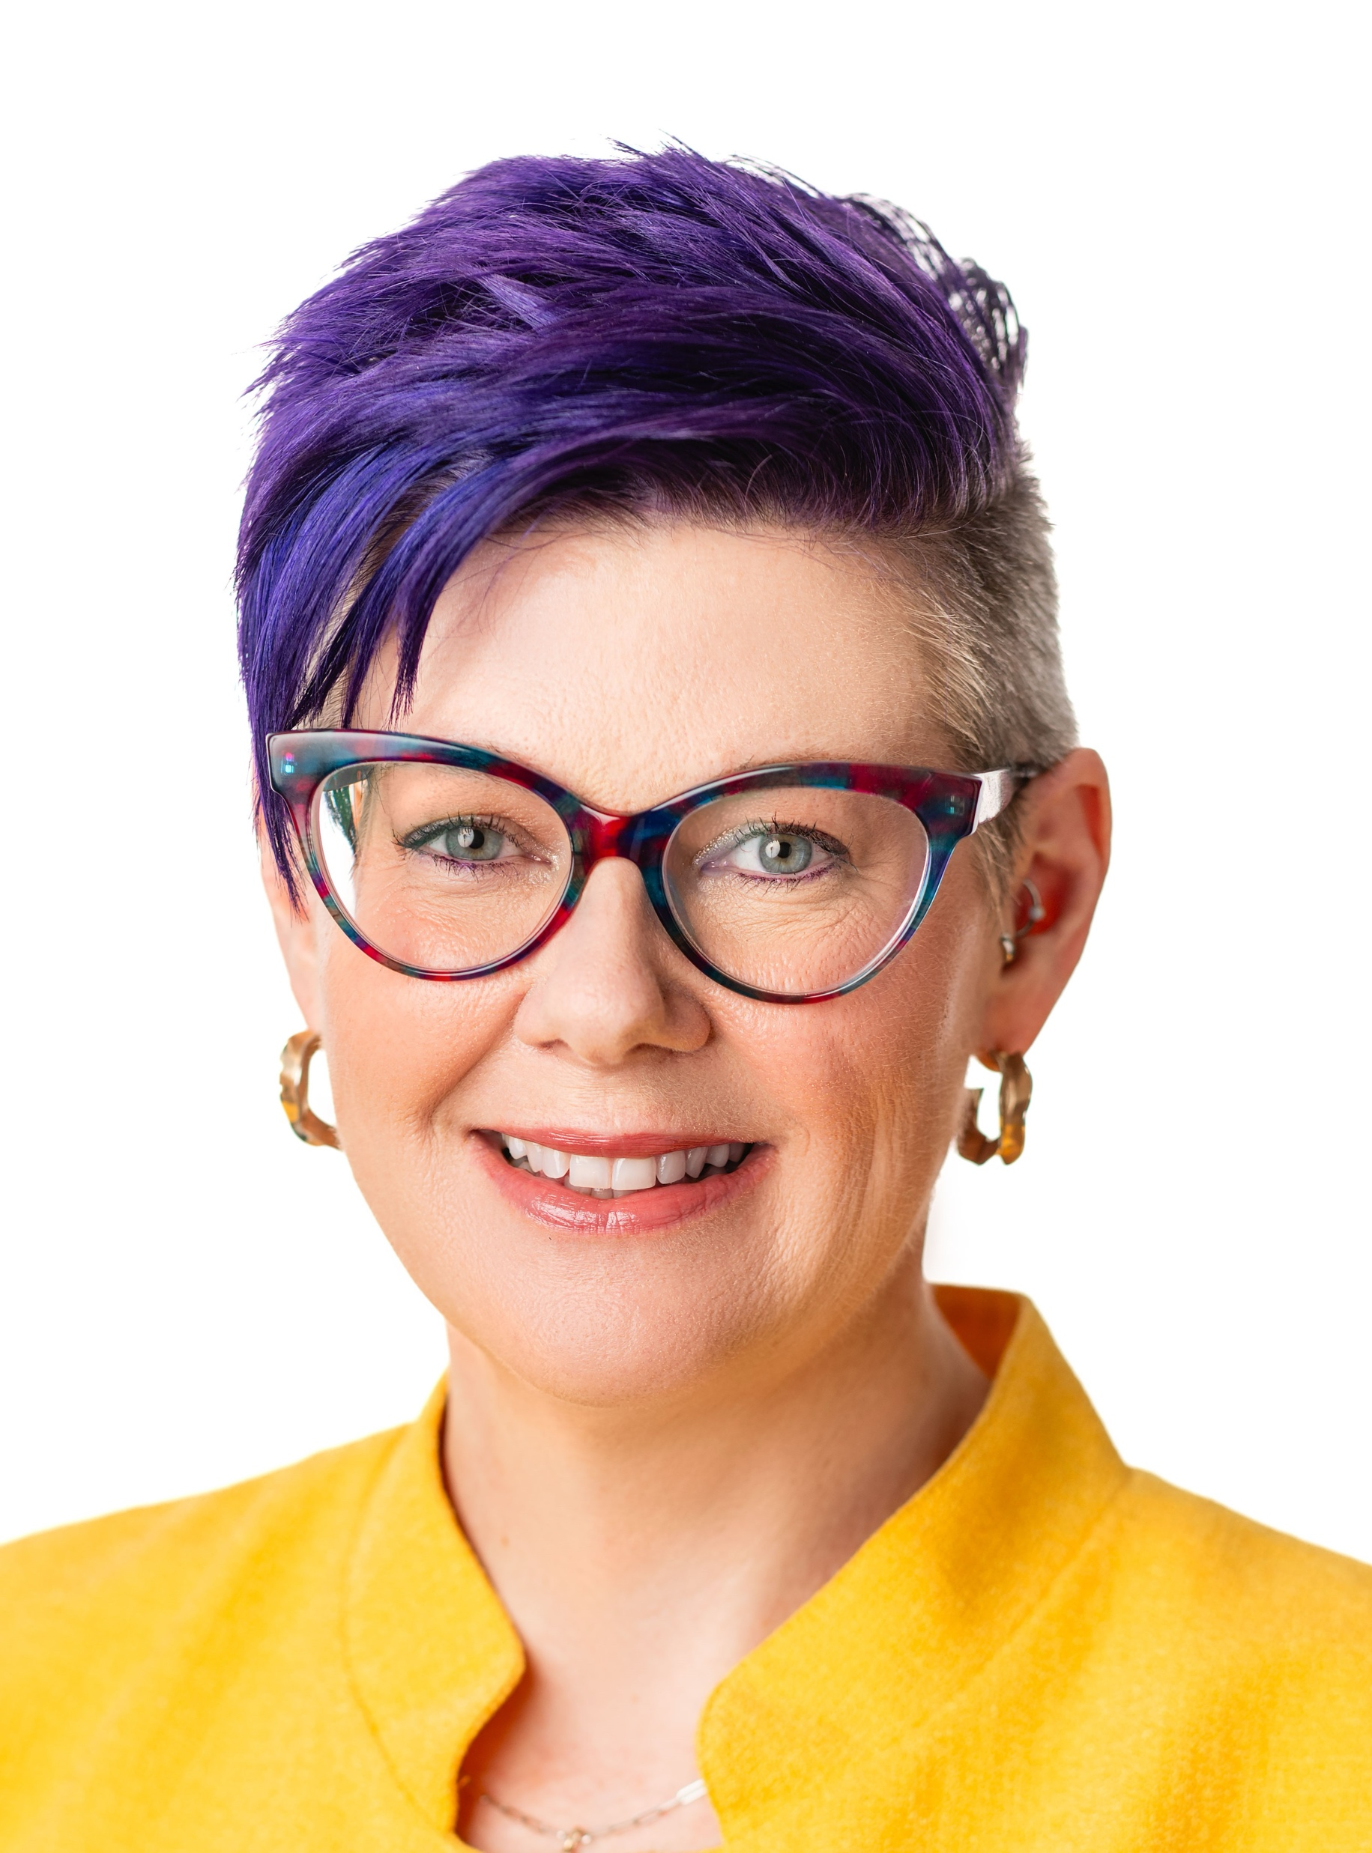







Andrea Stevens
PhD-trained scientist turned healthcare strategist, building the pathways that connect breakthrough science to patients
Senior Director, Precision Medicine Access & Policy
PhD, Transplantation Immunobiology
Research Scientist
Senior Clinical Scientist
Director, Value & Access
Andrea has built a career at the intersection of science, business, and healthcare innovation, working across diagnostics, evidence generation, market access, and commercial strategy to help ensure scientific discoveries reach the patients who can benefit from them. Her experience highlights the diverse career paths available to scientists outside of academia.

Slide 6
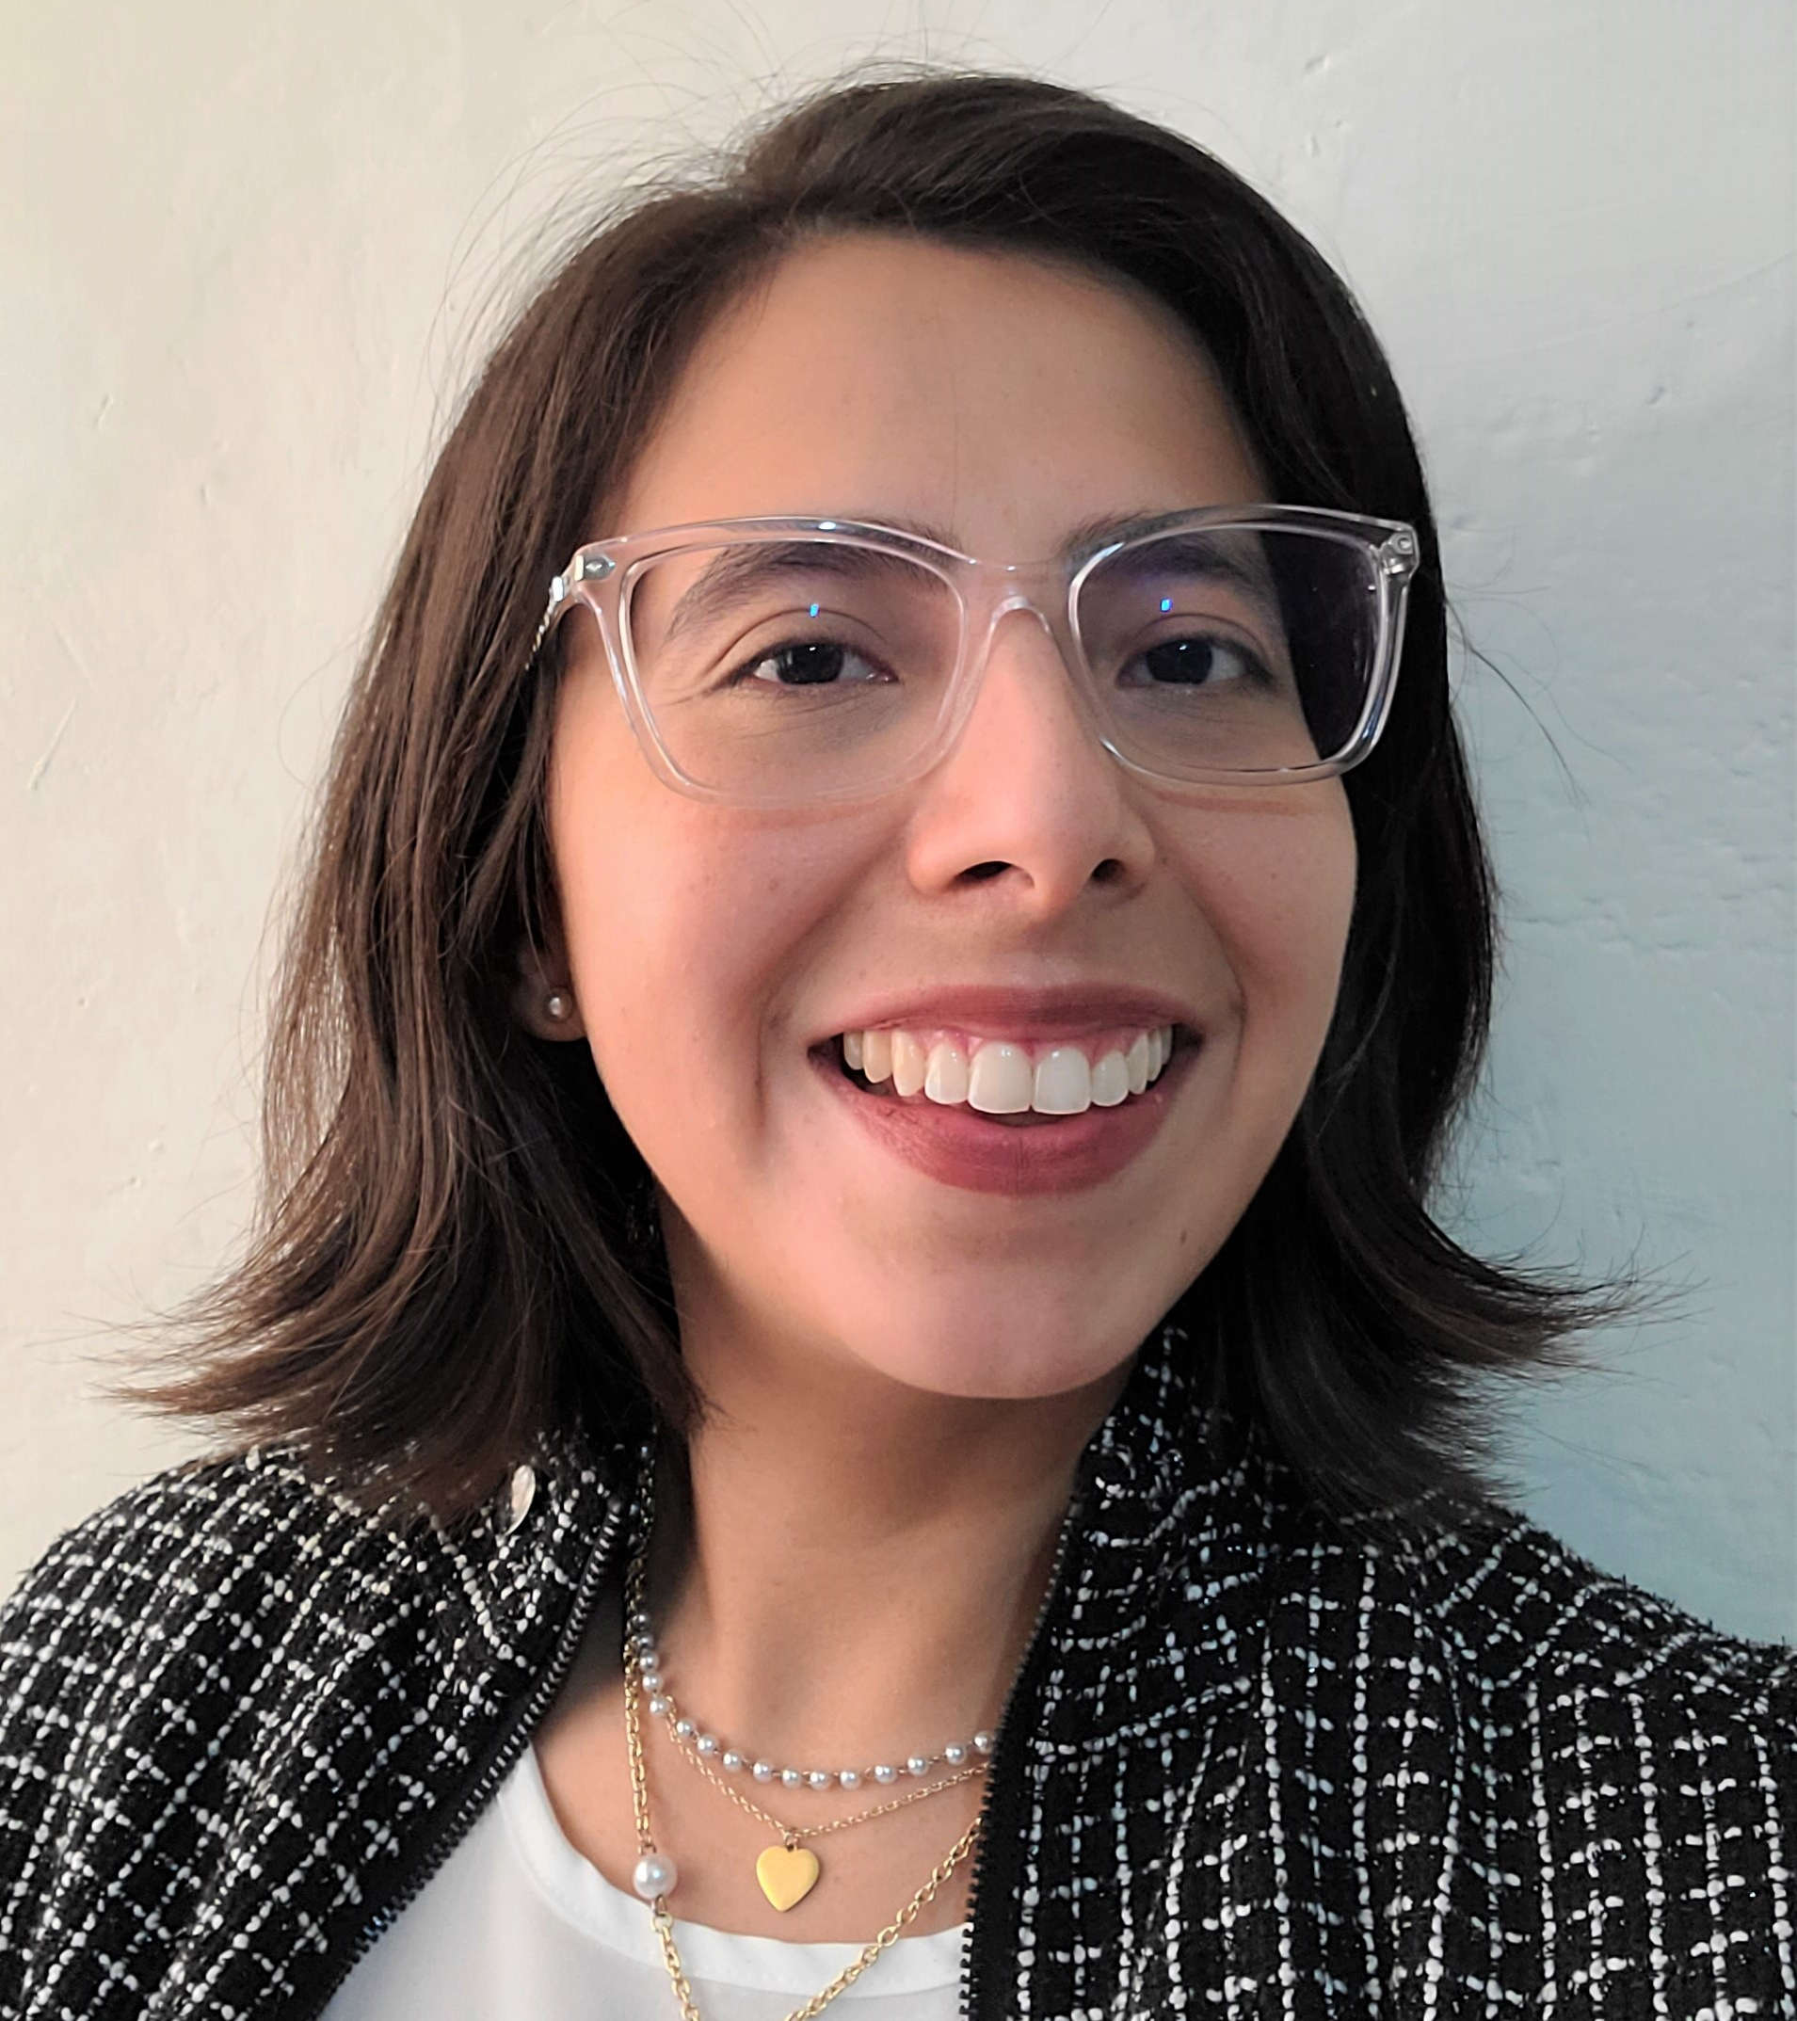
Carolina Bobadilla Mendez, PhD
Principal Scientist, Translational Science
Immunology Therapeutic Area
Carolina contributes to biomarker translational strategic planning by researching and understanding relevant target/disease biology. She oversees the design and execution of translational science and biomarker plans for clinical trials integrating both disease and pathway approaches to support IMM TA portfolio programs.
Carolina obtained a PhD degree in Biomedical Engineering from Rutgers University 2022. Prior to obtaining her PhD, she also was a summer intern at Johnson and Johnson where she focused on data analysis to evaluate platforms to identify biomarkers for clinical trials.
As part of the Hispanic and Latino (HOLA) employee resource group, Carolina has helped organize events to celebrate a culture of diversity within Johnson and Johnson.

Slide 7
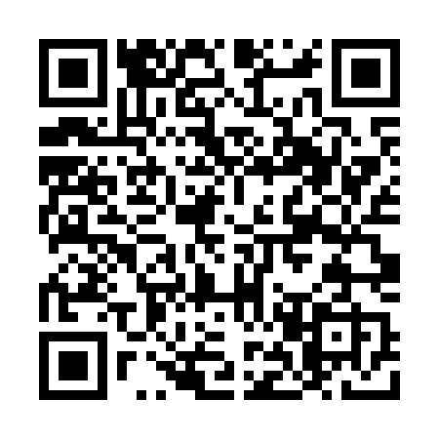
Yoliem Miranda Alarcón, PhD
Senior Scientist II, Drug Product Development-Proteins
Happy to connect on LinkedIn if you have any question!
Professional
Extracurricular Activities
Fill/finish manufacturing of Monoclonal Antibodies and Antibody-Drug Conjugates (ADCs)
Spray drying & drug-delivery devices
Ultra high concentration-drug delivery
SMDP Alumni
HOLA SLT Talent Pillar Lead
MBA at Villanova University; concentration in Strategic Management
- Process Development
- Tech-transfer lead
Academic Training
Ph.D. in Biomedical Engineering – Rutgers University, NJ
Thesis foci- tissue engineering and biomaterials
Internship: Finance in Biotech Hedge fund
Co-op: GSK in pharmacokinetics & pharmacodynamics
Drug Product Development
B.S in Chemistry– Fordham University, NY
Background
Hometown– Hatillo, PR
Maternal family from Bogotá, Colombia
Grew up around a dairy farm
FFA & 4-H Club active member/ dairy farm state competition
Committed in increasing in DE&I in STEM through academic and professional organizations: SACNAS, HOLA, SMDP, and other organizations
Some pearls of wisdom I can share from my on my career path include:
Seek mentorship from professionals you have an interest in their career path.
Develop a diverse skill set (not only technical, but also people skills, writing, public speaking, etc.).
Seek leadership and mentoring opportunities. Stay involved in professional organizations.
Embrace interdisciplinary work and continuous learning.
Be humble (but confident), respectful, and have a thirst for knowledge.

Slide 8
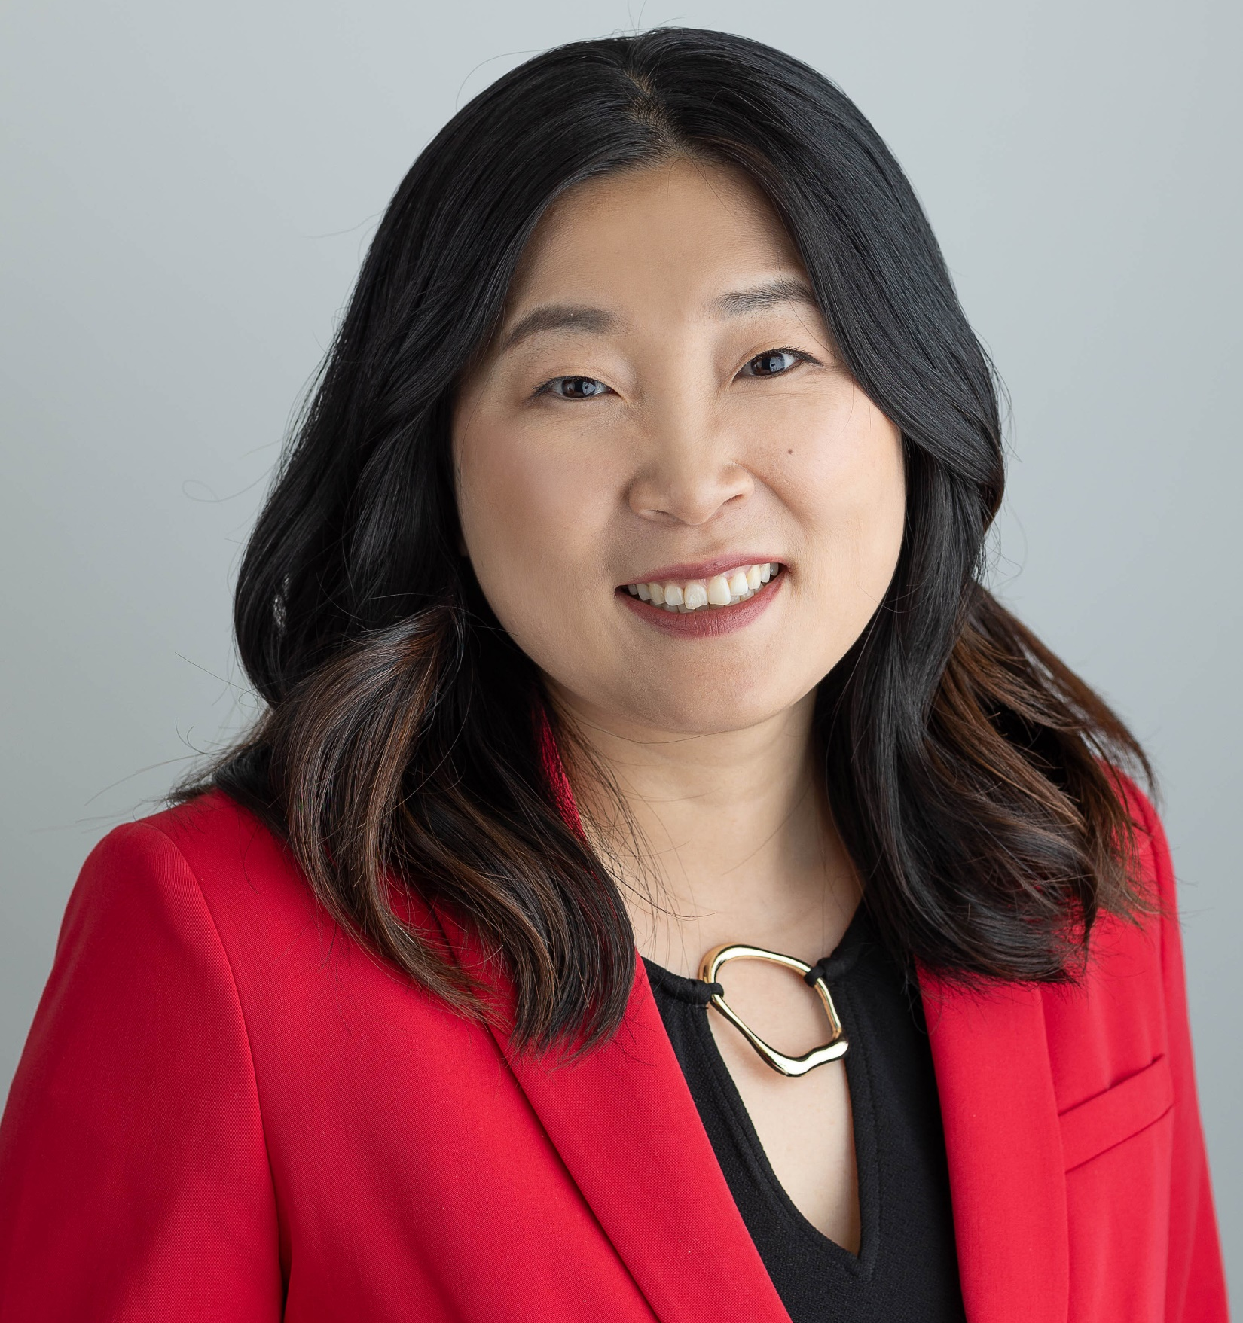


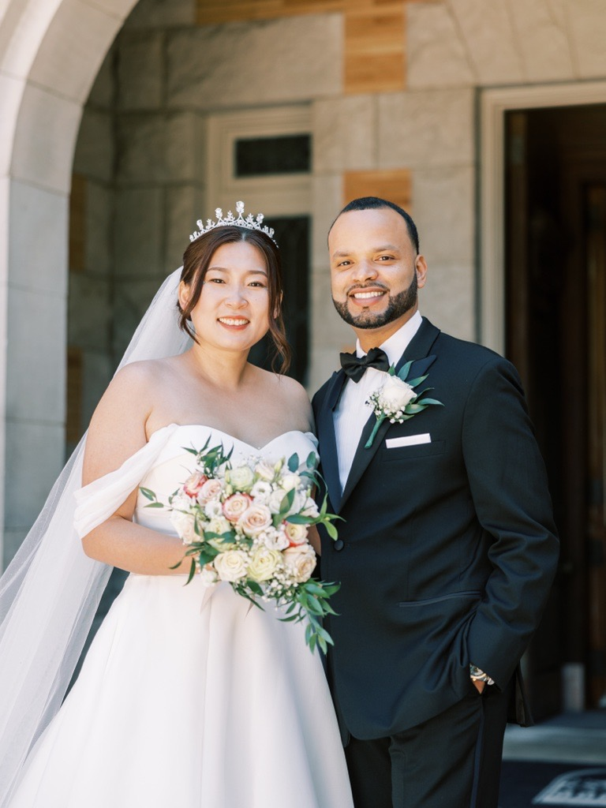
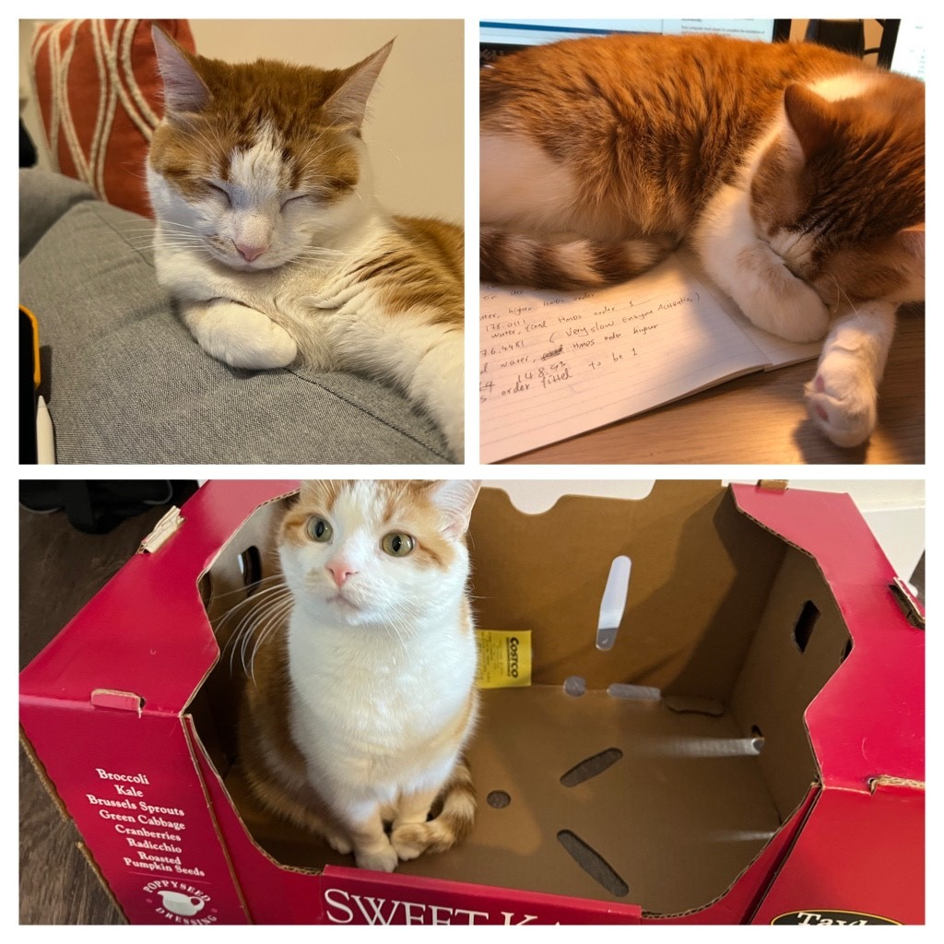

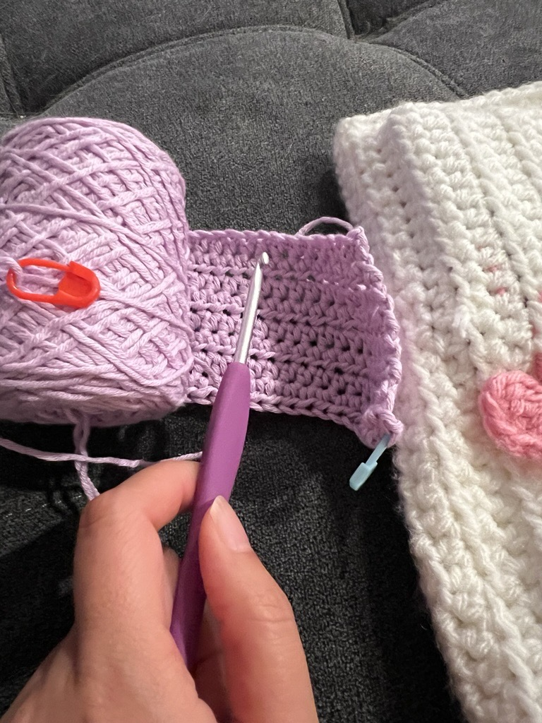
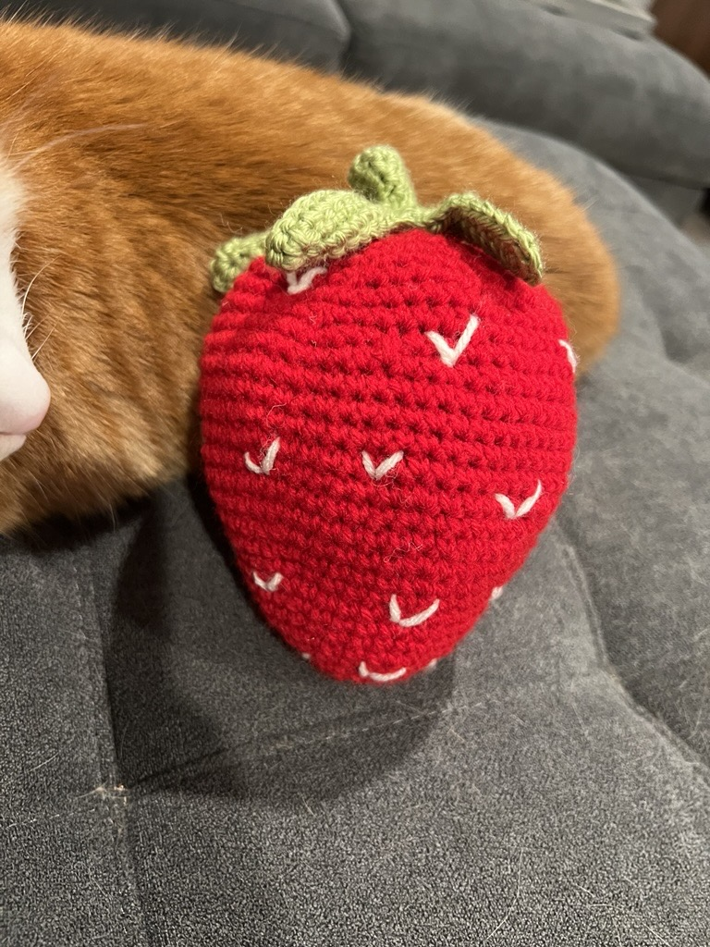
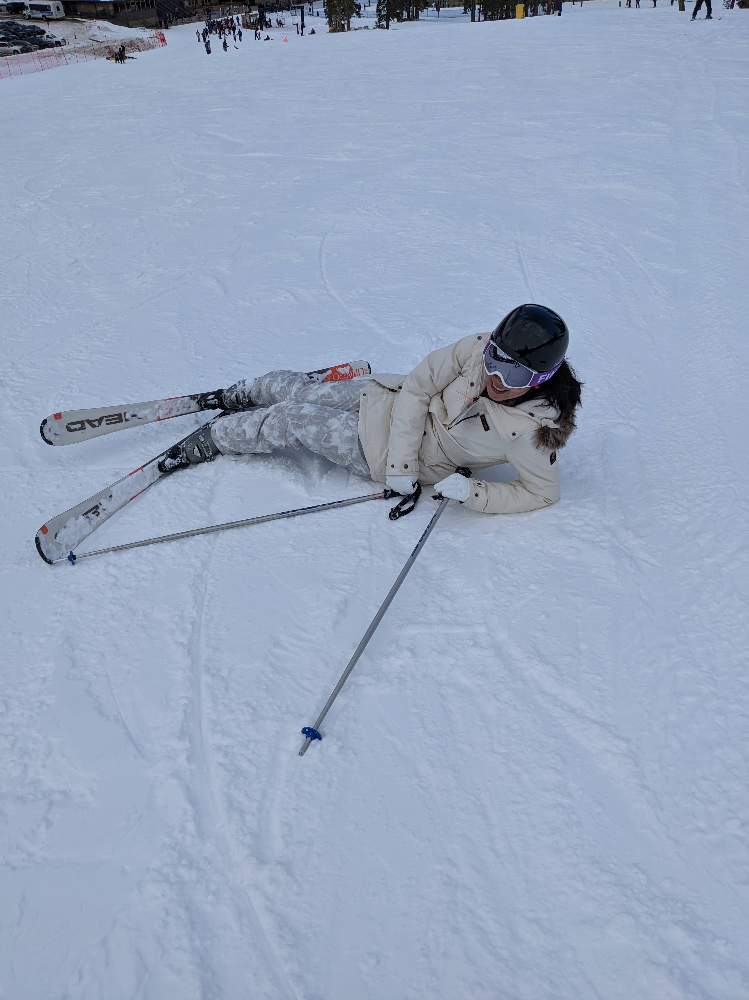
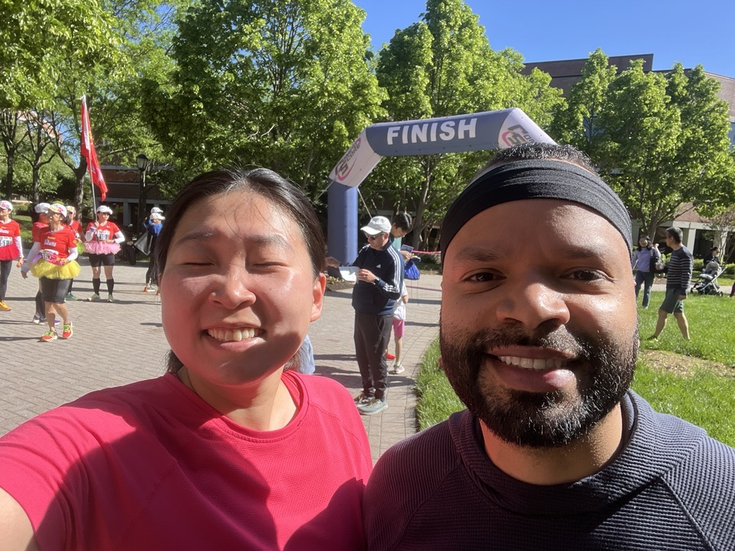



Professional
Skills
Modeling & analytics
Expertise in first-principles & predictive modelling
gPROMS, SIMCA
Process science
Strong knowledge biologics & small molecule manufacturing processes
Process monitoring and control
Personal Statement
As a passionate engineer, my mission is to bring science to life through a rigorous problem-solving mindset and clear communications – turning complex challenges into impactful solutions for patients. Firm believer of lifelong learning.
Data & digital
Data science modeling
Visualization and dashboarding
Technical leadership
Mentor scientists & interns
Lead investigations across
Manufacturing & Quality
Work
Claire Y. Liu
Visiting Scholar, 2018
Research assignment
Exposure to regulatory environment
Principal Scientist
Personal
Engineer, 2019 - 2022
Research and development of synthetic drugs
Excelled at lightening speed portfolio project such as Paxlovid
Family
Information
New Jersey, USA
Lead, Innovative Medicine Supply Chain, 2022 - 2024
Mathematical and data modeling for manufacturing science and technology
Principal Scientist, 2024 – now
Manufacturing process monitoring optimization and control
Investigation support via data
People managing & stakeholder management
yliu408@its.jnj.com
LinkedIn Profile Link
Fun
Education
B.s. and Ph.D. in Chemical Engineering
B.s. in Mathematics
Notes:
[Sources]
User-provided CV: resume_YCL_Modeling_Data_Technical_Leadership.docx (file_d6f315bf), Skills, Work History and Leadership sections. Skills reflect first-principles and predictive modeling, gPROMS/SIMCA experience, Python/MATLAB experience, working knowledge of SQL/Databricks, closed-loop process control, and mentoring and cross-functional investigations.
[/Sources]

