Slide 1
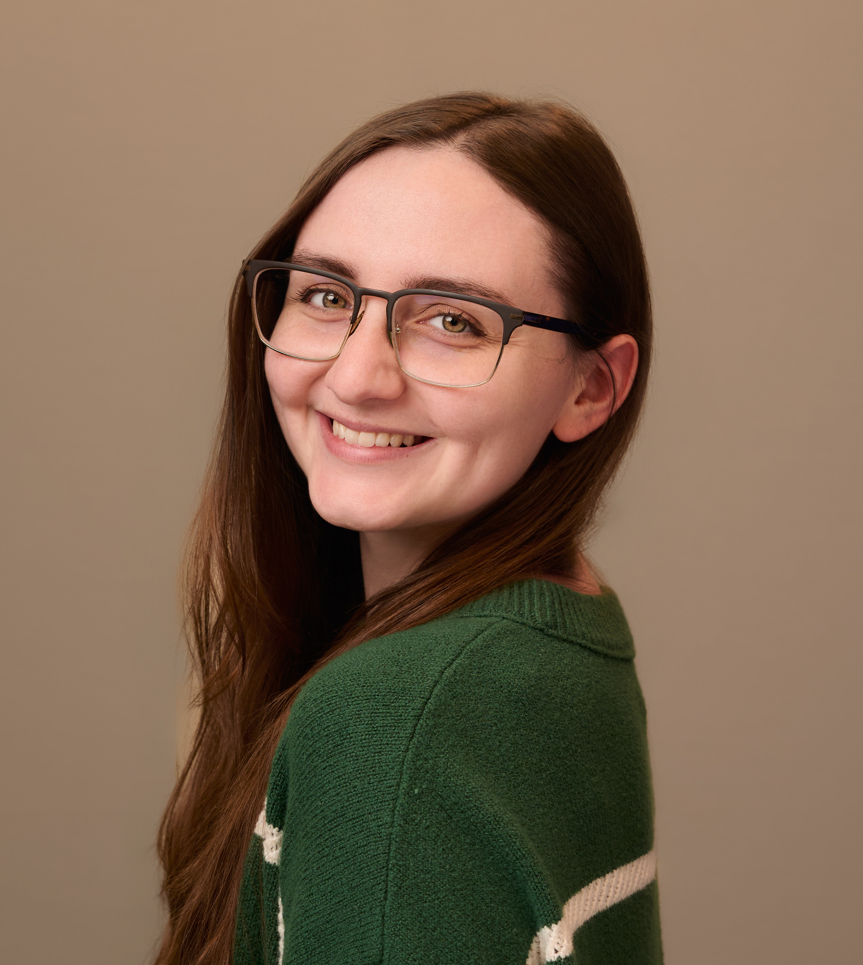
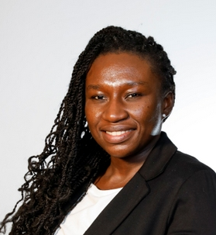
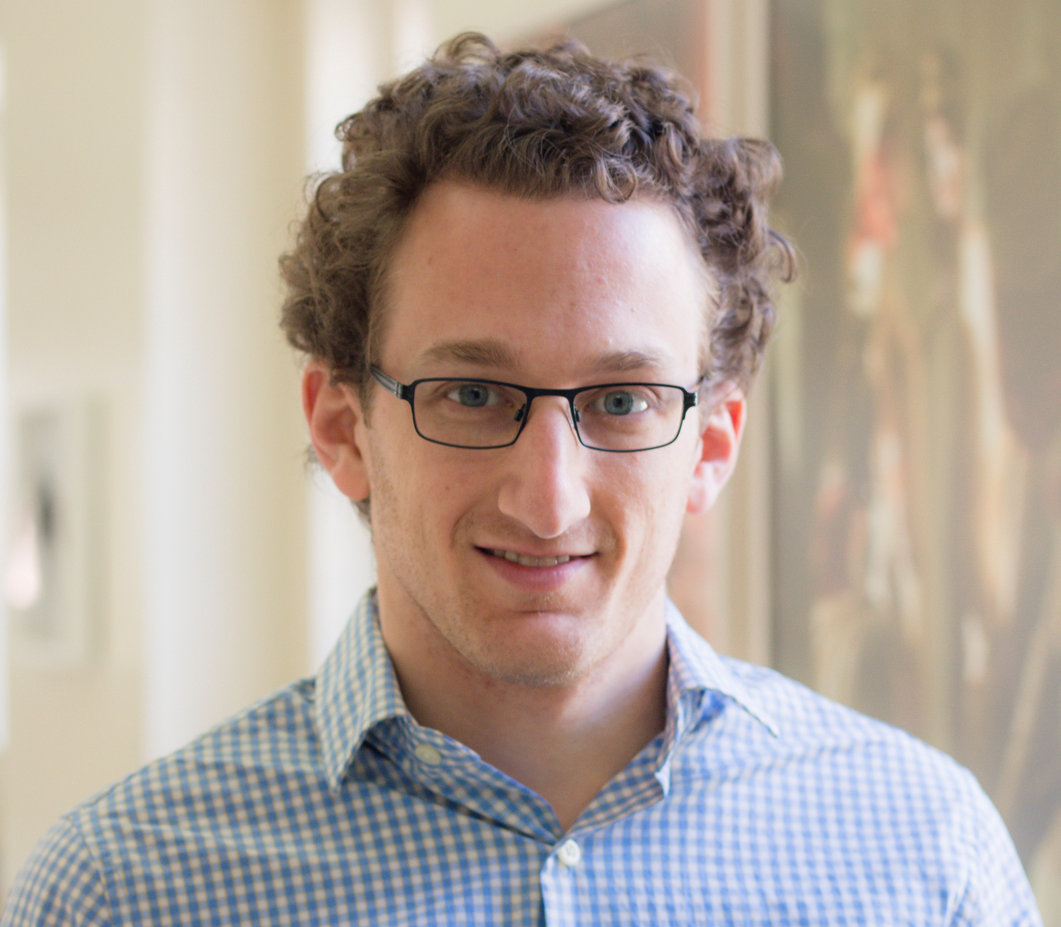
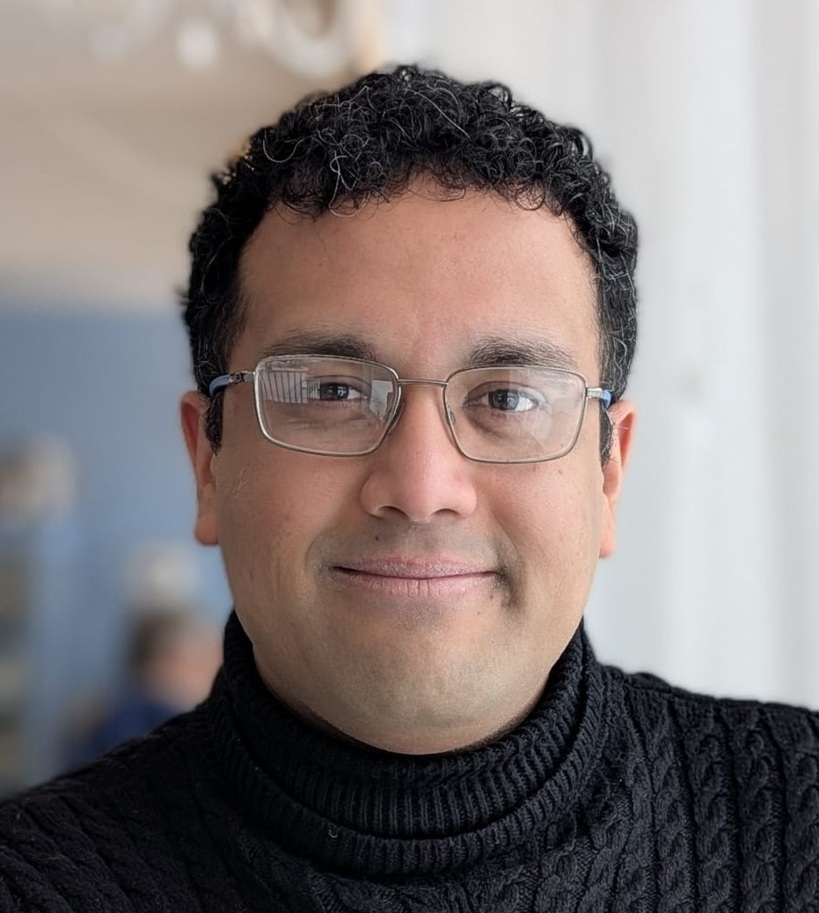
Meet Our Panelists
Agency
Pharma
Gina Sanchez, PhD
Medical Writer
Alphabet Health
Ella A. Kasanga, PhD, PMP Senior Manager
BeOne Medicines
Vishakh Iyer, PhD
Associate Director for Medical Communications and Publications
EMD Serono Inc
Adam Fishbein, PhD, CMPP
Senior Medical Writer
OPEN Health

Slide 2
ISMPP is Here For You!
ISMPP is a global not-for-profit organization with over 2,600 members
  Pharmaceutical, biotech, and device industries
  Medical publications and communications agencies
  Journal publishers and editors
  Professional medical writers
  Other allied professionals and organizations and students
Dedicated to the ethical and effective communication of medical research to inform treatment decisions
Website: www.ismpp.org

Slide 3
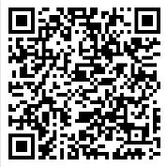
Learn more at Ismpp.org
Complimentary Resources
Member Benefits
AI info, tools, and resources
Access to webinars, podcasts & newsletters
Access to information and resources about ISMPP’s CMPP™ program
Career center
Learning hub, including access to guidance, template, and toolkit resources
In-person meetings
Vibrant online community forum
Committee and project volunteer opportunities
Tuition discount for applicable programs
Scan this QR code to visit the New Professionals Landing Page of the ISMPP Website
Questions?
Email: ismpp@ismpp.org

