Slide 1

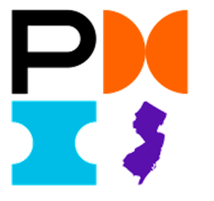

Many Paths, One Skillset: Project Management Across Industries
Career Journeys, Lessons Learned, and Practical Insights

Slide 2
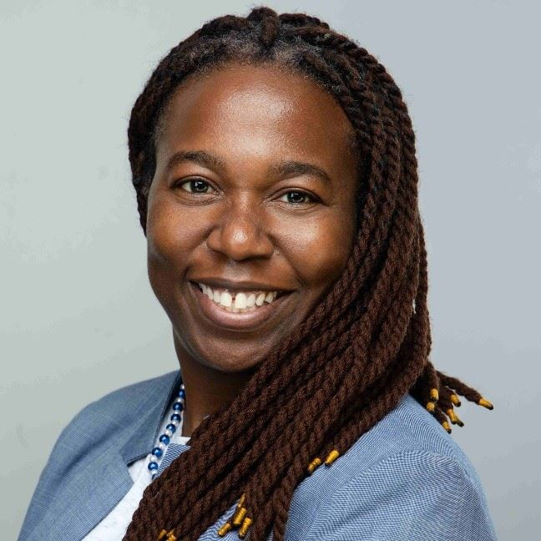
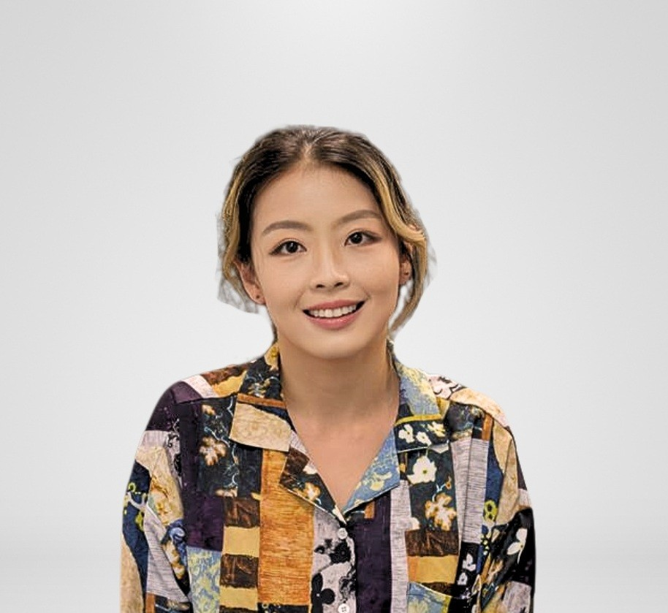

Meet the Session Co-Organizers
 | Olajompo Moloye-Olabisi, PhD, PMP | Yung Chan, MS, PMP
Company | Johnson & Johnson; Large Company (Global, multi-division) | Solabia USA; Small Company acquired by a Global Cosmetic Ingredients Supplier
Role | Senior Manager- Site lead Supply Chain , Project Manager and Technical Ops lead | Head of Formulation and Application; Project Manager & Principal Scientist
Background | Ph.D and Masters in Biomedical Engineering ; BSc in Chemical Engineering | MS Chemistry, MBS in Biochemical Engineering; moved into small company as 6th employee
Perspective | Follow structured path, deep functional specialization, matrix organization | Built from scratch, wore many hats, unified diverse functions
 | Works with all level of business from Ph.D s ( R&D and Supply Chain) to Manufacturing Operations | Works closely with cross-functional teams; align with 3 other global application labs; translates science to business

Slide 3
As a PhD student, you are already a project manager.
In industry, you move from managing your own experiments to oversee multiple projects at once, coordinating cross-functional teams while balancing timelines, budgets, stakeholder expectations, and business goals.
Notes:
Success is not only delivering good science. Success means aligning multiple stakeholders with different priorities.

Slide 4
The Project Management Lifecycle
Monitor & Control
Begin Project or Enter Phase
Close
Initiate
Plan
Execute
End Project or Phase
PMI® Definition – Model*: A thinking strategy to explain a process, framework or phenomenon.
Notes:
Yung

Slide 5
The Scientific Method
& Project Management
Observation / Problem
Experiment (Agile Iterations)
Decision Gate
Hypothesis
Evidence-based Data Analysis
.
Conclusion
Potential
Iterations
Notes:
Evidence and decision gates keep us ground and confidence with the outcome.
Think like a scientist, act like a project manager.
Use the scientific method to experiment and present evidence‑based project methods
Decision Gate (Go / No‑Go / Iterate / Escalate)
Go → lock scope, plan scale‑u (Waterfall).
Iterate → run another learning loop (Agile).
Escalate → grey zone; bring stakeholders + dissenting data.

Slide 6
Project Management Glossary: Speaking the Language
During Your PhD | Project Management Term | What It Means
Thesis proposal, grant proposal | Project Charter | Defines project objectives, scope, timeline, resources, stakeholders, risks, and success criteria
Research plan, experimental roadmap | Work Breakdown Structure (WBS) | Breaks a large project into smaller, manageable tasks and deliverables
Target validation; lead identification; candidate selection | Milestones | Key checkpoints that track and measure progress with no time duration
Semester research plan, publication timeline, graduation plan | Gantt Chart; Kanban Broad | Plan timelines, dependencies, milestones, and deadlines
Committee meetings, annual reviews, proposal defense, manuscript preparation, thesis defense | Stage-Gate Review | Go / Hold / Pivot / Stop decisions based on available data
PI, lab members, collaborators, core facilities, funding agencies, industry sponsors | Stakeholder Management | Understands stakeholder needs and maintains alignment through communication and expectation management.
Cell contamination, assay failure, reagent shortages, equipment breakdown | Risk Management | Identifies risks early and develop mitigation plans
Journal articles, thesis chapters, conference presentations, technical reports | Deliverables | Tangible outputs produced during the project.
Shared equipment scheduling, budget limitations, key reagent backordered, instrument breakdown before deadline | Resource Management | Optimizing use of people, budget, equipment, and time.
Coordinating experiments among collaborators and lab members | Communication Management | Ensures the right information reaches the right people
Deciding which experiments to prioritize when time or funding is limited | Portfolio Prioritization | Focusing resources on work that provides the highest scientific or business value.
Notes:
Stakeholder: Anyone who can influence the project or is affected by the project's outcome.

Slide 7

Stage-Gate Decision Making
Gate 1: Proposal Approval
Is the research question worthwhile?
Is funding available?
✅ Go: Start experimental work ❌ No-Go: Revise proposal
Gate 2: Proof of Concept
Does the assay work?
Does the methodology generate meaningful data?
✅ Go: Expand study 🔄Pivot: Modify experimental approach ❌ No-Go: Abandon studies
Gate 3: Key Milestone Review
Did we achieve the target endpoint?
Is the hypothesis still supported?
✅ Go: Continue toward publication ⚠ Hold: Gather more data 🔄 Pivot: Change direction
Gate 4: Final Defense / Publication
Is the body of work complete?
Is it robust enough for publication or graduation?
✅ Go: Submit manuscript / defend thesis
Notes:
Stage-Gate is a structured decision-making process. Instead of automatically continuing a project because time or money has already been invested, each gate asks whether the project still deserves additional resources.

Slide 8
Project Management Approaches
Waterfall
Agile
Scrum
Hybrid
A sequential project execution where each phase is completed before moving to the next
Research Example:
Develop assay
Complete validation
Run study
Analyze data
No major changes expected.
Each phase is largely completed before the next begins.
A set of principles emphasizing flexibility, frequent feedback, and incremental delivery.
Research Example:
Initial hypothesis doesn't hold up.
New data suggest a different pathway.
You pivot your research direction.
We know the goal is a robust assay, but we expect the science to evolve. We'll change our plan as we learn
Agile framework utilizing sprints (short cycles), backlog management, and regular team reviews.
Research Example:
2-week sprint:
Review results with advisor.
Decide priorities.
Identify blockers.
Define experiments for the next sprint.
Enables rapid adaptation as new experimental data emerge.
Combining the structured planning and governance of Waterfall with the flexibility and iterative execution of Agile.
Research Example:
Waterfall ---
SOP compliance
Cross-functional project plan
Validated protocol execution
Agile/Scrum ---
Iterative experimentation
Regular data reviews
Adjust priorities based on results
Hybrid = Fixed milestones + Flexible execution
Notes:
Hybrid use best for approach

Slide 9
Essential PM Concepts
Critical Path
Change Control
The sequence of tasks that determines the minimum project duration.
Research Example:
You cannot:
Start animal studies;
Until formulation is finalized;
Which cannot happen until analytical methods are validated
If assay validation is delayed, the whole study slips.
PMs evaluates:
Task dependencies
Schedule bottlenecks
Activities with zero schedule flexibility
Impact of delays on project completion
Formal process for evaluating and approving changes to project scope, schedule, or resources.
Research Example:
Halfway through a program, management requests:
Additional animal species
New biomarker testing
PM evaluates:
Cost
Timeline impact
Resource requirements
before approving the change.
Notes:
25

Slide 10
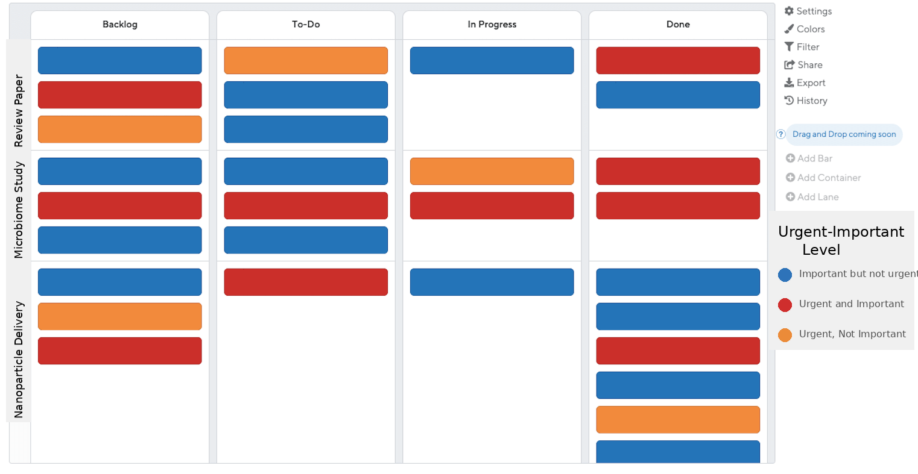

Common Project Management Tools
Gantt Chart
Kanban Board
Today
Sep '25
Nov '25
Jan '26
Mar '26
May '26
Jul '26
Start
Mon 8/4/25
Thesis
8/4/25 - 3/12/26
Finish
Fri 7/31/26
Outline/ Goals 8/4/25 - 8/29/25
Writing and Feedback 10/16/25 - 11/12/25
Editing and Finalization
12/19/25 - 3/12/26
Draft completion
8/29/25 - 12/18/25
Job Search
8/4/25 - 7/31/26
*
Preferences and Networking
8/4/25 - 7/3/26
Application and Follow ups
9/1/25 - 5/8/26
Resume and cover letters
10/27/25 - 12/19/25
Interview Prep
12/22/25 - 3/13/26
Interview and offers
5/11/26 - 7/31/26
Best for:
Long-term planning
Dependencies
Resource allocation
Best for:
Tracking day-to-day work
Quick status updates
Team visibility
Notes:
Gantt chart focuses on project timelines, task durations, and dependencies. It helps teams visualize when activities will occur, how long they will take, and which tasks must be completed before others can begin. This makes it easier to plan schedules, track progress, and identify potential delays to key project milestones.
A Kanban board focuses on workflow and current status. It helps teams visualize what is waiting to be started (Backlog), what is planned (To Do), what is actively being worked on (In Progress), and what has been completed (Done)

Slide 11
Panelist Session

Slide 12
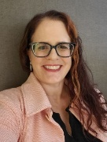
Monica Valdez MS, GSTD, PMP, LSS, MoP, CSPO
Education
  B.S. Biology
  M.S. Food Science & Technology
Certifications
  GSTD, PMP, LSS, MoP, CSPO, & Crucial Influence
Experience
  >20 years CPG & Healthcare Manufacturing Experience
    Nestle R&D, Nestle Professional, Nestle USA, & Abbott Nutrition
  Product Development (Confections + Ready to Drink Beverages + Food Service Beverages)
  Process Improvement (GSTD, Lean Six Sigma, Creating Standards, & Streamlining Processes)
  Project/Program/Portfolio Management (Waterfall, Agile, Hybrid; Category, Regional, & Divisional)
  People Management (Developers, PMs, Marketing, Paraprofessionals, & IT Business Analysts)
  Strategic Leadership (Goal Alignment, Advisor, JSPs, Digital Strategy, Product Owner Network, Governance, & Culture)
  Coach/Mentor (Developers, PMs, ERG Leadership, Crucial Influence Trainer, & Reverse Mentor)
Let’s connect: https://www.linkedin.com/in/monicavaldezpmpmop

Slide 13
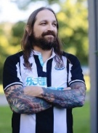

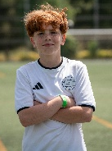





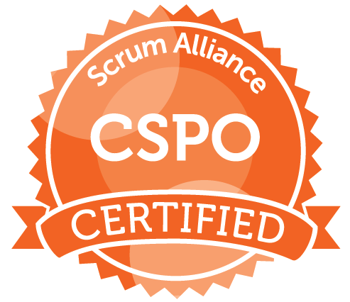



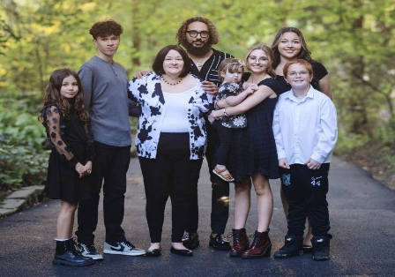


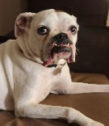
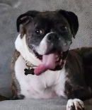
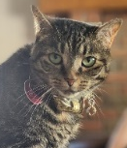
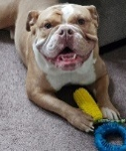
Emerging Leader Program
Milligan College
BS Biology
OSU
MS Food Science
& Technology
Nestle R&D
Ready-to-Drink
Beverages
& Confections
Nestle Professional
Out of Home / Food Service Beverages
Nestle USA
Prepared Meals,
Pizza & Snacking,
& Baking
Nestle USA
Data Systems
Nestle USA
Digital in Manufacturing
(DIM)
Abbott Nutrition
Strategic Initiatives
|------------------------------------------------ 19 years -------------------------------------------------|
|--------- 3 years -------|
Strategic Leadership
(Goal Alignment Champion, Advisor, JSP’s, Digital Strategy, Product Owner Network, Governance, Culture)
People Leader
(Developer, PMs, Marketing, Paraprofessionals, IT Analysts)
Program & Portfolio Management
(Platform, Category, Digital, Regional, Divisional)
Project Management
(Waterfall, Agile, Hybrid)
Monica Valdez
Program & PMO Leader | Digital Transformation | Governance & Change Leadership | PMP | MoP | CSPO
Process Improvement
(Go-See-Think-Do, Six Sigma, Creating Standards, Streamlining Processes)
GMP/Quality Compliance Governance
Coach & Mentor
(Wellness Champion, Mentor, Coach, ERG Leadership, NextUp Mentor, LeanIn Circle Lead, Crucial Influence Trainer)
Industry 4.0
Crucial Influence
98%
On-time milestones
40%
Leadership objectives
72%
Error
reduction
Product Development
(R&D and I&R)
95%
Compliance effectiveness
66
Stakeholders enabled
33%
Faster
delivery
OSU - Collegiate Honors
2nd Poster
2nd Prod Dev Team
3rd Dairy Judging
2004 Outstanding TA
2004 GRA Leadership
Nestle R&D - Leadership Honors
2008-13 Very Best Spirit Award (3x)
2008 OSU Dean’s Meritorious Service to Student’s (Nestle Women in Engineering Grow Program)
Nestle USA - PMO/TAG Honors
2018 Capabilities (Winner)
2017 Best Mentor (Finalist)
2016 Rookie of the Year (Finalist)
Nestle USA – DIM Honors
2023 DE&I Development Cohort
2022-23 NextUp Women Leadership Development
Abbott – Honor
2026 Emerging
Leader Program
Open to Senior Level Leadership Opportunities

Slide 14
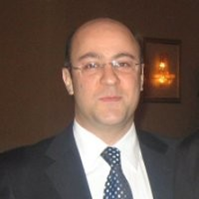
Reza Tehrani PhD, PMP | Academia & Education
ACADEMIA & EDUCATION — 16 YEARS (1996–2012)
Education
      B.S. in Physics and Biomedical Engineering
    M.S. in Biomedical Engineering and Computer Engineering
    Ph.D. in Biomedical Engineering
Academic journey
1996–2002 | Rensselaer Polytechnic Institute (RPI) — full-time student and half-time Computer Consultant for the university.
2002–2010 | Columbia University Medical Center — full-time Information Systems Manager while pursuing my Ph.D. part-time.
2010–2011 | New York University Medical Center, Child Study Center.
2011–2012 | Rutgers University Brain Imaging Center.

Slide 15
Industry Experience | MedSult Consulting
INDUSTRY EXPERIENCE — 14 YEARS (2012–2026)
Founder & Consultant | MedSult LLC
Since 2012, consulting on projects across multiple industries—bringing together technical, scientific, operational, and business perspectives.
Selected clients & project organizations
Pharmaceuticals: Eli Lilly Company
Food & nutrition: Nestlé Health Science; Mondelēz International
Healthcare: Saint Michael’s Medical Center
Preclinical research: PsychoGenics
Life sciences consulting: Trinity Life Sciences
Medical devices: Biobot Surgical; Olympus
Financial services: State Street
Cloud technology: Alphabet
Perspective: 16 years in academia + 14 years in consulting = 30 years across academic and industry environments.
Notes:
Technical Communication
🔬 Explain to non-technical stakeholders → simplify complex science
📊 Present to leadership & teams → speak to scientists & non-scientists; translate complex science into clear, understandable insights for leadership or business teams
⏱️ Summarize in 30 seconds → concise messaging; Short, structured summaries and concise reports save time and ensure alignment.
📝 Clear emails & reports → precise and actionable
Networking & Practice
🤝 Find allies → advisors, alumni, mentors, career center; Advisors, mentors, and alumni provide feedback, referrals, and shadowing opportunities to accelerate growth
💬 Ask for feedback & opportunities → referrals, shadowing, guidance
⭐ STAR for interviews → structured storytelling;
🎤 Elevator pitches → networking-ready Practice storytelling & pitching
STAR stories for interviews and elevator pitches for networking ensure you communicate your impact clearly.
👂 Listen & frame for collaboration → build trust across teams
💡 Advocate for value → Confidently negotiate salary, benefits, and job scope by framing accomplishments and potential contributions.

Slide 16
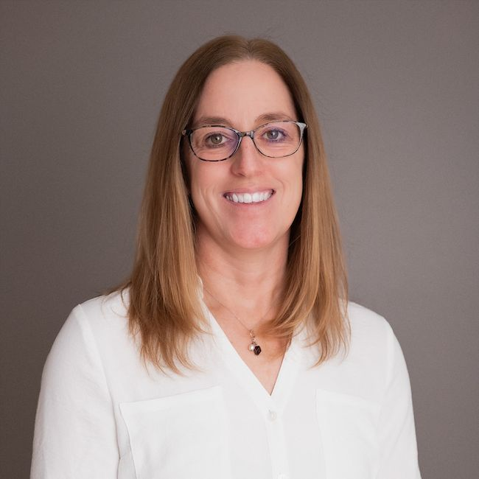
Kate Truncale, MS, PMP
Director, Program Management
Interventional Oncology
Education & credentials
Johnson & Johnson Innovative Medicine
B.S., Materials Engineering
Drexel University
Leading across engineering, discovery, and external innovation
M.S., Biomedical
Engineering
24+ years of development experience
NJIT
Pharmaceuticals, medical devices, biologics, and combination products
PMP certification
Scientist to project management: translating complex scientific strategies into actionable plans and aligning cross-functional teams to manage risk and deliver results.
Project Management
Institute

Slide 17
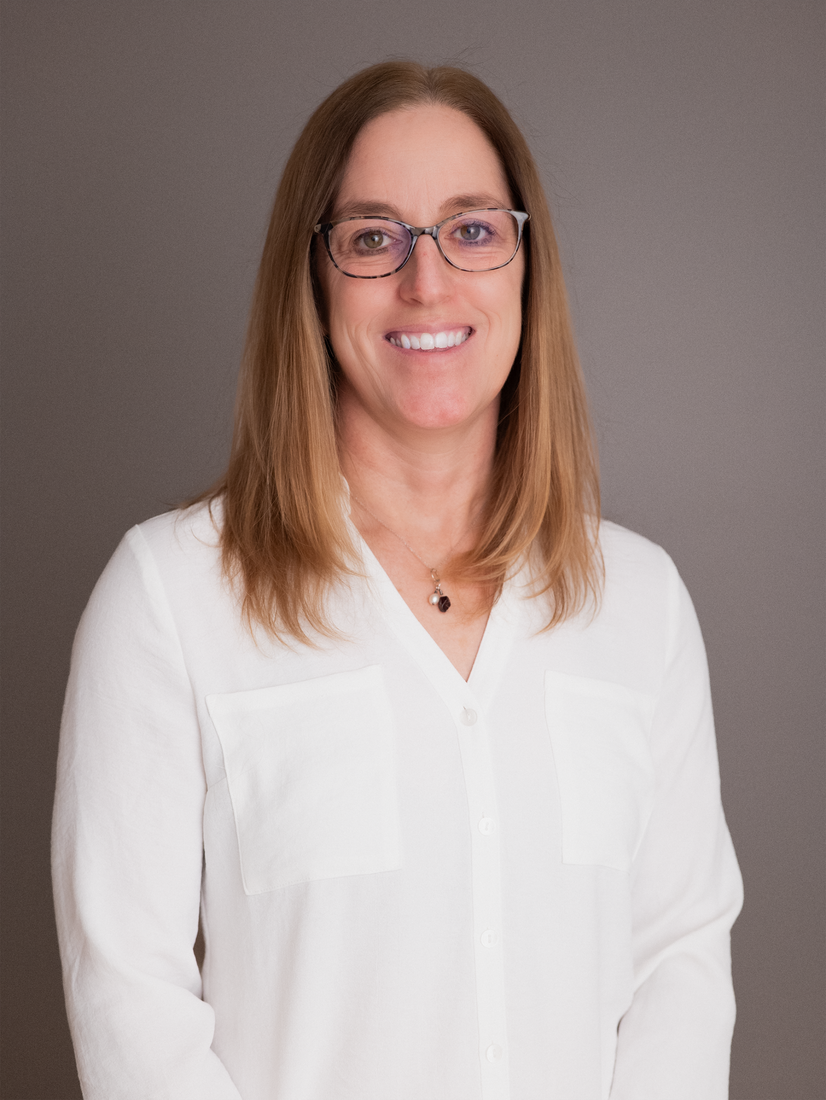



PROFESSIONAL HIGHLIGHTS:
Early & Late development across all therapeutic areas and modalities
Leading Cross-Functional Teams through Ambiguity
Connect scientific strategy to operational execution
Program & project management
> 24 years
“I thrive in matrix organizations, adapt quickly to change, and translate complex scientific strategies into actionable, insight‑driven decisions.”
Kate Truncale
B.S. Materials Eng
M.S. Biomedical Eng
PMP Certification
Execution Leadership
Strategic Leadership
Innovation Leadership
Drive strategic execution across all TAs in CMC, pre-clinical and clinical functions
  Translate complex scientific strategies across stakeholders creating cross functional alignment and impactful action plans
Led 30 % Reduction in FIH timeline through novel approach
Global Strategic Leader
CORE CAPABILITIES
Drug development expert
Creative Problem Solving
Bring structure to ambiguity
Cross‑Functional Program Leadership
Strategic Planning
Portfolio & Budget Management
Scenario Planning & Risk Mitigation
Agile Learner
Lead simplification & operational excellence initiatives pan-organization
Drive complex pharmaceutical programs forward by challenging the status quo from discovery to commercialization.
Shaped innovative trial design strategy for neurodegeneration asset resulting in ~$10M savings
Drive efficient decision-making through Proactive stakeholder engagement
Proactively gather HCP insights to inform key program decision in ambiguous situations
Influenced organization to adopt novel stability strategy, ensuring supply continuity
CAREER PATH HIGHLIGHTS:
Strength Finder:
Achiever
Restorative
Individualization
Deliberative
Learner
Medical Device – People Leadership
Pharmaceutical – People Leadership
Interventional Oncology
Sr. Scientist - PM
Manager, Biologics Dev
Tox Program Manager
Assoc. Director
Pre-clinical PM
Assoc. Director
Clinical PM
Assoc. Director
Pharm Dev PM
Director, Program Management
Designed orthopedic implants & instrumentation
Facilitated KOL sessions, partnered w/ Marketing
Device compliance
Life Cycle management
Pre-Clinical strategy & execution
Lead simplification
Clinical Strategy & execution
TA Liaison
CMC Strategy & execution
Health Equity Lead
Leading across engineering, discovery, and external innovation

Slide 18

Interactive Session
Q&A

Slide 19
Takeaways from our Panelist

Slide 20
Monica Valdez, MS, GSTD, PMP, LSS, MoP, CSPO
Communications
  Personal Branding – Elevator Speech (lead with a headline), Networking (visual intro), & Resume (tactical vs. strategic)
  Voice of the Customer (VoC) – Make it about them! (1 question (open → closed), TEDS*, & confirm/clarify)
  Executive Summaries – Brief, Context (history), & Clear (Inform/Discuss/Decide)
Development
  Seek Feedback – Start/Stop/Continue vs Recipe for Partnership
  Build a Village – Colleague, Leaders, Coach vs Mentor, Sponsor, Champion, & External Connections
  Technology – Be curious, Share knowledge, & Steal with pride
Advocacy
  Influencing – Invest in relationships, Be authentic, Close the loop, Consider human behavior not just process, Ask for you
  Interviewing – Use AI to research panel, Ask about challenges early, Portfolio sheet, & Confirm if they need clarity
  Negotiating – Get them to share a range first, Always negotiate (salary, signing bonus, flexibility, etc.), Document value
Notes:
TEDS:
Tell me more…
Explain that process…
Describe what good would look like…
Share your perspective on…
Source: https://www.exec-comm.com/

Slide 21
Monica Valdez – Differentiators & Impact
mcvaldez123@gmail.com | linkedin.com/in/monicavaldezpmpmop
Project, Program, & Portfolio Management
Cross-Functional People Leadership
Technology Strategy Leadership & Implementation
AN & NUSA Quality & Compliance PMO
Lab Equipment Replacement
Crucial Influence Training & Workshops
Regulatory & Quality Assurance (QA) Week Podcast
QA Improvements – Change Management & Implementation
Abbott & NUSA PMO & Program Leadership
Governance Lead (US), OCM Coach (up), & Crucial Influence Trainer
Stand Up PMO (2x)
Category/Program Management (2x)
Product Owner Network Lead
Abbott Nutrition (Global Safeguard Program)
3rd Party Automation
Loop Workspace
Planner → Dataverse → Power BI
SharePoint Lists & Power Automate
NUSA Digital in Manufacturing
Paper to Digital
Infrastructure Wi-Fi Upgrades
iPads & SaaS 3rd Party Apps Rollout
Robots & Cobots
Portfolio Governance Tools (Project, SharePoint, & Automate)
Team Management
IT Business Analysts
Paraprofessionals
Marketing Trainee
Contract Project Managers
Product Developers
NUSA DIM (Pizza & Snacking Category – 4 Plants)
Wi-Fi Infrastructure Expansions
Paper to Automated Digital Data
iPad Introduction & Charge/Store Station Rollout
iPad Application Introductions (SaaS)
Robots & Cobots
Nestle R&D & Nestle Professional Product Development
Innovation & Renovation / Line Extensions
Cost Savings / Process Improvements
Venture Capital / New Brand Categories
Mentorship & Development
PM CoP (Marketing Co-Lead) & WLA (LeanIn Circles Co-Lead)
Reverse Mentorship (Marketing, Sales, Clinical Research Development)
Mentor (P3 Governance, NextUp Leadership, & Product Development)
NUSA Data Systems (4 Technical Application Groups)
Power Platform Solutions (BI, App, & Automate)
BOM Scale-up Calculation Automation
Technology Pilots (e.g. ARVR, Monday.com, etc.
Want to learn more about HOW I work, please ask me about these moments…
1 - Change Management Reflection
People change when they feel seen in the why that matters to them.
Pivot: Moving from a rigid, redundant, process-oriented approach to a flexible, concise, behavior-focused one.
2 - Root Cause Data Trends
Start with curiosity before conclusions — the smallest reframes unlock the biggest momentum.
Action: When your team struggles to trend accurately, start upstream — with the structure, not just the data.
3 - Knowledge Sharing to Lift Others
When you teach from your strengths, everyone wins when passion meets purpose.
Pivot: Shifting from mentoring to coaching to provide the situational leadership needed — teaching rather than simply sharing experiences.
4 - Advocacy & Unraveling Complexity
Projects rarely fail because of the plan — they fail because risks aren't managed and teams aren't engaged.
Action: Show up, ask the hard questions, and advocate – for the team and for yourself. Visibility and value creation go together.
REFERENCES: Andy Cudney (QA), Kara Shell (Culture & Crucial Influence), Maya Achen & Tina Wolf (Project & Program Management), & Carolyn Kotsol (Operational Change Management)
PMP | MoP | CSPO | Crucial Influence Certified Trainer | Six Sigma Green Belt (in progress) | Emerging Leader Program '26

Slide 22

Takeaways & Advice | Lessons from Academia and Industry
Reza Tehrani PhD, PMP
1. Analytical vs. Business Mindsets
Academia rewards understanding why; industry rewards results and business value. Learn to think both ways.
2. Show the Value You Bring
Employers and clients focus on the problems you can solve. Emphasize your impact, not just your credentials.
3. Be Capable Without Threatening Others
Don’t outshine or undershine colleagues. Demonstrate your strengths with confidence, humility, and emotional intelligence.
4. Being Right Isn’t Always Enough
Communication, timing, organizational priorities, and relationships matter alongside technical correctness.
5. Progress Over Perfection
A strong solution delivered on time can be more valuable than a perfect solution delivered too late.
6. Build Your Network
Knowledge opens doors; relationships, trust, and reputation often determine how far you go.
7. Solve the Real Problem
Listen, ask thoughtful questions, and address the underlying need—not just the visible symptoms.
8. Communicate Simply
Translate complex ideas into language decision-makers understand. Communication turns expertise into influence.

Slide 23

Career advice
Kate Truncale, MS, PMP
01
Keep learning
Stay open-minded and keep learning new things
02
Stay curious
Ask curious questions, take on stretch assignments
03
Do what you love
It won’t feel like a job, follow your passion
04
Embrace change
Don’t be afraid of change, and stay flexible
05
Network
Ask others about their career path, learn what they do and how they got there
06
Create a One-Pager
Share your story with others, highlighting your key strengths, achievements, skills and what you’re looking for.

Slide 24
Thank you!
Questions?

